Slide 1


M O N T E N E G R O
Negotiating Team for the Accession of Montenegro to the European Union
Working Group for Chapter 5 – Public Procurement
Bilateral screening: Chapter 5
PRESENTATION OF MONTENEGRO
Brussels, November 19, 2012

Slide 2

M O N T E N E G R O
Negotiating Team for the Accession of Montenegro to the European Union
Working Group for Chapter 5 – Public Procurement
Bilateral screening: Chapter 5
Presentation of Montenegro
Brussels, November 19, 2012
Chapter 5:
Public Procurement

Slide 3
Chapter 5: Public Procurement
SOCIAL, GREEN, SME, INNOVATION
Bosiljka Vuković
Head of the Division for the Support to the National Council for Sustainabile Development, Ministry of Sustainable Development and Tourism
bosiljka.vukovic@kor.gov.me
M O N T E N E G R O
Negotiating Team for the Accession of Montenegro to the European Union
Chapter 5:
Public Procurement

Slide 4
Chapter 5: Public Procurement
OUTLINE
I RELEVANT EU DOCUMENTS WITH HARMONIZATION LEVELS
II LEGAL FRAMEWORK
III INSTITUTIONAL FRAMEWORK
IV ADMINISTRATIVE CAPACITIES
V PLANNED MID-TERM ACTIVITIES
M O N T E N E G R O
Negotiating Team for the Accession of Montenegro to the European Union
Chapter 5:
Public Procurement

Slide 5
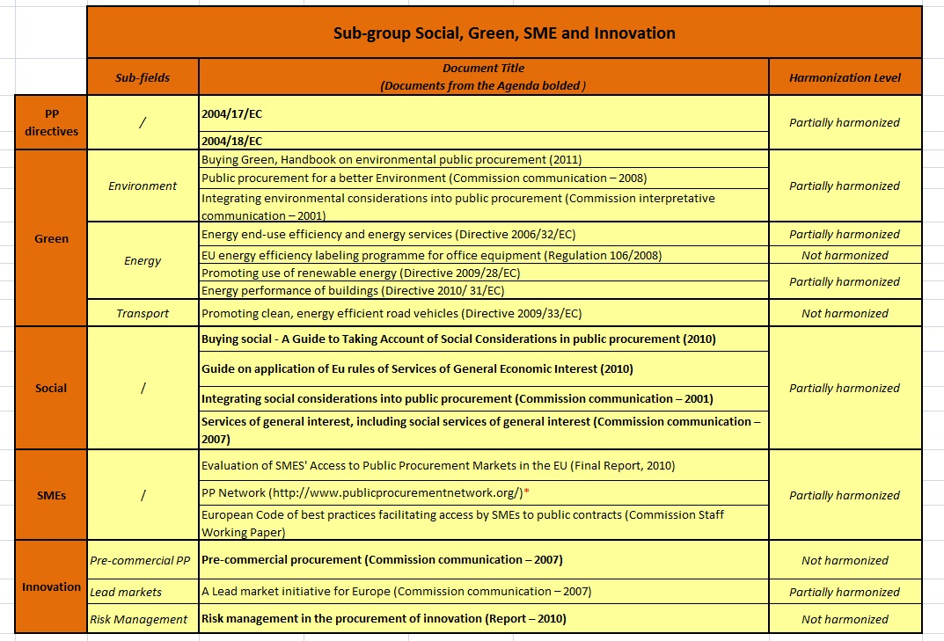
Chapter 5: Public Procurement
I Relevant EU documents with harmonization levels
M O N T E N E G R O
Negotiating Team for the Accession of Montenegro to the European Union
Chapter 5:
Public Procurement

Slide 6
Chapter 5: Public Procurement
II Legal framework
Law on Public Procurement (Official Gazette of Montenegro, no 42/11)
  Articles 4-8, 19, 23 – 25, 41 -43, 49 -51, 58, 62, 64 -67, 68-71, 77, 79, 82, 85, 92-95
  Rulebook on methodology of expressing subcriteria into an appropriate number of points, manner of evaluation and comparison of bids (Official Gazette of Montenegro, 63/11),
M O N T E N E G R O
Negotiating Team for the Accession of Montenegro to the European Union
Chapter 5:
Public Procurement

Slide 7
Chapter 5: Public Procurement
II Legal framework
1. Incorporated EU Principles (part 1)
BASIC PRECONDITIONS FOR S&G PP
    Lowest price Vs MEAT (most economically advantageous tender)
    Fixed technical specifications Vs performance and functional characteristics (social, green, innovation)
  Use of Variants
  Accessibility criteria for people w/ disabilities
  Proof of Quality – principle of equivalence
M O N T E N E G R O
Negotiating Team for the Accession of Montenegro to the European Union
Chapter 5:
Public Procurement

Slide 8
Chapter 5: Public Procurement
I Legal framework
1. Incorporated EU Principles (part 2)
Including Social/Green/EE criteria in:
  technical specification (Social, Green, EE),
  Selection criteria – environmental/social technical capacity
  Award criteria for MEAT (Green, EE)
  BUT ONLY IF THE CRITERIA ARE:
LINKED to the subject matter of the contract,
Precisely MENTIONED in the tender documents,
NOT discriminatory, NOT reducing competition, transparent.
M O N T E N E G R O
Negotiating Team for the Accession of Montenegro to the European Union
Chapter 5:
Public Procurement

Slide 9
Chapter 5: Public Procurement
I Legal framework
1. Incorporated EU Principles – Social/Green
Optional conditions – expert-technical and educational-professional qualifications for public works, services and goods
Exclusion from the tender procedures for:
  not fulfilling obligations relating to the payment of social security contributions,
  not fulfilling obligations relating to the payment of taxes in accordance.
Abnormally low tenders:
  compliance with the provisions relating to employment protection and working conditions in force at the place where the work, service or supply is to be performed
M O N T E N E G R O
Negotiating Team for the Accession of Montenegro to the European Union
Chapter 5:
Public Procurement

Slide 10
Chapter 5: Public Procurement
I Legal framework
1. Incorporated EU Principles – SMEs
Overcoming difficulties relating to the size of the contracts:
  Allowing joint bids and
  Submitting offers per specific parts of the tender
Ensuring access to relevant information
  Free information
  E-info
  Help desks planned
M O N T E N E G R O
Negotiating Team for the Accession of Montenegro to the European Union
Chapter 5:
Public Procurement

Slide 11
Chapter 5: Public Procurement
III Institutional framework and
Administrative capacities
Directorate for Public Procurement
Ministry of Sustainable Development and Tourism (environment)
  Division for the Support to the National Council for SD (strategic planning, training)
Ministry of Economy (EE, RES, innovation)
  Directorate for Small and Medium Sized Enterprises (SMEs)
Ministry of Science (innovation)
Ministry of Transport (fuel efficiency)
M O N T E N E G R O
Negotiating Team for the Accession of Montenegro to the European Union
Chapter 5:
Public Procurement

Slide 12
Chapter 5: Public Procurement
V Further activities
Analysis of state of the affairs on SPP in EU and development of systematic model for implementation of SPP in MNE system
EU EXPERT&TECHNICAL ASSISTANCE NEEDED
M O N T E N E G R O
Negotiating Team for the Accession of Montenegro to the European Union
Chapter 5:
Public Procurement

Slide 13
Thank you for your attention!
QUESTIONS

