Slide 1


M O N T E N E G R O
Negotiating Team for the Accession of Montenegro to the European Union
Working Group for Chapter 11 – Agriculture and rural development
Bilateral screening: Chapter 11
PRESENTATION OF MONTENEGRO
Brussels, 13. 12. 2012

Slide 2

Chapter 11: Agriculture and rural development
Working Group for Chapter 11
MARKET SECTORS
Bilateral screening: Chapter 11
Presentation of Montenegro
Zorka Prljevic
Brussels, 13.12.2012
M O N T E N E G R O
Negotiating Team for the Accession of Montenegro to the European Union

Slide 3
Chapter 11: Agriculture and rural development
ORGANIZATION OF THE MARKET
CEREALS
FIBRE FLAX
HEMP
COTTON
SILKWORM
OILSEEDS
DRIED FODDER
HOP
SEEDS
BANANAS
RAW TOBACCO
SUGAR
M O N T E N E G R O
Negotiating Team for the Accession of Montenegro to the European Union

Slide 4
Chapter 11: Agriculture and rural development
NATIONAL LEGAL FRAMEWORK
Law on Agriculture and Rural Development
(Official Gazette of Montenegro 56/09)
M O N T E N E G R O
Negotiating Team for the Accession of Montenegro to the European Union

Slide 5
Chapter 11: Agriculture and rural development
CEREALS
Due to specific natural conditions, Montenegro has limited areas of arable land, which are underutilized.
Average yields of field crops are low, which reduces the producers’ competitiveness and the interest in this form of production.
Development of field crop production is one of conditions for rational use of already limited natural resources.
M O N T E N E G R O
Negotiating Team for the Accession of Montenegro to the European Union

Slide 6
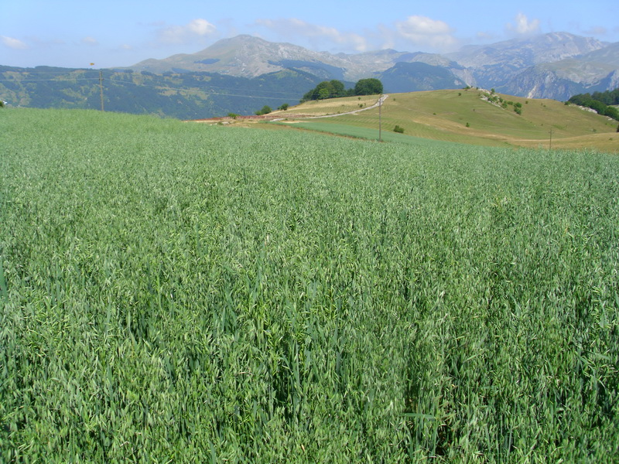
Chapter 11: Agriculture and rural development
CEREALS
M O N T E N E G R O
Negotiating Team for the Accession of Montenegro to the European Union

Slide 7
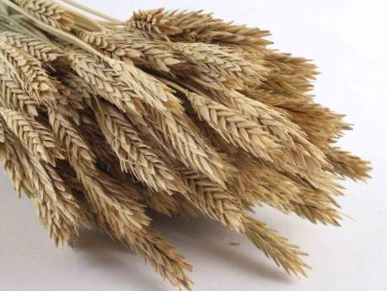
Chapter 11: Agriculture and rural development
CEREALS
Production of cereals in Montenegro is at a low level, for example wheat 2.465 tons in 2010 – statistical yearbook 2011 and it meets only 2.5% of total annual consumption (97.345 t) of this product.
The remaining quantities have to be ensured trough import.
M O N T E N E G R O
Negotiating Team for the Accession of Montenegro to the European Union

Slide 8
Chapter 11: Agriculture and rural development
CEREALS
Production of cereals in Montenegro |  |  |  |  |  |  |  |  | ha
 | Wheat |  |  | Barley |  |  | Corn
 | harvested area, ha | yield, tons |  | harvested area | yield, tons |  | harvested area | yield, tons
 |  | total | per ha | ha | total | per ha | ha | total | per ha
2007 | 808 | 1 969 | 2,44 | 868 | 1 058 | 1,22 | 2 756 | 6 937 | 2,52
2008 | 826 | 2 856 | 3,46 | 787 | 2 244 | 2,85 | 2 712 | 9 625 | 3,55
2009 | 846 | 3 044 | 3,6 | 807 | 2 221 | 2,75 | 2 664 | 10 009 | 3,76
2010 | 734 | 2 465 | 3,36 | 731 | 2 011 | 2,75 | 2 734 | 10 484 | 3,84
2011 | 756 | 2 446 | 3,24 | 740 | 1 955 | 2,64 | 2 798 | 11 688 | 4,18
Source: Monstat, Division for Agricultural Statistics
M O N T E N E G R O
Negotiating Team for the Accession of Montenegro to the European Union

Slide 9
Chapter 11: Agriculture and rural development
CEREALS
Production of cereals in Montenegro |  |  |  |  |  |  |  |  | ha
 | Ray |  |  | Oats |  |  | Maslin
 | harvested area, ha | yield, tons |  | harvested area | yield, tons |  | harvested area | yield, tons
 |  | total | per ha | ha | total | per ha | ha | total | per ha
2007 | 194 | 214 | 1,1 | 221 | 240 | 1,1 | - | - | -
2008 | 200 | 577 | 2,9 | 221 | 524 | 2,4 | 5 | 18 | 3,5
2009 | 324 | 1000 | 3,1 | 200 | 494 | 2,5 | 5 | 20 | 4,0
2010 | 259 | 799 | 3,1 | 195 | 499 | 2,6 | 5 | 15 | 3,0
2011 | 268 | 826 | 3,1 | 233 | 586 | 2,5 | 5 | 15 | 3,0
Source: Monstat, Division for Agricultural Statistics
M O N T E N E G R O
Negotiating Team for the Accession of Montenegro to the European Union

Slide 10
Chapter 11: Agriculture and rural development
FIBRE FLAX, HEMP, COTTON AND SILKWORM
In Montenegro, there is no production or processing of fibre flax, hemp, cotton and silkworm.
In accordance with the Law on Prevention of Drug Abuse, OG MNE 28/11, Article 18 growing of poppy and hemp is allowed for food and industrial purposes.
Poppy and hemp may be grown by legal and natural persons who are licensed for poppy and hemp growing and have a contract concluded on buy-up of the entire yield with a legal entity registered for trade in poppy and/or hemp, in accordance with the Law.
M O N T E N E G R O
Negotiating Team for the Accession of Montenegro to the European Union

Slide 11
Chapter 11: Agriculture and rural development
OILSEEDS
Montenegro does not produce any oilseed (rapeseed, sunflower seed and soya beans).
Montenegro does not produce oil and all necessary quantities are ensured trough import.
Montenegro does not have the system of import licenses for oilseeds and the aid system for exports.
M O N T E N E G R O
Negotiating Team for the Accession of Montenegro to the European Union

Slide 12
Chapter 11: Agriculture and rural development
DRIED FODDER
Montenegro is very rich in mountain pastures that are used very extensive. Traditional system for use of this mountain pasture is trough sun dried fodder.
The largest share in the structure of agricultural land are pastures and natural meadows.
These categories of most extensive land usage together form about 88% of total agricultural area.
According to this indicator Montenegro is close to
Ireland (73%), Great Britain and Slovenia (about 60%).
M O N T E N E G R O
Negotiating Team for the Accession of Montenegro to the European Union

Slide 13
Chapter 11: Agriculture and rural development
DRIED FODDER
Natural meadows form 90% of the total areas under meadows, while sown lawns are present in smaller areas of well managed households.
Average yields of meadows are relatively low (1,5-1,8 t/ha of hay) due to the fact that agro-technological measures are not applied in most of these areas.
Natural meadows and pastures, are the most important potential for forage production.
M O N T E N E G R O
Negotiating Team for the Accession of Montenegro to the European Union

Slide 14
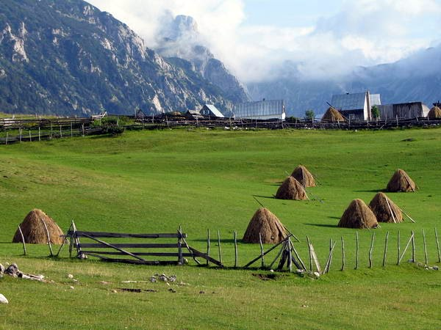
Chapter 11: Agriculture and rural development
DRIED FODDER
M O N T E N E G R O
Negotiating Team for the Accession of Montenegro to the European Union

Slide 15
Chapter 11: Agriculture and rural development
DRIED FODDER
Production of sun dried fodder in Montenegro |  |  |  |  |  |  |  |  | ha
 | Clover |  |  | Lucerne |  |  | Forage beet
 | harvested area, ha | yield, tons |  | harvested area | yield, tons |  | harvested area | yield, tons
 |  | total | per ha | ha | total | per ha | ha | total | per ha
2007 | 866 | 2800 | 3,23 | 3250 | 11474 | 3,53 | 234 | 1946 | 8,31
2008 | 887 | 3959 | 4,46 | 3315 | 15358 | 4,63 | 217 | 3670 | 16,92
2009 | 906 | 3925 | 4,33 | 3313 | 15126 | 4,57 | 203 | 3288 | 16,20
2010 | 823 | 3414 | 4,15 | 3182 | 14446 | 4,54 | 152 | 2180 | 14,34
2011 | 854 | 3638 | 4,26 | 3271 | 14980 | 4,58 | 148 | 2024 | 13,68
Source: Monstat, Division for Agricultural Statistics
M O N T E N E G R O
Negotiating Team for the Accession of Montenegro to the European Union

Slide 16
Chapter 11: Agriculture and rural development
DRIED FODDER
Production of sun dried fodder in Montenegro |  |  |  |  |  |  |  |  | ha
 | Fodder maize |  |  | Meadows |  |  | Pastures
 | harvested area, ha | yield, tons |  | harvested area | yield, tons |  | harvested area | yield, tons
 |  | total | per ha | ha | total | per ha | ha | total | per ha
2007 | 113 | 1417 | 12,54 | 128781 | 184290 | 1,43 | 323876 | 73685 | 0,23
2008 | 127 | 2694 | 21,21 | 127853 | 233147 | 1,82 | 324269 | 69298 | 0,18
2009 | 150 | 2999 | 20,00 | 126931 | 249234 | 1,96 | 324531 | 84830 | 0,26
2010 | 167 | 2922 | 17,50 | 126870 | 243868 | 1,92 | 324447 | 86059 | 0,27
2011 | 269 | 4108 | 15,27 | 126990 | 254325 | 2,00 | 323953 | 88118 | 0,27
Source: Monstat, Division for Agricultural Statistics
M O N T E N E G R O
Negotiating Team for the Accession of Montenegro to the European Union

Slide 17
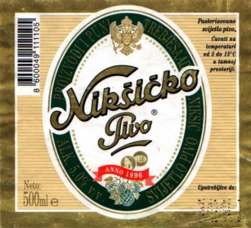
Chapter 11: Agriculture and rural development
HOPS
Montenegro does not produce hop.
One local breweries :
Beer and juices industry "Trebjesa" JSC Niksić
type of beer: light and dark;
quantity: in 2011, 399,040 hl
sale in Montenegro in 2011: 373,765hl
export in 2011: 62,868 hl
total sale in 2011 (MNE & export): 436,633hl
M O N T E N E G R O
Negotiating Team for the Accession of Montenegro to the European Union

Slide 18
Chapter 11: Agriculture and rural development
SEEDS
Montenegro does not produce seeds that are under EU common market organization.
Production in Montenegro (other seeds):
M O N T E N E G R O
Negotiating Team for the Accession of Montenegro to the European Union

Slide 19
Chapter 11: Agriculture and rural development
SEEDS
Production of sun cereal seeds in Montenegro |  |  |  |  |  |  |  | ha
 | Winter triticale | Winter rye | Winter wheat | Spring barley | Spring oat | Spring rye | Spring wheat | Total
2011 | 10,1 | 14,35 | 6,4 | 14,25 | 25,3 | - | - | 70,4
2012 | 4 | 7,79 | - | 31,15 | 39,81 | 3.3 | 4.5 | 90.55
Source: Phytosanitary Directorate
M O N T E N E G R O
Negotiating Team for the Accession of Montenegro to the European Union

Slide 20
Chapter 11: Agriculture and rural development
BANANAS
Montenegro does not produce bananas.
Import in Montenegro
 | 2007 | 2008 | 2009 | 2010 | 2011
tone | 11123 | 9590 | 10156 | 7425 | 8146
Source: Monstat, Division for Agricultural Statistics
M O N T E N E G R O
Negotiating Team for the Accession of Montenegro to the European Union

Slide 21
Chapter 11: Agriculture and rural development
RAW TOBACCO
There is no state trade monopoly in Montenegro.
Production and marketing of tobacco and tobacco products is free in Montenegro.
The land near the Skadar lake are areas less favorable for growing of other cultures, but this land provide all necessary conditions for production of tobacco.
Optimal exploitation of these areas would incite significant increase in the production of tobacco.
M O N T E N E G R O
Negotiating Team for the Accession of Montenegro to the European Union

Slide 22
Chapter 11: Agriculture and rural development
RAW TOBACCO
Production of raw tobacco in Montenegro
 | 2007 | 2008 | 2009 | 2010 | 2011
Harvested area, ha | 159 | 154 | 126 | 125 | 125
Yield – tons –total | 358 | 324 | 272 | 270 | 258
Yield – tons per ha | 2,25 | 2,1 | 2,16 | 2,16 | 2,06
Source: Monstat, Division for Agricultural Statistics
M O N T E N E G R O
Negotiating Team for the Accession of Montenegro to the European Union

Slide 23
Chapter 11: Agriculture and rural development
SUGAR
In Montenegro, sugar beet is not grown and thus no production of sugar exists.
Montenegro does not apply the system of import/export licensing nor does it perform control and monitoring of trade.
Montenegro is the net importer of sugar.
M O N T E N E G R O
Negotiating Team for the Accession of Montenegro to the European Union

Slide 24
Chapter 11: Agriculture and rural development
MARKETING STANDARDS
(QUALITY AND LABELING RULES)
  Until the date of the accession, Montenegro will draft and adopt proper legislation with the aim to ensure that appropriate implementation takes place and it will make all necessary preparations for establishing institutional solutions to improve organization and effectiveness.
M O N T E N E G R O
Negotiating Team for the Accession of Montenegro to the European Union

Slide 25
Thank you for your attention!
QUESTIONS

