Slide 1


M O N T E N E G R O
Negotiating Team for the Accession of Montenegro to the European Union
Working Group for Chapter 11 – Agriculture and Rural Development
Farm Accountancy Data Network
FADN
Vesna Stojković
Senior advisor in the Database Department
vesna.stojkovic@mpr.gov.me
Brussels, 11–13 December 2012

Slide 2

M O N T E N E G R O
Negotiating Team for the Accession of Montenegro to the European Union
Legal Framework
The Law on Agriculture and Rural Development (Official Gazette No. 56/09) Art. 68 envisages establishment of an accountancy data system on selected agricultural holdings based on the following criteria: type of production, size and regional distribution.
The FADN system has not been established in Montenegro yet.
Chapter 11
Agriculture and rural development

Slide 3
M O N T E N E G R O
Negotiating Team for the Accession of Montenegro to the European Union
Agricultural Census 2010
Agricultural Census 2010 (Statistical Office of Montenegro – MONSTAT) – a good basis for establishing the FADN system
Agricultural Census 2010 in Montenegro – in compliance with:
  Regulation (EC) 1166/2008 on farm structure surveys and the survey on agricultural production methods
  Regulation(EC) 1242/2008 on establishing a Community typology for agricultural holdings
M O N T E N E G R O
Negotiating Team for the Accession of Montenegro to the European Union
Chapter 11
Agriculture and rural development

Slide 4
M O N T E N E G R O
Negotiating Team for the Accession of Montenegro to the European Union
Agricultural Census 2010
Total number of agricultural holdings 48,870
  48,824 family agricultural holdings
  46 business entities
Agricultural holdings according to the utilised agricultural land and economic size:
 | Number of holdings | Utilised agricultural land (ha) | Average holding size, ha | Economic size of agricultural holdings | Economic size per agricultural holding | Economic size per ha of agricultural holding
Agricultural holdings | 48870 | 221.297,6 | 4,6 | 125.817.765,2 | 2574,54 | 559,68
Family agricultural holdings | 48824 | 212.724,4 | 4,4 | 109.319.482,4 | 2239,1 | 513,9
Business entities | 46 | 8573,2 | 186,4 | 16.498.282,8 | 358.658,3 | 1924,13
*Source: MONSTAT Agricultural Census 2010
Chapter 11
Agriculture and rural development

Slide 5
M O N T E N E G R O
Negotiating Team for the Accession of Montenegro to the European Union
Structure of agricultural holdings
Structure of agricultural holdings by economic size:
 | Number of holdings | Less than 2000 | 2000-<4000 | 4000-<8000 | 8000-<15000 | 15000-<25000 | 25000-<50000 | 50000-<100000 | 100000-<250000 | 250000-<500000 | 500000-<750000 | 750000-<1000000 | 1000000-<1500000 | 1500000-<3000000 | More than 3000000
Agricultural holdings | 48870 | 31779 | 9462 | 5220 | 1788 | 428 | 139 | 38 | 10 | 2 | 2 | - | - | 1 | 1
Family agricultural holdings | 48824 | 31769 | 9462 | 5216 | 1783 | 426 | 132 | 30 | 6 | - | - | - | - | - | -
Business entities | 46 | 10 | - | 4 | 5 | 2 | 7 | 8 | 4 | 2 | 2 | - | - | 1 | 1
*Source: MONSTAT Agricultural Census 2010
Chapter 11
Agriculture and rural development

Slide 6
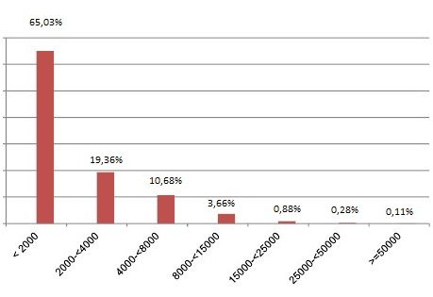
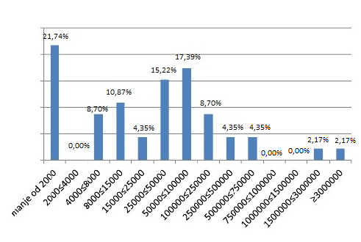
M O N T E N E G R O
Negotiating Team for the Accession of Montenegro to the European Union
Structure of agricultural holdings
Structure of family agricultural holdings by economic size:
Structure of business entities by economic size:
*Source: MONSTAT Agricultural Census 2010
Chapter 11
Agriculture and rural development

Slide 7
M O N T E N E G R O
Negotiating Team for the Accession of Montenegro to the European Union
Structure of agricultural holdings
Structure of agricultural holdings by general type of agricultural production:
 | Number of holdings | Field crops | Horticulture (vegetables, flowers, ornamentals) | Permanent crops (vineyards and fruits ) | Livestock (bovines, sheep, goats) | Pigs and poultry | Mixed plant production | Mixed livestock production | Mixed plant and livestock production | Non-classified holdings
Agricultural holdings | 48870 | 12381 | 530 | 2209 | 23242 | 3931 | 519 | 2212 | 2420 | 1426
Family agricultural holdings | 48824 | 12372 | 523 | 2205 | 23233 | 3923 | 518 | 2210 | 2419 | 1421
Business entities | 46 | 9 | 7 | 4 | 9 | 8 | 1 | 2 | 1 | 5
*Source: MONSTAT Agricultural Census 2010
Chapter 11
Agriculture and rural development

Slide 8
M O N T E N E G R O
Negotiating Team for the Accession of Montenegro to the European Union
Structure of agricultural holdings
Structure of agricultural holdings by type of agricultural production:
*Source: MONSTAT Agricultural Census 2010
Chapter 11
Agriculture and rural development

Slide 9
M O N T E N E G R O
Negotiating Team for the Accession of Montenegro to the European Union
Agricultural Census 2010 – records on income and expenditures
The term “records” means keeping the records, including informal notes on all income generated and expenditures carried out related to the holding
Of the total 48,870 agricultural holdings, 5,448 holdings keep the records on income and expenditures
Of the total 48,870 agricultural holdings, 598 holdings use personal computer for the needs of the holding
Chapter 11
Agriculture and rural development

Slide 10
M O N T E N E G R O
Negotiating Team for the Accession of Montenegro to the European Union
Agricultural Census 2010 – records on income and expenditures
Records on income and expenditures
Using personal computer
*Source: MONSTAT Agricultural Census 2010
Chapter 11
Agriculture and rural development

Slide 11
M O N T E N E G R O
Negotiating Team for the Accession of Montenegro to the European Union
Farm structure survey (FSS)
In 2013 the Statistical Office of Montenegro MONSTAT will carry out a Farm structure survey (FSS)
Chapter 11
Agriculture and rural development

Slide 12
M O N T E N E G R O
Negotiating Team for the Accession of Montenegro to the European Union
Activity Plan
Steps for implementation of FADN:
Adoption of sublegal act (rulebook on FADN)
Establishment of a body responsible for collection of data, data processing and system management
Preparation of a FADN system implementation plan in compliance with EU requirements and methodology (agricultural holdings selection plan, forms, guidelines for accounting agencies, education of farmers, preparation of FADN software)
Data collection, processing and control
Submission of report
Chapter 11
Agriculture and rural development

Slide 13
Thank you for your attention!
QUESTIONS

