Slide 1


M O N T E N E G R O
Negotiating Team for the Accession of Montenegro to the European Union
Working Group for Chapter 11 – Agriculture and Rural Development
SHEEP AND GOAT
MEAT
Sunčica Boljević & Milan Marković
suncica.boljevic@mpr.gov.me
Bilateral screening: Chapter 11
Brussels, 11-13. December 2012

Slide 2

Presentation outline
M O N T E N E G R O
Negotiating Team for the Accession of Montenegro to the European Union
General frame for the sector
Primary production
Processing industry
Market of sheep and goat meat
2
Chapter 11
Agriculture and rural development

Slide 3

M O N T E N E G R O
Negotiating Team for the Accession of Montenegro to the European Union
LEGAL FRAMEWORK
Law on Agriculture and Rural Development (Official Gazette of Montenegro 56/09)
Law on Livestock Farming (Official Gazette of MNE 72/10)
Veterinary Law (Official Gazette of Montenegro 30/12)
Law on Food Safety (Official Gazette of Montenegro 14/07)
Law on Animal Identification and Registration (Official Gazette of the Republic of Montenegro 48/07, 73/10)
Decree on implementation of the agrarian policy measures for 2011 - Agrobudget (Official Gazette of Montenegro 66/11).
Secondary legislation (sublaws, rulebooks)
Chapter 11:
Agriculture and Rural Development
Poglavlje 25
Nauka i istraživanje

Slide 4
M O N T E N E G R O
Negotiating Team for the Accession of Montenegro to the European Union
POLICY FRAME FOR SHEEP AND GOAT MEAT PRODUCTION
Strategy ‘’MONTENEGRO’S AGRICULTURE AND EUROPEAN UNION – Food Production and Rural Development (background, objectives, scenarios of development etc.)
National program for food production and rural development 2009-2013 (the instruments and measures of support, financial framework)
Agrobudget – national budgetary support (adopted and published each year, consists of the support measures)
Sectorial documents (Meat sector study for IPARD, etc.)
Chapter 11:
Agriculture and Rural Development
Poglavlje 25
Nauka i istraživanje

Slide 5
INSTITUTIONAL SUPPORT
M O N T E N E G R O
Negotiating Team for the Accession of Montenegro to the European Union
Ministry of Agriculture and Rural Development
Veterinary service
  Veterinary Directorate (under the responsibility of the Ministry)
  Diagnostic vet Laboratory (public body)
  Field veterinary service (privately organised)
Biotechnical Faculty - University of Montenegro
  The Livestock Selection Service (breeding programs, premimus implementations)
  The Dairy Laboratory (analyses of milk for payment purposes)
  Livestock Department (education and research)
Other state institutions and organizations
Advisory service at the municipal level
Chapter 11
Agriculture and rural development

Slide 6
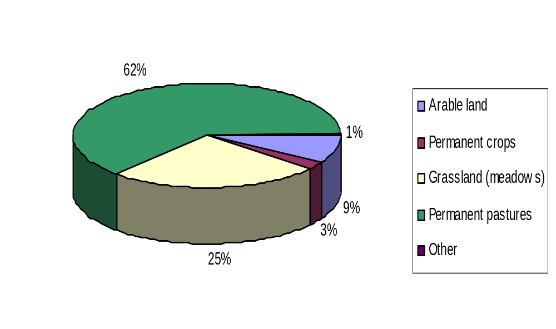
AGRICULTURAL LAND AS THE MAIN PRECONDITION
FOR THE SHEEP AND GOATS SECTOR
M O N T E N E G R O
Negotiating Team for the Accession of Montenegro to the European Union
Total Agricultural land - 516,070 ha
Arable land (fields and gardens) | 44,524 ha | Grassland (meadows) | 128,621 ha
Permanent crops | 16,107 ha | Permanent pastures | 325,436 ha
Other | 2,649 ha

Slide 7
M O N T E N E G R O
Negotiating Team for the Accession of Montenegro to the European Union
SHEEP AND GOATS POPULATION
Item | 2007 | 2008 | 2009 | 2010 | 2011
Sheep*
Total size of the flock: | 222,244 | 209,354 | 199,764 | 198,165 | 208,771
Number of breeding sheep | 169,926 | 160,912 | 159,905 | 158,503 | 172,924
Goats (all categories)** | - | - | - | 35,001 | -
* - Source: MONSTAT, Statistical Yearbook 2011, state as at January 15th
** - MONSTAT - Agricultural Census 2010
Chapter 11:
Agriculture and Rural Development
Poglavlje 25
Nauka i istraživanje

Slide 8
Chapter 11: Agriculture and Rural Development
STRUCTURE OF SHEEP FLOCKS
(flocks above 20 breeding animals eligible for premiums)
Flock size | Number of flocks | % | Number of sheep | %
20-50 | 1018 | 47,2 | 34963 | 26,4
50-100 | 829 | 38,4 | 53867 | 40,6
100-150 | 224 | 10,4 | 26210 | 19,8
150-200 | 56 | 2,6 | 8989 | 6,8
200-300 | 16 | 0,7 | 3525 | 2,7
>300 | 13 | 0,6 | 5196 | 3,9
Total | 2156 | 100 | 132750 | 100
M O N T E N E G R O
Negotiating Team for the Accession of Montenegro to the European Union

Slide 9
Chapter 11: Agriculture and Rural Development
STRUCTURE OF GOATS FLOCKS
(flocks above 10 breeding animals eligible for premiums)
Flock size | Number of flocks | % | Number of animals | %
10-50 | 264 | 67,6 | 7046 | 38,9
50-100 | 95 | 24,3 | 6206 | 34,3
100-200 | 24 | 6,2 | 2873 | 15,8
200-300 | 6 | 1,5 | 1382 | 7,6
>300 | 2 | 0,5 | 620 | 3,4
Total | 391 | 100 | 18127 | 100
M O N T E N E G R O
Negotiating Team for the Accession of Montenegro to the European Union

Slide 10
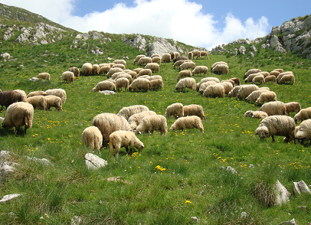
Chapter 11: Agriculture and Rural Development
SHEEP SECTOR
– the main features
Sheep breeding is the second most important livestock subsector after the cattle farming.
Semi-extensive or extensive farming system prevail – ewes are still used for milk production with decreasing tendency;
Sheep production is present mostly in distant rural areas that face problem of abandonment of vital workforce;
Lamb meat is by far the main product
of sheep sector, 60-65% in total value,
milk is rest (30-35%), wool does not
have economic value
M O N T E N E G R O
Negotiating Team for the Accession of Montenegro to the European Union

Slide 11
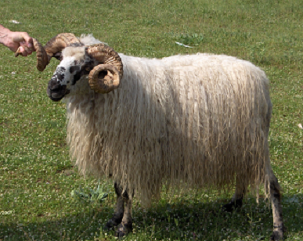
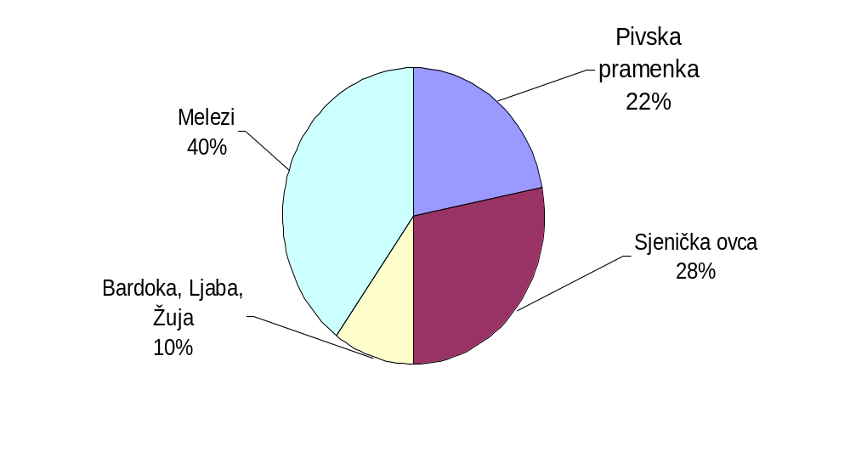
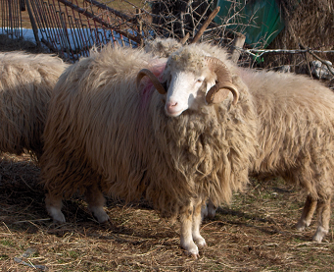
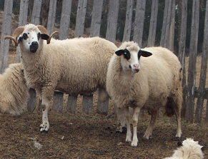
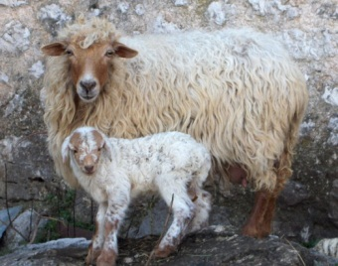
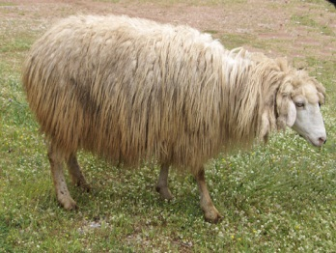
Chapter 11: Agriculture and Rural Development
SHEEP SECTOR
– breed structure
The local coarse wool triple-purpose breeds (milk, meat, wool) are dominated by two: Pivska and Sjenička.
Crosses
40 %
M O N T E N E G R O
Negotiating Team for the Accession of Montenegro to the European Union

Slide 12
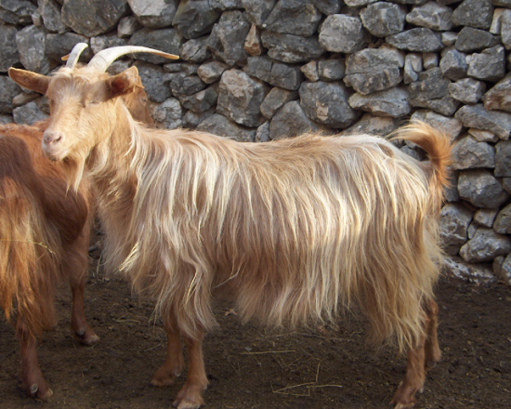
Chapter 11: Agriculture and Rural Development
GOATS SECTOR
- the main features
Extensive or semi-extensive farming prevail – mainly for milk production;
Goat production is mostly present in karst region (area of Niksic, Cetinje, Danilovgrad, partly Podgorica and Coastal region);
Flocks with more than 10 goats (subsidies 2011) – in 391 flocks 18127 breeding animals are reared (46.4 heads in average);
Half of the population is reared as individual animals, with much higher milk yield and number of kids born per goat (doe)
Autochthonous Balkan breed is dominant, especially in bigger flocks reared, in smaller flocks there are crosses with Alpine and Saanen breed
Average meat production per goat (doe) is about 15 kg annually
There are no special breeds for meat production
M O N T E N E G R O
Negotiating Team for the Accession of Montenegro to the European Union

Slide 13
Chapter 11: Agriculture and Rural Development
DISTRIBUTION OF SHEEP AND GOATS
by the regions, in 2010
Region | Sheep* |  | Goats**
 | Number | Share, % | Number | Share, %
Coastal | 10,553 | 5 | 5,417 | 15
Central | 50,019 | 25 | 18,734 | 54
Northern | 137,594 | 70 | 10,850 | 31
MNE total | 198,165 | 100 | 35,001 | 100
*) - Source: MONSTAT, Statistical Yearbook 2011,
**) - MONSTAT - Agricultural Census 2010
M O N T E N E G R O
Negotiating Team for the Accession of Montenegro to the European Union

Slide 14
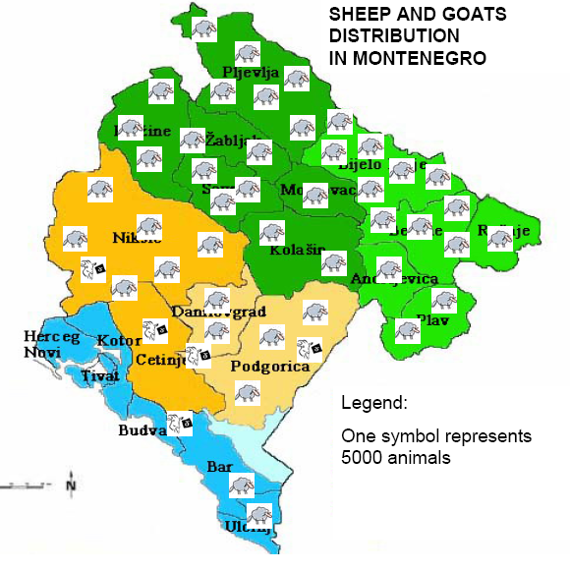
Chapter 11: Agriculture and Rural Development
M O N T E N E G R O
Negotiating Team for the Accession of Montenegro to the European Union

Slide 15
Chapter 11: Agriculture and Rural Development
MEAT INDUSTRY - Slaughterhouses
The highest percentage of lambs is slaughtered at several rather big companies that integrated slaughtering and processing plants.
Three biggest (MI MESOPROMET Bijelo Polje, MI GORANOVIC Nikšić, MI GRADINA Rožaje) cover 2/3 of the slaughtered lambs in slaughterhouse;
These medium-sized companies (in EU terminology) except slaughtering perform processing and retail selling throughout the country
Two companies have submitted the request for approval to export meat products to the EU, no one is approved yet
There are 20 small family slaughterhouses which supply local market (e.g. butcher shops, hotels, restaurants) by fresh lamb meat
There are 250 lamb meat retailers (estimation), bigger supermarkets have their meat sectors or they have business cooperation with slaughtering industry.
All the establishments are privately owned
M O N T E N E G R O
Negotiating Team for the Accession of Montenegro to the European Union

Slide 16
Table 5. The main entities in sheep and goats meat sector:
Chapter 11: Agriculture and Rural Development
THE MAIN ENTITIES IN MEAT INDUSTRY
- sheep and goat meat
Company | Slaughter capacity /8hrs | Cutting | Processing | Wholesale | Retail
MI Mesopromet Bijelo Polje | 1000 | + | + | + | +
MI Goranović Niksic | 800 | + | + | - | +
MI Gradina, Rozaje | 500 | + | + | + | +
MI Point, Podgorica | 30 | + | - | - | +
MI Golijanin, Budva | 20 | + | - | + | +
M O N T E N E G R O
Negotiating Team for the Accession of Montenegro to the European Union

Slide 17
Chapter 11: Agriculture and Rural Development
Market of sheep anf goat meat
Systems of purchasing of sheep and goats:
  direct purchase from the farmers
  purchase via so called livestock markets
Bigger slaughterhouses have their own vehicles for transport of animals for slaughtering,
Livestock markets (places for selling live animals) belong to the local municipalities, and local authorities manage and maintain those markets
Some slaughterhouses slaughter animals as a service for other business entities which are dealing with selling of meat.
Traditionally lambs are sold per kg of live weight
There is no classification system in Montenegro
During 2011, system of identification and registration of sheep and goats populations was developed
M O N T E N E G R O
Negotiating Team for the Accession of Montenegro to the European Union

Slide 18
Chapter 11: Agriculture and Rural Development
The prices monitoring on the markets
In 2006, Agrarian Marketing Information System (AMIS) for gathering and disseminating data of agricultural product prices was established
AMIS single internet portal was developed for weekly monitoring of agricultural product prices on livestock markets in the major towns of Montenegro.
System for monitoring prices is not established so far in line with Regulation No. 1234/2008 and Regulation No. 1249/2008 laying down detailed rules on the implementation of the Community scales for the classification of beef, pig and sheep carcasses and the reporting of prices thereof.
Until the accession to the EU at latest, Montenegro will establish the sector-related data gathering system,
M O N T E N E G R O
Negotiating Team for the Accession of Montenegro to the European Union

Slide 19
Chapter 11: Agriculture and Rural Development
The average prevailing prices within livestock markets in 2011:
Category of animals | Price
Lambs, kg LW | 2.59€
Yearlings, kg LW | 2.55€
Culled sheep, kg LW | 1.74€
Rams, kg LW | 2.33€
Kids, kg LW | 3.01€
Culled goats, kg LW | 1.48€
Breeding sheep, head | 119.74€
Breeding goats, head | 95.70€
Source: AMIS - http://www.amiscg.org/cijene/php/prcijena_frm.php,
M O N T E N E G R O
Negotiating Team for the Accession of Montenegro to the European Union

Slide 20
M O N T E N E G R O
Negotiating Team for the Accession of Montenegro to the European Union
BALANCE SHEET FOR SHEEP AND GOAT MEAT,
(in carcass weight equivalent - cwe)
Item | 2007 | 2008 | 2009 | 2010 | 2011
Net production in tonnes of cwe (estimation) | 4,117 | 3,922 | 3,949 | 3,904 | 3,937
Import of live animals (cwe), t | 17,2 | 194,0 | 133,6 | 219,0 | 318,6
Import of meat, t | 71,9 | 160,6 | 144,8 | 37,2 | 19,0
Import total, t | 89,0 | 354,6 | 278,4 | 256,3 | 337,6
Export, t | 0,28 | 0,62 | 9,32 | 5,75 | 0,78
Public stocks | - | - | - | - | -
Total domestic use, t | 4,206 | 4,276 | 4,218 | 4,155 | 4,274
Per capacita consumption, kg/head/year | 6.47 | 6.58 | 6.49 | 6.39 | 6.58
Self-sufficiency (%) | 97.9 | 91.7 | 93.6 | 94.0 | 92.1
Chapter 11:
Agriculture and Rural Development
Poglavlje 25
Nauka i istraživanje

Slide 21
Chapter 11: Agriculture and Rural Development
Import regime for live animals and sheep and goat meat
Montenegro is a member of World Trade Organization:
  no quantitative restrictions on import
  custom duties: lambs IBR 50%, FBR 40% in 2016
  custom duties: lamb meat IBR 40%, FBR 30% in 2022.
EU countries – SAA is implemented: tariff rates for live animals and sheep and goats meat are on 50% of MFN.
CEFTA members : import of live animals and sheep and goat meat - full liberalisation
EFTA members: import of live animals from Norway - MFN duty, from the others 20%; live animals from Switzerland and Lichtenstein - MFN duty is applied, meat from these two countries is 50% of MFN duty
Free Trade Agreement with Russian Federation - no duties on import.
Import of sheep and goats meat from Turkey - MFN duty of 30% is applied
M O N T E N E G R O
Negotiating Team for the Accession of Montenegro to the European Union

Slide 22
Chapter 11: Agriculture and Rural Development
SWOT analyses of the sheep and goat sector
Strengths Family business with long tradition; Resources available for fodder production for ruminants; Positive structural changes, farm size has been increasing; Legal and strategic frame are put in place | Weaknesses Small scale production – subsistence farming, Horizontal integration – collaboration among farmers is weak; Low productive sheep and goat breeds prevail; Inappropriate buildings, mechanization and equipment; Aged farm owners
Opportunities Improvement of technology by investments in barns, machinery, equipment; Support – from national source (MARD) and EU grants - IPARD; Tourism as a driving force for the local products | Threats Opening of the market can threaten the sectors; Problems in an access to the bank loans; Rural area depopulation; Failure in implementation of CAP-like agricultural policy; Failure in implementation of the strong EU requirements
Source: MONSTAT Statistical Office, the Statistical Yearbook and Federation of Beekeepers’ Associations of Montenegro
M O N T E N E G R O
Negotiating Team for the Accession of Montenegro to the European Union

Slide 23
M O N T E N E G R O
Negotiating Team for the Accession of Montenegro to the European Union
THE MAIN CHALLENGES
On the farm level:
  To improve barns, fodder production, genetics
  To strengthen horizontal (producer groups and organizations) and vertical integration
  To improve skills (management, hygienic standards)
On the processing industry level:
  International standards, including carcass classification
  To develop better link with farmers
Distribution channels and consumer side:
  To increase public awareness on the importance of local products for the total economy
Chapter 11
Agriculture and rural development

Slide 24
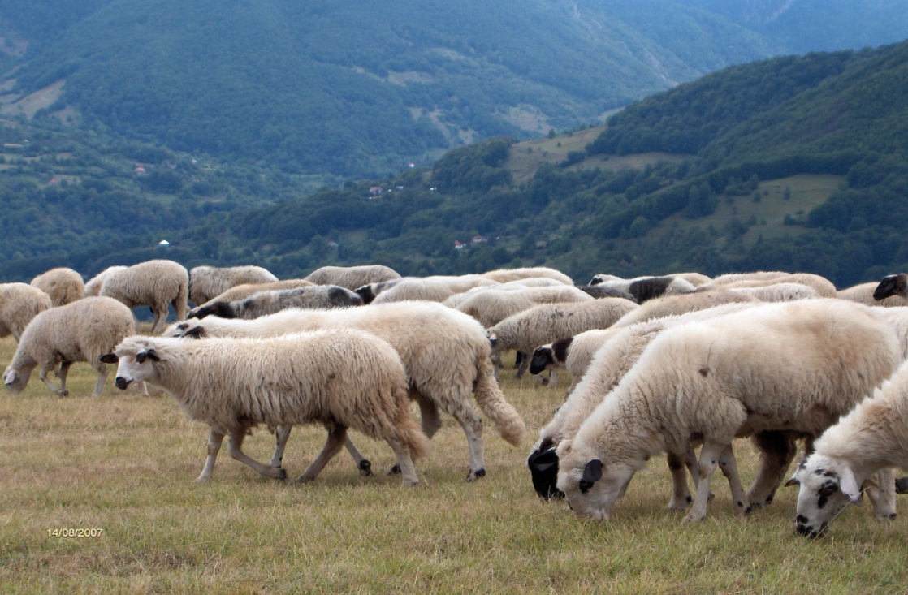
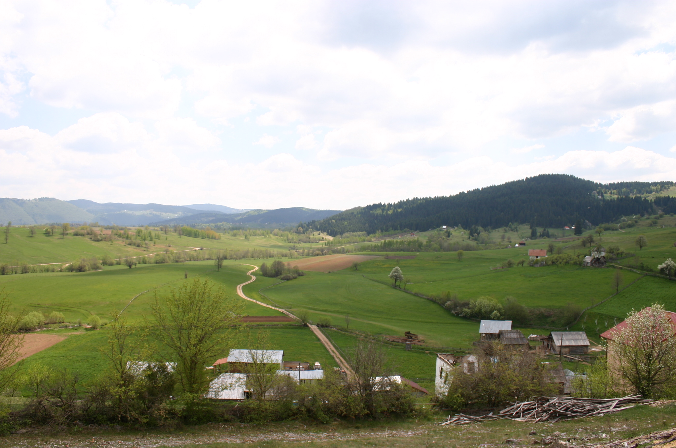
M O N T E N E G R O
Negotiating Team for the Accession of Montenegro to the European Union
The main challenges
On the farm level:
  To develop larger commercial units with technical improvements (barns, fodder production, genetics)
  To strengthen horizontal (producer groups and organizations) and vertical integration
  To improve skills (management, hygienic standards)
On the processing industry level:
  International standards, including carcass classification
  To develop link with farmers
Distribution channels and consumer side:
  To increase public awareness on the importance of local products for the economy
Thank you for the attention!
Chapter 11
Agriculture and rural development

