Slide 1


M O N T E N E G R O
Negotiating Team for the Accession of Montenegro to the European Union
Working Group for Chapter 14 – Transport Policy
Bilateral screening: Chapter 14
PRESENTATION OF MONTENEGRO
Brussels 27-30 May 2013

Slide 2
Chapter 14: Transport Policy
112 eCalls
2011/750/EU
Dragan Radulović
Inspector I
Ministry of the Interior
Department for emergency situations and civil security
mupvanrednebar@t-com.me

Slide 3

Chapter 14: Transport Policy
CONTENS
Institutional framework
The legislative framework
Current and future activities
M O N T E N E G R O
Negotiating Team for the Accession of Montenegro to the European Union

Slide 4
Chapter 14: Transport Policy
Institutional framework
SECTOR FOR EMERGENCY MANAGEMENT
Sector Manager
Deputy Minister of Interior
DEPARTMENT FOR STRATEGIC-DEVELOPMENT AND LEGAL AFFAIRS
DEPARTMENT FOR CIVIL PROTECTION
DEPARTMENT FOR PREVENTION AND INSPECTION
DEPARTMENT FOR AIRPLANE/HELICOPTER UNIT
TERRITORIAL UNITS
Podgorica
Bijelo Polje
DEPARTMENT FOR OPERATIONAL AFFAIRS
DEPARTMENT FOR RISK MANAGEMENT
DEPARTMENT 112- OPERATIONAL-COMMUNICATION CENTER
Nikšić
Herceg Novi
Bar
Berane
Pljevlja
M O N T E N E G R O
Negotiating Team for the Accession of Montenegro to the European Union

Slide 5
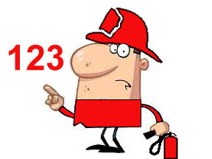
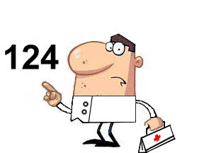

Chapter 14: Transport Policy
The legislative framework
Emergency numbers in MONTENEGRO
The Law on protection and rescue
European 112
Police 122
Protection and rescue service -
PRS (Fire-fighters) 123
Emergency medical services - EMS 124
M O N T E N E G R O
Negotiating Team for the Accession of Montenegro to the European Union

Slide 6
Chapter 14: Transport Policy
112 Project in Montenegro
Agency for Telecommunications and Postal Services
has authorized the MoI to use the EEN 112, since
July 11th 2008
The EEN 112 is funded by government through the
MoI
M O N T E N E G R O
Negotiating Team for the Accession of Montenegro to the European Union

Slide 7
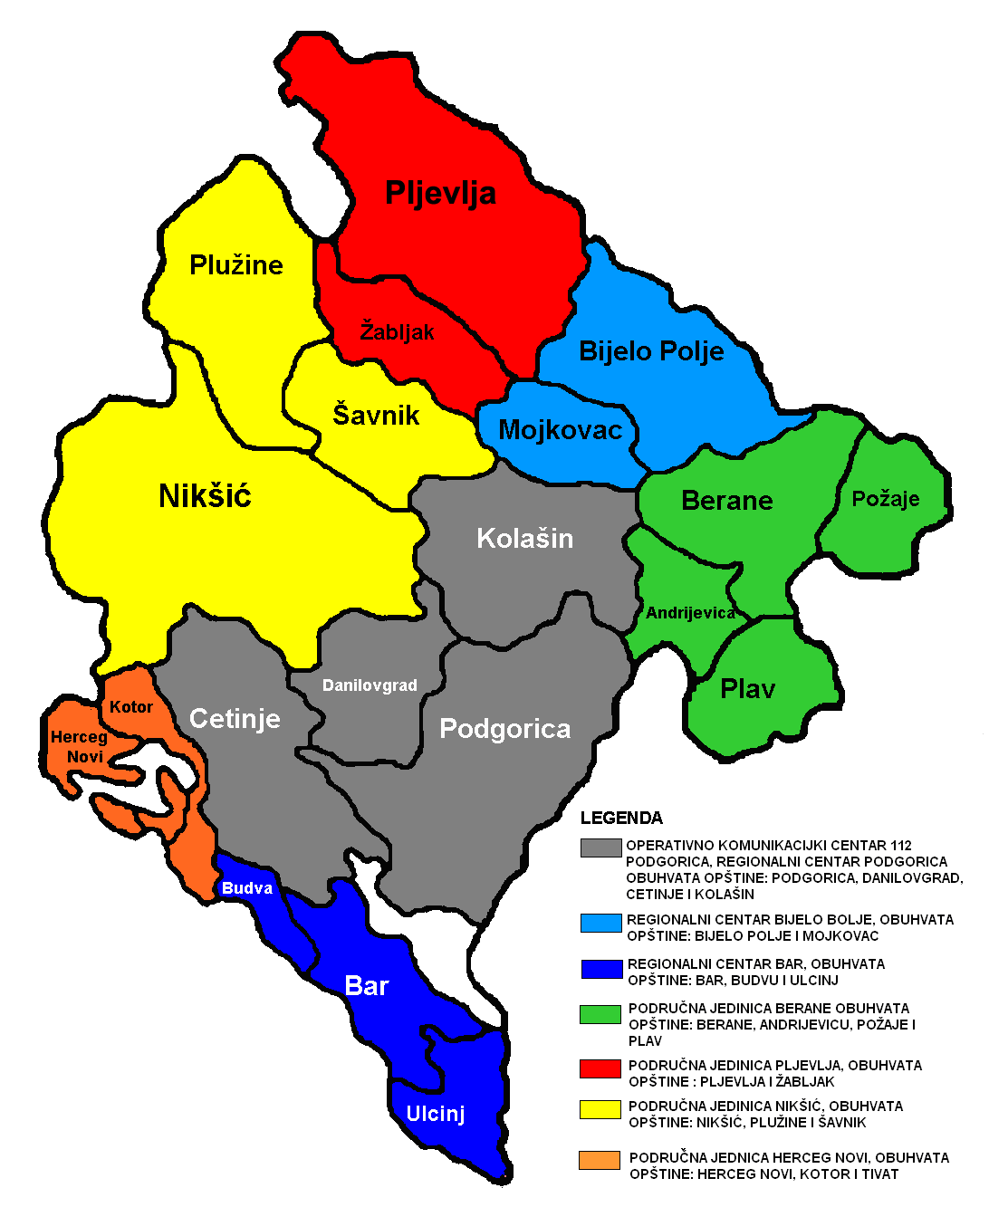
Chapter 14: Transport Policy
Current and future activities
112 PROJECT
Montenegro has 21 municipalities, which are divided in 7 Territorial Units
TU Podgorica (Podgorica, Cetinje, Kolašin & Danilovgrad)
TU Nikšić (Nikšić, Šavnik & Plužine)
TU Bijelo Polje (Bijelo Polje & Mojkovac)
TU Pljevlja (Pljevlja & Žabljak)
TU Berane (Berane, Rožaje, Plav & Andrijevica)
TU Bar (Bar, Budva & Ulcinj)
TU Herceg Novi (Herceg Novi, Kotor & Tivat)
M O N T E N E G R O
Negotiating Team for the Accession of Montenegro to the European Union

Slide 8
Chapter 14: Transport Policy
112 Project
Implementing Ericsson Nikola Tesla System – ComCord
  Podgorica (main server) – Regional Center
  Bijelo Polje (redundant server) – Regional Center
  36 workplaces for call-takers and shift leaders
  Transfer of calls and data sharing between organisations
  Accessibility for people with disabilities
  Caller-location (landline and mobile)
The Standard Operating Procedures are finished
Multilingual calls (40% of call-takers know English language, language courses are regularly organized)
M O N T E N E G R O
Negotiating Team for the Accession of Montenegro to the European Union

Slide 9
Chapter 14: Transport Policy
112 Project
OKC 112
PODGORICA
Radio Network
RC
Podgorica
OKC 112
PODGORICA
112 WAN
112 WAN
TU
Nikšić
TU
Herceg Novi
RC Podgorica
RC Bijelo Polje
112 WAN
112 WAN
PSTN
GSM
PSTN
GSM
TU
Bar
RC Bijelo Polje
112 WAN
112 WAN
TU
Nikšić
TU
Bar
TU
Herceg Novi
TU
Berane
TU
Pljevlja
TU
Berane
TU
Pljevlja
Radio Network
M O N T E N E G R O
Negotiating Team for the Accession of Montenegro to the European Union

Slide 10


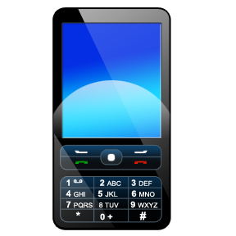






Chapter 14: Transport Policy
112 Model in Montenegro
Present state
122
123
124
112
M O N T E N E G R O
Negotiating Team for the Accession of Montenegro to the European Union

Slide 11
Chapter 14: Transport Policy
112 Model in Montenegro
Planed state
112
M O N T E N E G R O
Negotiating Team for the Accession of Montenegro to the European Union

Slide 12
Chapter 14: Transport Policy
Human Resources
112
 | Current number | Planned number
Call-takers | 36 | 61
Shift leader | 3 | 7
Police | EMS | PRS | Civil Protection | Army
1635 | 385 | 599 | 2000(planed) | 2000 (452)
M O N T E N E G R O
Negotiating Team for the Accession of Montenegro to the European Union

Slide 13
Chapter 14: Transport Policy
Level of emergency service integration
Present situation is that, all emergency services (Police, EMS, Firefighters …) don’t have the same software and they are not situated in the same room or building. They share data in the case of joint action.
M O N T E N E G R O
Negotiating Team for the Accession of Montenegro to the European Union

Slide 14
Chapter 14: Transport Policy
INTERNATIONAL COOPERATION
Memorandum of intention on cooperation in the field of prevention of natural and man-made disasters and sanation of their consequences are signed with :
Bosnia and Herzegovina
Republic of Serbia
Memorandum of intention for cooperation in the field of prevention and liquidation of emergencies is signed with :
The Russian Federation.
Initiatives to sign Agreements are sent to:
Turkey,
Albania and
Italy
Ukraine.
Government of Montenegro has bilateral Agreements with the following countries:
Bosnia and Herzegovina,
Croatia,
Greece,
Serbia,
Macedonia ,
Slovenia
M O N T E N E G R O
Negotiating Team for the Accession of Montenegro to the European Union

Slide 15
Chapter 14: Transport Policy
112 Acces
From July 11th 2008 – July 26th 2010 The EEN 112 has been used by the Police
Sector for emergency management uses the EEN 112 since July 26th 2010. For the period July 26th 2010 – december 31st 2010 OKC 112 has received 74765 calls (around 830 calls daily). Most of received calls are hoax (random calls, calls with no answer) or info calls.
In December 2010 and February 2012 we had emergency situation (flooding 2010 and snow storm 2012), in which all communication and coordination went through OKC 112.
M O N T E N E G R O
Negotiating Team for the Accession of Montenegro to the European Union

Slide 16
Thank you for your attention
QUESTIONS ?

