Slide 1


M O N T E N E G R O
Negotiating Team for the Accession of Montenegro to the European Union
Working Group for Chapter 14 – Transport policy
Bilateral screening: Chapter 14
PRESENTATION OF MONTENEGRO
Brussels 27- 30 May 2013

Slide 2
Chapter 14: Transport Policy
Pilotage
Snezana Djurkovic
Ministry of transport and maritime affairs
snezana.djurkovic@msp.gov.me
M O N T E N E G R O
Negotiating Team for the Accession of Montenegro to the European Union
Chapter 14: Transport Policy

Slide 3
CONTENT
Chapter 14: Transport policy
Institutional Framework
Legal Framework
Current and Future Activities
M O N T E N E G R O
Negotiating Team for the Accession of Montenegro to the European Union
Chapter 14: Transport Policy

Slide 4

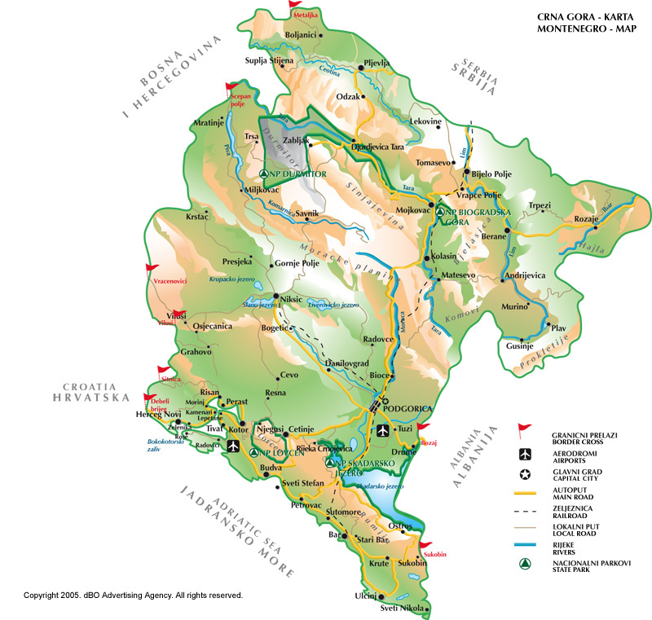

Montenegro:
Waterway and coastal seas
Ports in Montenegro: Bar, Bijela, Kotor, Zelenika, Risan i Budva
Territorial waters area:
Boka bay:
4

Slide 5
Chapter 14: Transport Policy
Montenegro has surface area of 13 812 sq km and sea area of 4 800 sq km (inland waters and territorial sea). In 2003, the reported population was 620 145 citizens with population density at 44.8 people per sq km. Total length of land borders is 614 km, and the width of its territorial sea borders is 12 nautical miles (22 224 m).
M O N T E N E G R O
Negotiating Team for the Accession of Montenegro to the European Union
Chapter 14: Transport Policy

Slide 6
Institutional Framework
Pilotage services in the ports of Montenegro are performed by qualified (certified) pilots hired by the business entity that performs those activities in the port area
In the Port of Bar there is a concessions for a period of 30 years of carrying out following services: pilot service, mooring / untying boats, tug boat services, the delivery of water to the ships at anchor in the Port, transportation of port authorities on vessels in the Port; transportation of ship chandler to the ship in the Port, towing vessels.
Chapter 14: Transport Policy
M O N T E N E G R O
Negotiating Team for the Accession of Montenegro to the European Union
Chapter 14: Transport Policy

Slide 7
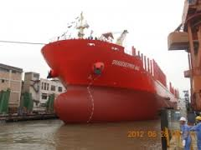
LEGAL FRAMEWORK
Ships of Montenegrin nationality are obliged to obey international standards and to comply with the regulations of the countries in which they sail and in that sense to apply the
Council Directive 79/115/EEC
Chapter 14: Transport Policy
M O N T E N E G R O
Negotiating Team for the Accession of Montenegro to the European Union
Chapter 14: Transport Policy

Slide 8
LEGAL FRAMEWORK
- Law on maritime and inland navigation (“Official Gazette SRJ” no. 12/98, 44/99, 74/99 i 73/00)
- Law on maritime and inland navigation (“Official Gazette RCG” no. 19/78, 8/79, 19/87, 22/90 i 13/91).
- The Law on prevention of pollution from vessels (“Official Gazette CG” no. 20/11)
- Code of Practice on pilotage, educational qualifications required for pilots and requirements for performing pilotage
(Official Gazette SRJ no. 63/98 ),
-Code on Boka bay(Official Gazette RCG no. 47/01 ),
- Regulations on qualifications and navigational experience, educational program and the professional exam for pilot of marine pilotage (Official Gazette SRCG no. 2/76 )
- Regulation on uniform for pilot of marine pilotage (Official Gazette RCG no. 47/92 )
- Order on labeling pilot boats and call signs for piloting (Official Gazette SRCG no. 2/76 ) and
- Instructions on maritime pilots legitimation (Official Gazette SRCG no. 2/76 ).
Chapter 14: Transport Policy
M O N T E N E G R O
Negotiating Team for the Accession of Montenegro to the European Union
Chapter 14: Transport Policy

Slide 9
LEGAL FRAMEWORK
Port pilotage is: pilotage (management) of the vessel in the port or the port maritime zone, as well as piloting the vessel in the Bay of Kotor and it is required. Notwithstanding the port pilotage is not subject to: Montenegrin military ships and Montenegrin public ships; passenger and ro-ro passenger ships sailing on the regular line, if the commander has passed the pilot examination for that area of ​​the port; yachts up to 500 GT, regardless of nationality, if not carrying dangerous or harmful substances in liquid or liquefied gases. Port Pilotage is compulsory for the ship to be moved to a port from one operating berth to another and moves along the operational coast with the use of the machinery. The commander of the vessel shall seek the port pilotage at least two hours before its arrival, departure, movement or shifting of the vessel.
Chapter 14: Transport Policy
M O N T E N E G R O
Negotiating Team for the Accession of Montenegro to the European Union
Chapter 14: Transport Policy

Slide 10
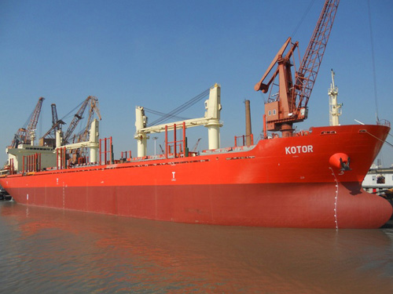
Chapter 14: Transport Policy
Current and Future Activities
Draft Law on maritime safety of navigation (deadline: 2013) and bylaw acts that will be drafted in compliance with the Draft Law (deadline: 2014)
Draft amendments of the Law on prevention of pollution from vessels (deadline: 2014)
M O N T E N E G R O
Negotiating Team for the Accession of Montenegro to the European Union
Chapter 14: Transport Policy

Slide 11
Thank you for your attention
QUESTIONS

