Slide 1


M O N T E N E G R O
Negotiating Team for the Accession of Montenegro to the European Union
Working Group for Chapter 14 – Transport policy
Bilateral screening: Chapter 14
PRESENTATION OF MONTENEGRO
Brussels 27-30 May 2013

Slide 2
Chapter 14: Transport Policy
International Relations
International Agreements
Snezana Djurkovic
Ministry of transport and maritime affairs
snezana.djurkovic@msp.gov.me
M O N T E N E G R O
Negotiating Team for the Accession of Montenegro to the European Union
Chapter 14: TRANSPORT POLICY

Slide 3
Chapter 14: Transport Policy
CONTENT
Institutional Framework
Legislative Framework
Current and Future Activities
Chalanges
M O N T E N E G R O
Negotiating Team for the Accession of Montenegro to the European Union
Chapter 14: TRANSPORT POLICY

Slide 4
Chapter 14: Transport Policy
Institutional Framework
MINISTRY OF TRANSPORT AND MARITIME AFFAIRS
MARITIME SAFETY DEPARTEMENT
HARBOUR MASTERS OFFICES IN BAR AND KOTOR
PORT AUTHORITY
M O N T E N E G R O
Negotiating Team for the Accession of Montenegro to the European Union
Chapter 14: TRANSPORT POLICY

Slide 5
Montenegro was accepted into the United Nations with the resolution of the General Assembly A/RES/60/264 of June 28, 2006
Montenegro as a member of the United Nations, has taken the United Nations Convention on the Law of the Sea, 1982 (UNCLOS) by succession.
16 October 2006, Montenegro became a member of the International Maritime Organization, with the deposition of the instruments of accession in general IMO Convention in 1948. year.
Chapter 14: Transport Policy
M O N T E N E G R O
Negotiating Team for the Accession of Montenegro to the European Union
Chapter 14: TRANSPORT POLICY

Slide 6
Chapter 14: Transport Policy
Council Regulation (EEC) No 4057/86 of 22 December 1986 on unfair pricing practices in maritime transport, OJ L 378, 31.12.1986, p. 14.
Decision No 167/2006/EC of the European Parliament and of the Council of 18 January 2006 concerning the activities of certain third countries in the field of cargo shipping (codified version), OJ L 33, 4.2.2006,
Council Decision 77/587/EEC of 13 September 1977 setting up a consultation procedure on relations between Member States and third countries in shipping matters and on action relating to such matters in international organizations, OJ L 239, 17.9.1977, p. 23.
Council Decision 92/143/EEC of 25 February 1992 on radionavigation systems for Europe, OJ L 59, 4.3.1992, p. 17
Council Decision 2008/143/EC of 28 January 2008 concerning the conclusion of the Agreement on maritime transport between the European Community and its Member States, of the one part, and the Government of the People’s Republic of China, of the other part, OJ L46 of 21/02/2008, p.23.
M O N T E N E G R O
Negotiating Team for the Accession of Montenegro to the European Union
Chapter 14: TRANSPORT POLICY

Slide 7
Chapter 14: Transport Policy
STATUS OF CONVENTIONS
Commission Regulation (EEC) No 2158/93 of 28 July 1993 concerning the application of amendments to the International Convention for the Safety of Life at Sea, 1974, and to the International Convention for the Prevention of Pollution from ships, 1973, for the purpose of Council Regulation (EEC) No 613/91
Regulation (EC) No 1490/2007 of the European Parliament and of the Council of 11 December 2007 repealing Council Regulation (EEC) No 954/79 concerning the ratification by Member States of, or their accession to, the United Nations Convention on a Code of Conduct for Liner Conferences, OJ L 332, 18.12.2007, p. 1.
Council Decision 2002/971/EC of 18 November 2002 authorising the Member States, in the interest of the Community, to ratify or accede to the International Convention on Liability and Compensation for Damage in Connection with the Carriage of Hazardous and Noxious Substances by Sea, 1996 (the HNS Convention), OJ L 337, 13.12.2002, p. 55.
Council Decision 2004/246/EC of 2 March 2004 authorising the Member States to sign, ratify or accede to, in the interest of the European Community, the Protocol of 2003 to the International Convention on the Establishment of an International Fund for Compensation for Oil Pollution Damage, 1992, and authorising Austria and Luxembourg, in the interest of the European Community, to accede to the underlying instruments OJ L 78, 16.3.2004, p. 22.
Amended by
Council Decision 2004/664/EC of 24 September 2004 L 303, 30.9.2004, p. 28.
M O N T E N E G R O
Negotiating Team for the Accession of Montenegro to the European Union
Chapter 14: TRANSPORT POLICY

Slide 8
Chapter 14: Transport Policy
STATUS OF CONVENTIONS
Council Decision 2002/762/EC of 19 September 2002 authorising the Member States, in the interest of the Community, to sign, ratify or accede to the International Convention on Civil Liability for Bunker Oil Pollution Damage, 2001 (the Bunkers Convention), OJ L 256, 25.9.2002, p. 7.
Council Decision 2012/22/EU of 12 December 2011 concerning the accession of the European Union to the Protocol of 2002 to the Athens Convention relating to the Carriage of Passengers and their Luggage by Sea, 1974, with the exception of Articles 10 and 11 thereof, OJ L 8, 12.1.2012, p.1.
Council Decision 2012/23/EU of 12 December 2011 concerning the accession of the European Union to the Protocol of 2002 to the Athens Convention relating to the Carriage of Passengers and their Luggage by Sea, 1974, as regards Articles 10 and 11 thereof, OJ L 8, 12.1.2012, p.13.
M O N T E N E G R O
Negotiating Team for the Accession of Montenegro to the European Union
Chapter 14: TRANSPORT POLICY

Slide 9
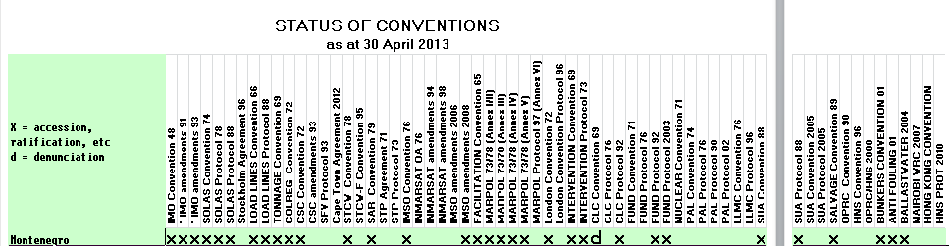
Chapter 14: Transport Policy
STATUS OF CONVENTIONS
M O N T E N E G R O
Negotiating Team for the Accession of Montenegro to the European Union
Chapter 14: TRANSPORT POLICY

Slide 10
LEGAL FRAMEWORK
-Constitution of Montenegro
- Law on maritime and inland navigation (“Official Gazette SRJ” no. 12/98, 44/99, 74/99 i 73/00)
- The Law on prevention of pollution from vessels (“Official Gazette CG” no. 20/11)
- Law on port (“Official Gazette CG” no. 51/08)
- Law on sea (Official Gazette CG no. 17/07)
Chapter 14: Transport Policy
M O N T E N E G R O
Negotiating Team for the Accession of Montenegro to the European Union
Chapter 14: TRANSPORT POLICY

Slide 11
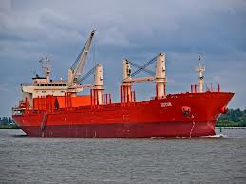
LEGAL FRAMEWORK
Constitution of Montenegro
Ratified and published international agreements and generally accepted rules of international law are an integral part of the internal legal order, and have primacy over national legislation and are applied when different from national legislation.
Chapter 14: Transport Policy
M O N T E N E G R O
Negotiating Team for the Accession of Montenegro to the European Union
Chapter 14: TRANSPORT POLICY

Slide 12
Chapter 14: Transport Policy
CURRENT AND FUTURE ACTIVITIES
Draft Law on maritime safety of navigation (deadline: 2013)
Draft amendments of the Law on prevention of pollution from vessels (deadline: 2014)
Ratifacion of Athens Convention relating to the carriage of passenger and their luggage by sea (deadline: 2013)
M O N T E N E G R O
Negotiating Team for the Accession of Montenegro to the European Union
Chapter 14: TRANSPORT POLICY

Slide 13
Chapter 14: Transport Policy
CHALENGES
Implementation and application of the relevant international instruments by the competent authorities
M O N T E N E G R O
Negotiating Team for the Accession of Montenegro to the European Union
Chapter 14: TRANSPORT POLICY

Slide 14
Thank you for your attention.
QUESTIONS

