Slide 1

M O N T E N E G R O
Negotiating Team for the Accession of Montenegro to the European Union
Working Group for Chapter 16 – Taxation
Bilateral screening: Chapter 16
PRESENTATION OF MONTENEGRO
Brussels, April 2013

Slide 2


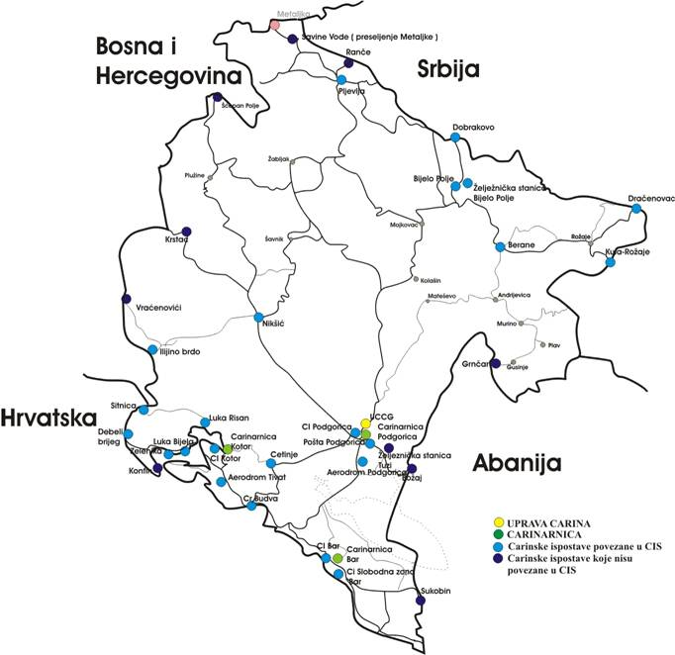




TAXATION
Chapter 16:
In accordance with the available data, total length of border of Montenegro is 840.4 km, including: land border 571.6 km, sea border 137 km; lakes 50.5 km and river border 81.3 km.
Pursuant to specific regulations – decisions, agreements, decrees, protocols, 32 border crossing points were established on the territory of Montenegro, out of which 5 are still not occupied.
M O N T E N E G R O
Negotiating Team for the Accession of Montenegro to the European Union
Chapter 16:
Taxation

Slide 3
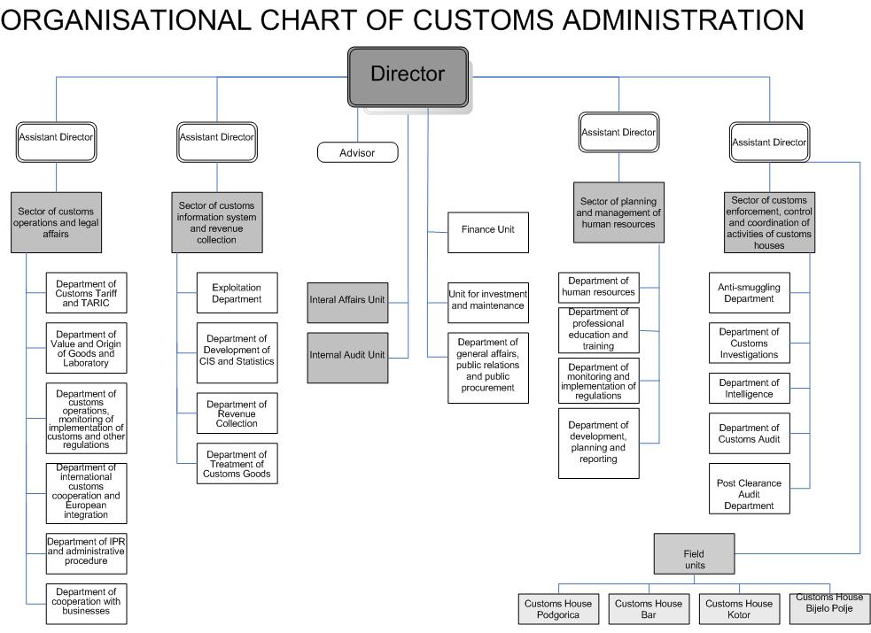
TAXATION
Chapter 16:
M O N T E N E G R O
Negotiating Team for the Accession of Montenegro to the European Union
Chapter 16:
Taxation

Slide 4
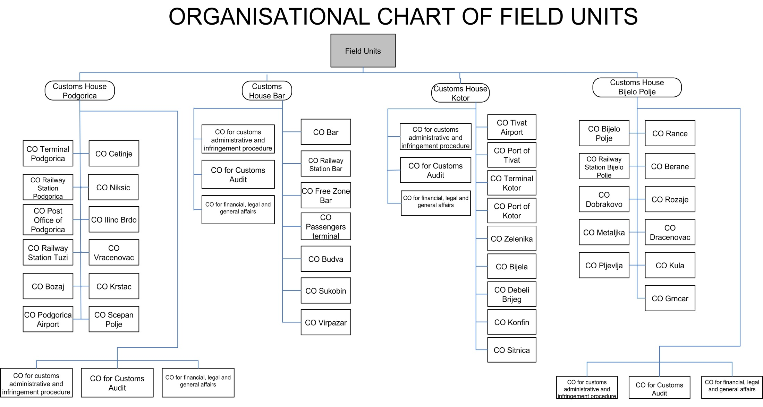
TAXATION
Chapter 16:
M O N T E N E G R O
Negotiating Team for the Accession of Montenegro to the European Union
Chapter 16:
Taxation

Slide 5
TAXATION
Chapter 16:
AVAILABLE STAFF:
Rulebook on internal organization and job descriptions of Customs Administration has systematized 385 work posts with 721 employees.
At the moment, there are 546 employees in the Customs Administration, out of which:
460 employees with tenure, and
80 at fixed-term contracts,
6 trainees (5 with 4 year faculty degree and 1 with high school diploma) at fixed-term
contracts.
- 40 persons with university degrees are involved in a 9 month programme of professional training which provides them professional knowledge and adequate working experience.
QUALIFICATION STRUCTURE OF EMPLOYEES IN CUSTOMS ADMINISTRATION:
4 year faculty education - 199
2 year college – 92
High school education – 248
Primary school – 7
M O N T E N E G R O
Negotiating Team for the Accession of Montenegro to the European Union
Chapter 16:
Taxation

Slide 6
TAXATION
Chapter 16:
BUSINESS STRATEGY
Drafting of Business Strategy for the next three years (2013-2015) is finalized (draft version is ready). It defines new Vision, Mission and Strategic Objectives for the referred time period. Strategy defines precisely everything that customs administration wishes to accomplish at the end of this period, in terms of standards of services provided to the business community and the public; operational performance; infrastructure and equipment; information technology and management of human resources.
M O N T E N E G R O
Negotiating Team for the Accession of Montenegro to the European Union
Chapter 16:
Taxation

Slide 7
TAXATION
Chapter 16:
Business Strategy
(2013-2015)
  Training Strategy
  Strategy for Management of Human Resources
  (ongoing)
  IT Strategy (ongoing)
M O N T E N E G R O
Negotiating Team for the Accession of Montenegro to the European Union
Chapter 16:
Taxation

Slide 8
TAXATION
Chapter 16:
LEGISLATION, PROJECTS
M O N T E N E G R O
Negotiating Team for the Accession of Montenegro to the European Union
Chapter 16:
Taxation

Slide 9
TAXATION
Chapter 16:
Legal framework
  Customs legislation (Customs Law, Customs Service Law.....)
  Foreign trade legislation
  Tax legislation
  Market surveilance legislation
  Legislation on environmental protection, etc.
  International Conventions and FTA
  Agreements on customs cooperation – 27 agreements
M O N T E N E G R O
Negotiating Team for the Accession of Montenegro to the European Union
Chapter 16:
Taxation

Slide 10
TAXATION
Chapter 16:
Ongoing projects
1. Simplified procedures
2. New computerized transit system – NCTS
3. SPP – Business rules app
4. SAT CG – New RMS
5. Systematic electronic exchange of data - SEED Project
6. CUSTOMS 2013
M O N T E N E G R O
Negotiating Team for the Accession of Montenegro to the European Union
Chapter 16:
Taxation

Slide 11
TAXATION
Chapter 16:
1. Simplified procedures
Application for simplified procedure of declaring goods on the basis of entry into the book-keeping records (ongoing)
Application for simplified procedure of declaring goods on the basis of an invoice (June 2011)
M O N T E N E G R O
Negotiating Team for the Accession of Montenegro to the European Union
Chapter 16:
Taxation

Slide 12


TAXATION
Chapter 16:
2. NCTS
Project ’’Preparation of the customs administration for implementation of new computerized transit system – NCTS’’
Realization of the Project started on 28 January 2013
Twinning light with the Austrian customs service
Activities: amendment of regulations, drafting
instructions, specification, organizing training
M O N T E N E G R O
Negotiating Team for the Accession of Montenegro to the European Union
Chapter 16:
Taxation

Slide 13

TAXATION
Chapter 16:
3. SPP – SYSTEM OF BUSINESS RULES
Application SPP – System of business rules is intended for maintenance of business rules i.e. controls over the customs documents in the information system of the customs administration.
Donated application has been integrated into the CIS.
M O N T E N E G R O
Negotiating Team for the Accession of Montenegro to the European Union
Chapter 16:
Taxation

Slide 14
TAXATION
Chapter 16:
4. SAT CG – NEW RMS
SAT (Risk analysis system) is an internet application where we maintain rules and it amends the existing RMS Application, which has been used since 2006. With these rules, we are checking risk in customs procedures on the basis of data from the declaration.
The application supports the SAT rules, random rules and risk indicators.
Donated application has been integrated into the CIS.
M O N T E N E G R O
Negotiating Team for the Accession of Montenegro to the European Union
Chapter 16:
Taxation

Slide 15

TAXATION
Chapter 16:
5. SYSTEMATIC ELECTRONIC EXCHANGE OF INFORMATION SEED PROJECT
Finalized Phase II of SEED Project, which is implemented within the MB IPA 2010
Project “SEED maintenance” has started under the multi-beneficiary IPA 2012, lasting 20 months, and the main activities of the Project are the following:
maintenance of SEED JCT infrastructure module and software,
implementation of new functions of SEED web application,
expansion of functions of SEED platform by the implementation of module ”Transborder transfer of money“,
activities related to the application for protection of intellectual property rights.
M O N T E N E G R O
Negotiating Team for the Accession of Montenegro to the European Union
Chapter 16:
Taxation

Slide 16

TAXATION
Chapter 16:
6. CUSTOMS 2013
2012 Montenegro has begun with participation in the program in 2012.
Under the scope of this Program, MCA officers are participating in seminars and workshops, project groups, study visits and trainings.
Under this Program, MCA officers are exchanging experiences and best practices with the customs services of the EU member states.
M O N T E N E G R O
Negotiating Team for the Accession of Montenegro to the European Union
Chapter 16:
Taxation

Slide 17
TAXATION
Chapter 16:
CHALLENGES for MCA
Full approximation with the acquis in terms of customs legislation,
Meeting the Conditions of Interconnectivity and Interoperability of the EU IT systems
Administrative capacities (human resources and infrastructure)
M O N T E N E G R O
Negotiating Team for the Accession of Montenegro to the European Union
Chapter 16:
Taxation

Slide 18
TAXATION
Chapter 16:
THANK YOU FOR YOUR ATTENTION!
Stojanka Milošević
Head of Department for value, origin of goods and customs laboratory
stojanka.milosevic@carina.gov.me
M O N T E N E G R O
Negotiating Team for the Accession of Montenegro to the European Union
Chapter 16:
Taxation

