Slide 1


M O N T E N E G R O
Negotiating Team for Accession of Montenegro to the European Union
Working Group for Chapter 18 – Statistics
Bilateral screening: Chapter 18
PRESENTATION OF MONTENEGRO
Luxembourg, June 2013

Slide 2

STATISTICS
Chapter 18:
BUSINESS REGISTER
Bilateral screening: Chapter 18
Presentation of Montenegro
Luxembourg, 23-24 June2013
Marijana Popovic - Roncevic, MSc
Head of Department of Registers and Classifications
M O N T E N E G R O
Negotiating Team for Accession of Montenegro to the European Union
Chapter 18:
Statistics

Slide 3
BUSINESS REGISTER
STATISTICS
Chapter 18:
Current situation
MONSTAT encompasses the following registers:
  Business register
  Administrative register
  Register of spatial units and
  Farm register
Business register began to be used in 2007, when he served as the directory which contains only a list of legal entities and their addresses.
Today, the Business Register is the main source for the process of selection of observation units for statistical surveys.
It is the basis and framework for statistics that provide information about the economy of our country and contribute to the description of the situation and development of the economy by providing the basis for the delineation and definition of population.
M O N T E N E G R O
Negotiating Team for Accession of Montenegro to the European Union
Chapter 18:
Statistics

Slide 4
STATISTICS
Chapter 18:
Current situation
The units are in the business register:
Legal Unit and
statistical units which include:
  enterprise
  local unit
  enterprise group
In the Business register following variables are included for all units:
Identification
Stratification
Demographic and
Relational
M O N T E N E G R O
Negotiating Team for Accession of Montenegro to the European Union
Chapter 18:
Statistics

Slide 5
STATISTICS
Chapter 18:
Current situation
In the Business Register statistical units are created but they are derived and often do not correspond the legal or administrative units.
Coverage
Business Register includes all active businesses in the territory of Montenegro. Exceptions are households and embassies.
Privacy
All individual data are strictly confidential (regulated by the Law on official statistics and the system of official statistics Official Gazette of Montenegro no.18/12). Publication of data is performed at different levels of aggregation.
M O N T E N E G R O
Negotiating Team for Accession of Montenegro to the European Union
Chapter 18:
Statistics

Slide 6
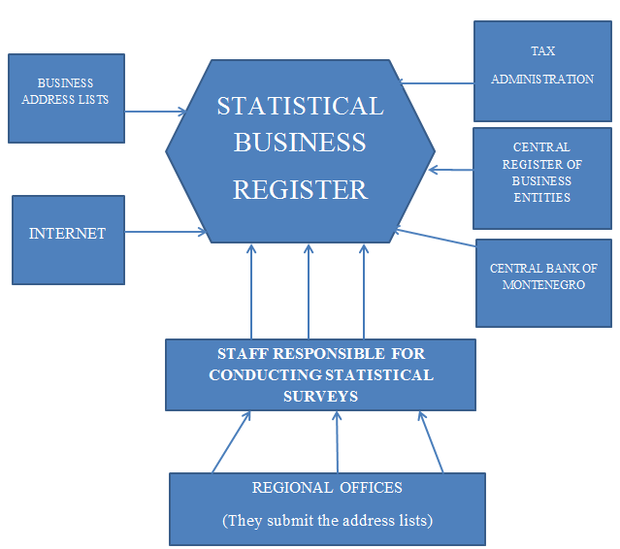
STATISTICS
Chapter 18:
Current situation
UPDATING
M O N T E N E G R O
Negotiating Team for Accession of Montenegro to the European Union
Chapter 18:
Statistics

Slide 7
STATISTICS
Chapter 18:
Current situation
UPDATE SOURCES
The sources from which the Business register is updated are: administrative sources and statistical surveys.
Administrative sources used for update are:
  Tax Administration
  Central Register of Business Entities
  Montenegro Business Alliance
  Union of Employers
  Central Bank
M O N T E N E G R O
Negotiating Team for Accession of Montenegro to the European Union
Chapter 18:
Statistics

Slide 8
STATISTICS
Chapter 18:
Current situation
Statistical surveys from which the business register is updated are:
Structural business statistics (SBS)
Survey on the wages and salaries of employees (RAD-1)
Short-term statistics (trade, construction, industry, agriculture, etc.)
Periodic of UPDATES
Central Register of Business Entities - administrative changes - weekly
Tax administration - number of employees – monthly
  - turnover, VAT – quarterly
M O N T E N E G R O
Negotiating Team for Accession of Montenegro to the European Union
Chapter 18:
Statistics

Slide 9
STATISTICS
Chapter 18:
Current situation
Central Bank - Financial Accounts – annually
Montenegro Business Alliance and the Union of Employers - contact information – annually
Update mode - Regulated by the Rulebook on Maintenance, Updating and Use of Statistical Business Registers – adopted on 20 February 2012;
When we talk about updating data from administrative sources, the data are obtained in electronic format and automatically entered into the database of Business register.
Update from statistical surveys is conducted in two ways:
- A questionnaire that includes the data that is currently in the business register is created, and statisticians who conduct the survey enter any changes and submit the completed questionnaire to the statisticians who conduct a review and changes in the business register database;
M O N T E N E G R O
Negotiating Team for Accession of Montenegro to the European Union
Chapter 18:
Statistics

Slide 10
STATISTICS
Chapter 18:
Current situation
Statistician who conduct the survey, that is of particular importance for updating of business register, has access via username, password and authority to modify certain information (address, phone number, e-mail address, the status of activities, etc.)
As a key variable for the connection of data, ID number of the business entity is used. That number is unique and it is used by all administrative body.
CLASSIFICATION
In the business register the business entities are classified according to the activity, and for that purpose we used classification NACE Rev. 2
M O N T E N E G R O
Negotiating Team for Accession of Montenegro to the European Union
Chapter 18:
Statistics

Slide 11
STATISTICS
Chapter 18:
Current situation
The enterprises into the Business register are classified by size into small, medium and large according to the Law on Accounting and Auditing of Montenegro (Official Gazette 69/05, 80/08 and 32/11).
  Work on updating Business register is increasingly moving towards the use of as many administrative sources in order to reduce the burden of reporting units. For this reason, a Memorandum of Understanding with the Tax Administration, the Central Bank, the Union of Employers and Montenegro Business Alliance were signed.
MONSTAT did three reports on the burden of reporting units.
M O N T E N E G R O
Negotiating Team for Accession of Montenegro to the European Union
Chapter 18:
Statistics

Slide 12
STATISTICS
Chapter 18:
Current situation
MONSTAT made a first report on the quality of the Business register. The report is based on all quality components. It also contains a detailed description of Business register and the problems that exist. For the quality improvement survey MONSTAT used a survey on the operations of large and medium enterprises. This survey was conducted in April this year.
DISSEMINATION
Following analysis were conducted:
Analysis of the number and structure of business entities in Montenegro, in the 2011
Analysis of the number and structure of business entities in Montenegro by municipalities
Holders of ownership of business entities in Montenegro in 2011, by sex
M O N T E N E G R O
Negotiating Team for Accession of Montenegro to the European Union
Chapter 18:
Statistics

Slide 13
STATISTICS
Chapter 18:
Current situation
Analysis on the number and structure of business entities in Montenegro 2012, quarterly
Following releases were published:
Newly established and inactive businesses for the period 1st January – 30th September 2012
The number and structure of business entities in foreign ownership in Montenegro
M O N T E N E G R O
Negotiating Team for Accession of Montenegro to the European Union
Chapter 18:
Statistics

Slide 14
STATISTICS
Chapter 18:
Legal framework:
Regulation of the European Parliament and the Council (EC) No. 177/2008 of 20 February 2008
Commission Regulation (EC) No. 192/2009 of 11 March 2009
Commission Decision No. 2009/252/EC of 11 March 2009
M O N T E N E G R O
Negotiating Team for Accession of Montenegro to the European Union
Chapter 18:
Statistics

Slide 15
STATISTICS
Chapter 18:
COMPLIANCE
Business register is compliant with EU regulations regarding:
- content,
- definition,
- variables,
- classification.
Creating a Database of Enterprise Group - survey conducted in April 2013
Gap in relation to the requirements of Regulation mostly refers to the number of employees
Data for year 2012 were sent to EUROSTAT trough eDamis.
M O N T E N E G R O
Negotiating Team for Accession of Montenegro to the European Union
Chapter 18:
Statistics

Slide 16
STATISTICS
Chapter 18:
Future activities:
Conduction of Local units survey, September 2013
Collecting data on the number of employees and total number of employees, because for the information an administrative data source does not exist.
Full compliance and transmission of data for variables related to enterprise groups.
Continued work on the analysis related to business demography.
M O N T E N E G R O
Negotiating Team for Accession of Montenegro to the European Union
Chapter 18:
Statistics

Slide 17
Thank you for your attention!
QUESTIONS

