Slide 1


M O N T E N E G R O
Negotiating Team for the Accession of Montenegro to the European Union
Working Group for Chapter 19 – Social Policy and Employment
Bilateral screening: Chapter 19
PRESENTATION OF MONTENEGRO
Brussels, 11-13 March 2013

Slide 2
M O N T E N E G R O
Negotiating Team for the Accession of Montenegro to the European Union
SAFETY AND HEALTH AT WORK
Zlatko Popović, Labour inspector for safety at work – coordinator for safety at work
Administration for Inspection Affairs
Department for Labour Inspection
Email:
zlatkopuznr@t-com.me
2
M O N T E N E G R O
Negotiating Team for the Accession of Montenegro to the European Union
Chapter 19: SOCIAL POLICY AND EMPLOYMENT

Slide 3
Chapter 19: Social Policy and Employment
CONTENT:
Council Resolution of 25 June 2007 on a new Community strategy on health and safety at work (2007–2012)
Council Directive 89/391/EEC of 12 June 1989 on the introduction of measures to encourage improvements in the safety and health of workers at work – Zakon o zaštiti na radu
Council Directive 89/654/EEC of 30 November 1989 concerning the minimum safety and health requirements for the workplace (first individual directive within the meaning of Article 16 (1) of Directive 89/391/EEC)
Directive 2009/104/EC of the European Parliament and of the Council of 16 September 2009 concerning the minimum safety and health requirements for the use of work equipment by workers at work (second individual Directive within the meaning of Article 16(1) of Directive 89/391/EEC)
Council Directive 89/656/EEC of 30 November 1989 on the minimum health and safety requirements for the use by workers of personal protective equipment at the workplace (third individual directive within the meaning of Article 16 (1) of Directive 89/391/EEC)
M O N T E N E G R O
Negotiating Team for the Accession of Montenegro to the European Union
Chapter 19: SOCIAL POLICY AND EMPLOYMENT

Slide 4
Chapter 19: Social Policy and Employment
CONTENT:
Council Directive 92/58/EEC of 24 June 1992 on the minimum requirements for the provision of safety and/or health signs at work (ninth individual Directive within the meaning of Article 16 (1) of Directive 89/391/EEC)
Council recommendation of 18 February 2003 concerning the improvement of the protection of the health and safety at work of self-employed workers
Commission Recommendation of 19 September 2003 concerning the European schedule of occupational diseases (Text with EEA relevance) (notified under document number C(2003)
Council Directive 90/269/EEC of 29 May 1990 on the minimum health and safety requirements for the manual handling of loads where there is a risk particularly of back injury to workers (fourth individual Directive within the meaning of Article 16 (1) of Directive 89/391/EEC)
Council Directive 90/270/EEC of 29 May 1990 on the minimum safety and health requirements for work with display screen equipment (fifth individual Directive within the meaning of Article 16 (1) of Directive 89/391/EEC)
M O N T E N E G R O
Negotiating Team for the Accession of Montenegro to the European Union
Chapter 19: SOCIAL POLICY AND EMPLOYMENT

Slide 5
Chapter 19: Social Policy and Employment
CONTENT:
Council Directive 92/29/EEC of 31 March 1992 on the minimum safety and health requirements for improved medical treatment on board vessels
Council Directive 93/103/EC of 23 November 1993 concerning the minimum safety and health requirements for work on board fishing vessels (thirteenth individual Directive within the meaning of Article 16 (1) of Directive 89/391/EEC)
Council Directive 92/57/EEC of 24 June 1992 on the implementation of minimum safety and health requirements at temporary or mobile construction sites (eighth individual Directive within the meaning of Article 16 (1) of Directive 89/391/EEC)
Council Directive 92/91/EEC of 3 November 1992 concerning the minimum requirements for improving the safety and health protection of workers in the mineral-extracting industries through drilling (eleventh individual Directive within the meaning of Article 16 (1) of Directive 89/391/EEC)
Council Directive 92/104/EEC of 3 December 1992 on the minimum requirements for improving the safety and health protection of workers in surface and underground mineral-extracting industries (twelfth individual Directive within the meaning of Article 16 (1) of Directive 89/391/EEC)
M O N T E N E G R O
Negotiating Team for the Accession of Montenegro to the European Union
Chapter 19: SOCIAL POLICY AND EMPLOYMENT

Slide 6
Chapter 19: Social Policy and Employment
CONTENT:
Directive 2004/37/EC of the European Parliament and of the Council of 29 April 2004 on the protection of workers from the risks related to exposure to carcinogens or mutagens at work (Sixth individual Directive within the meaning of Article 16(1) of Council Directive 89/391/EEC) (codified version) (Text with EEA relevance)
Directive 2009/148/EC of the European Parliament and of the Council of 30 November 2009 on the protection of workers from the risks related to exposure to asbestos at work
Council Conclusions of 7 April 1998 on the protection of workers against the risks from exposure to asbestos
Commission Directive 91/322/EEC of 29 May 1991 on establishing indicative limit values by implementing Council Directive 80/1107/EEC on the protection of workers from the risks related to exposure to chemical, physical and biological agents at work
Council Directive 98/24/EC of 7 April 1998 on the protection of the health and safety of workers from the risks related to chemical agents at work (fourteenth individual Directive within the meaning of Article 16(1) of Directive 89/391/EEC)
M O N T E N E G R O
Negotiating Team for the Accession of Montenegro to the European Union
Chapter 19: SOCIAL POLICY AND EMPLOYMENT

Slide 7
Chapter 19: Social Policy and Employment
CONTENT:
Commission Directive 2000/39/EC of 8 June 2000 establishing a first list of indicative occupational exposure limit values in implementation of Council Directive 98/24/EC on the protection of the health and safety of workers from the risks related to chemical agents at work (Text with EEA relevance)
Commission Directive 2006/15/EC of 7 February 2006 establishing a second list of indicative occupational exposure limit values in implementation of Council Directive 98/24/EC and amending Directives 91/322/EEC and 2000/39/EC
Commission Directive 2009/161/EU of 17 December 2009 establishing a third list of indicative occupational exposure limit values in implementation of Council Directive 98/24/EC and amending Commission Directive 2000/39/EC
Directive 2000/54/EC of the European Parliament and of the Council of 18 September 2000 on the protection of workers from risks related to exposure to biological agents at work (seventh individual directive within the meaning of Article 16(1) of Directive 89/391/EEC)
M O N T E N E G R O
Negotiating Team for the Accession of Montenegro to the European Union
Chapter 19: SOCIAL POLICY AND EMPLOYMENT

Slide 8
Chapter 19: Social Policy and Employment
CONTENT:
Commission Directive 2000/39/EC of 8 June 2000 establishing a first list of indicative occupational exposure limit values in implementation of Council Directive 98/24/EC on the protection of the health and safety of workers from the risks related to chemical agents at work (Text with EEA relevance)
Directive 2002/44/EC of the European Parliament and of the Council of 25 June 2002 on the minimum health and safety requirements regarding the exposure of workers to the risks arising from physical agents (vibration) (sixteenth individual Directive within the meaning of Article 16(1) of Directive 89/391/EEC) – Joint Statement by the European Parliament and the Council
Directive 2003/10/EC of the European Parliament and of the Council of 6 February 2003 on the minimum health and safety requirements regarding the exposure of workers to the risks arising from physical agents (noise) (Seventeenth individual Directive within the meaning of Article 16(1) of Directive 89/391/EEC)
Directive 2004/40/EC of the European Parliament and of the Council of 29 April 2004 on the minimum health and safety requirements regarding the exposure of workers to the risks arising from physical agents (electromagnetic fields) (18th individual Directive within the meaning of Article 16(1) of Directive 89/391/EEC)
M O N T E N E G R O
Negotiating Team for the Accession of Montenegro to the European Union
Chapter 19: SOCIAL POLICY AND EMPLOYMENT

Slide 9
Chapter 19: Social Policy and Employment
CONTENT:
Directive 2006/25/EC of the European Parliament and of the Council of 5 April 2006 on the minimum health and safety requirements regarding the exposure of workers to risks arising from physical agents (artificial optical radiation)
Directive 1999/92/EC of the European Parliament and of the Council of 16 December 1999 on minimum requirements for improving the safety and health protection of workers potentially at risk from explosive atmospheres (15th individual Directive within the meaning of Article 16(1) of Directive 89/391/EEC)
Council Directive 2010/32/EU of 10 May 2010 implementing the Framework Agreement on prevention from sharp injuries in the hospital and healthcare sector concluded by HOSPEEM and EPSU
Council Directive 92/85/EEC of 19 October 1992 on the introduction of measures to encourage improvements in the safety and health at work of pregnant workers and workers who have recently given birth or are breastfeeding (tenth individual Directive within the meaning of Article 16 (1) of Directive 89/391/EEC)
M O N T E N E G R O
Negotiating Team for the Accession of Montenegro to the European Union
Chapter 19: SOCIAL POLICY AND EMPLOYMENT

Slide 10
Chapter 19: Social Policy and Employment
CONSTITITION
LAW ON SAFETY AT WORK
BY LAW REGULATIONS
III
COLLECTIVE AGREEMENT
IV
GENERAL ACT OF EMPLOYER
V
LEGAL FRAMEWORK
10
M O N T E N E G R O
Negotiating Team for the Accession of Montenegro to the European Union
Chapter 19: SOCIAL POLICY AND EMPLOYMENT

Slide 11
Chapter 19: Social Policy and Employment
Constitution of Montenegro
Right to work
Article 62
Everyone shall have the right to work, to free choice of occupation and employment, to fair and human working conditions and to protection during unemployment.
Rights of the employed
Article 64
The employed shall have the right to adequate salary.
The employed shall have the right to limited working hours and paid vacation.
The employed shall have the right to safety at work.
Youth, women and the disabled shall enjoy special safety at work.
M O N T E N E G R O
Negotiating Team for the Accession of Montenegro to the European Union
Chapter 19: SOCIAL POLICY AND EMPLOYMENT

Slide 12
Chapter 19: Social Policy and Employment
EMPLOYEES IN MONTENEGRO
 | 2000 | 2001 | 2002 | 2003 | 2004 | 2005 | 2006 | 2007 | 2008 | 2009 | 2010
TOTAL | 140773 | 141114 | 140100 | 142679 | 143479 | 144340 | 150800 | 156408 | 166221 | 174152 | 161742
Agriculture, forestry and water-power economy | 2870 | 2877 | 4310 | 3926 | 2926 | 2786 | 2607 | 2586 | 2651 | 2700 | 2347
Fishing | 62 | 63 | 120 | 90 | 64 | 98 | 115 | 112 | 129 | 119 | 102
Mining and quarrying | 4492 | 4503 | 5349 | 5451 | 4578 | 4079 | 4159 | 3753 | 3721 | 3178 | 2332
ManufacturePreradjivacka industrija | 25779 | 25843 | 31566 | 30891 | 26286 | 25971 | 26065 | 25697 | 24335 | 21824 | 16563
Production and supply of electricity, gas and water | 5388 | 5401 | 5838 | 5535 | 5491 | 5496 | 5627 | 5594 | 6042 | 5456 | 4369
Construction | 6746 | 6762 | 6166 | 6522 | 6879 | 7563 | 6853 | 6647 | 8831 | 9997 | 7903
TWholesale and retail trade, repair of vehicles, personal and household goods | 23648 | 23707 | 16782 | 20002 | 24101 | 23789 | 29602 | 30750 | 31854 | 36117 | 36918
Hotels and restaurants | 9391 | 9405 | 8574 | 9024 | 9562 | 11110 | 10928 | 11307 | 14641 | 16678 | 13131
Transport, storage and communication | 13878 | 13912 | 14856 | 14502 | 14145 | 13745 | 12133 | 11358 | 12798 | 13858 | 12541
Financial intermediation | 3264 | 3272 | 3311 | 2793 | 3316 | 3014 | 3114 | 3143 | 3476 | 3748 | 3959
Real estate, renting and business activities | 4608 | 4620 | 3904 | 4238 | 4699 | 5067 | 5905 | 5354 | 5631 | 7356 | 9264
Public administration and compulsory social security | 9160 | 9183 | 9157 | 9444 | 9337 | 9524 | 10345 | 17575 | 18643 | 18860 | 18868
Education | 12850 | 12882 | 13437 | 13016 | 13098 | 12974 | 12846 | 12687 | 12892 | 12992 | 11854
Health and social work | 11385 | 11414 | 9885 | 10021 | 11605 | 11200 | 12012 | 12004 | 12356 | 12238 | 11238
Other community, social and personal service activities | 7252 | 7270 | 6845 | 7224 | 7392 | 7924 | 8489 | 7481 | 8221 | 9031 | 10353
M O N T E N E G R O
Negotiating Team for the Accession of Montenegro to the European Union
Chapter 19: SOCIAL POLICY AND EMPLOYMENT

Slide 13

Chapter 19: Social Policy and Employment
Regulation on Risk Assesement at Workplaces
Regulation on the Records and Reports in the Field of Safety at Work
Regulation on the Conditions to be fulfilled by an Authorized Organization Performing Expert Tasks in the Field of Safety at Work
Regulation on Manner and Procedure applied in Preventive Medical Examination of Employees
Regulation on Means of Personal Safety for Work and Personal Safety Equipment
Regulation on Safety in the Loading and Unloading of Lorries
Regulation on Safety at Work on the Railways
Regulation on Hygienic and Technical Safety Measures for Work in Ferrous Metallurgy
Ordinance on the Prohibition of Absolving and Claming Metallic Parts and other Materials with Fuel Petrochemicals
Regulation on General Measures and Norms for Safety at Work Concerning Construction Works Intended for Working and Accessory Premises
Regulation on Safety at Work in Forest Industry
Regulation on Hygienic and Technical Safety Measures for Work in the Mechanical Processing and Shaping of Wood and Similar Materials
Regulation on Safety at Work Concerning the Danger of Electric Power
Regulation on Provision of Accommodation and Meals to Employees and their Transport from Place of Residence to Workplace and in the Opposite Direction
Regulation on Safety in the Maintained and Use of Motor Vehicles
Regulation on Safety at Work and Technical Measures Concerning Acetylene Generators and Acetylene Stations
Regulation on Measures and Norms Concerning Safety at Work with Work Tools
Regulation on General Measures and Norms Concerning Noise at Work Premises
Regulation and Special Measures and Norms for Safety at Work in the processing of Hides, Furs and Fur Wastes
Regulation on Safety in Agriculture Work
M O N T E N E G R O
Negotiating Team for the Accession of Montenegro to the European Union
Chapter 19: SOCIAL POLICY AND EMPLOYMENT

Slide 14
Chapter 19: Social Policy and Employment
November 2010 Government of Montenegro was adopted STRATEGY FOR IMPROVEMENT HEALTH OF EMPLOYEES AND SAFETY AT WORK IN MONTENEGRO
2010 – 2014 with Action plan of implementation
Law on Safety at Work (“Official Gazette of Republic of Montenegro”, no. 79/04 and “Official Gazette of Montenegro”, no. 26/10)
Adopted in accordance with “FRAMEWORK” directive 89/391/EC
Article 1 - The safety at work, based on the implementation of modern technical-technological, organizational, health, social and other safety at work measures and means shall be ensured and implemented in accordance with the present Law by other regulations, decrees of the European Union and international Conventions
Article 4 - Provisions of the present Law shall apply to all employees who work in the territory of Montenegro with national and international legal and natural entities, Government authorities, local government units, the employees who are referred to work abroad respectively if the legislation of the receiving country envisages less favourable safety at work measures than the ones established by the present Law, and all other persons who participate in the process of work and work environment if not otherwise established by a separate Law.
The Law shall apply on employees and on: pupils and students on apprenticeship, professional practice or practical classes (workshops, economies, cabinets, laboratories etc.), persons undergoing professional training, training for a particular job or higher qualification. persons undergoing professional rehabilitation, persons obliged during serving prison sentence to perform certain jobs, persons on volunteering and public works organized for the common good, on working action and competitions andvolunteers. It shall not apply shall not apply to persons for whom the employer, in line with the law, has organized work at home, that is with whom employment contract has been concluded for performing business in the household
M O N T E N E G R O
Negotiating Team for the Accession of Montenegro to the European Union
Chapter 19: SOCIAL POLICY AND EMPLOYMENT

Slide 15

Chapter 19: Social Policy and Employment
Article 6 – Preventive measures for enabling safety at workplace are provided for by applying contemporary technical, ergonomic, health (medical), educational, social, organizational and other measures and facilities to eliminate risks of injury and harmful effect on health of employees or to rdeuce that as mush as possible, in the pocedure of:
1) designing, construction, usage and maintenance of structures designated as working and auxilliary premises, as well as structures designated for work at the open space, for the aim of safe conducting of work process;
2) designing, construction, usage and maintenance of technological processes of work with all corresponding work facilities, for the aim of safe work of employees and adjustment of chemical, physical and biological damage, micro-climate and lightening at workplaces and in the working and auxilliary premises with prescribed measures and norms for activity performed at such workplace and in such work premises;
3) designing, production, usage and maintenance of work facilities, construction of structures for collective protection at the workplace, auxilliary structures and objects and other facilities which are used in the process of work which are in any way connected with the work process, thus preventing harmful effects and ruining of the employees’ health during their usage;
4) production, packing, transportation, storing, usage and distroying of dangerous substances, in a manner and in accordance with regulations and rules which eliminate possibility for employees to harm or ruin their health;
5) designing, production and usage of facilities and personal protection equipment during work, which eliminate, if used, risks or dangers which could not have been eliminated by application of certain preventive measures;
6) education, teaching and training in the field of safety at the workplace..
Articles 8 and 10 – checking and examinations of work equipment and working conditions
M O N T E N E G R O
Negotiating Team for the Accession of Montenegro to the European Union
Chapter 19: SOCIAL POLICY AND EMPLOYMENT

Slide 16

Chapter 19: Social Policy and Employment
RIGHTS, OBLIGATIONS AND RESPONSIBILITIES OF EMPLOYER
Article 13ª Employer shall be liable to provide preventive measures of safety at the workplace, considering the following principles:
- avoiding risks;
- estimation of risk that can not be avoided and their elimination at the very source by applying contemporary technical solutions;
- adjustment of work and workplaces to the employee, especially regarding construction of the workplace, selection of facilities for work, selection of work and production methods with an emphasize to avoidance of monotonous work and work at already defined pace and decrease of their effect on health;
- replacement of dangerous technological processes, facilities for work and work methods with undangerous or less dangerous ones;
- giving advantages to collective rather than individual work safety measures;
- appropriate training and notifying of employees and by giving instructions for work.
Article 14 – general act, labour contract, norm of personal protective equipment
Article 15 - Employer shall be responsible for adopting the Risk Assessment Act for all positions and for determining the way and the measures for removing such risk.
In case of occurrence of any new danger and changes to the level of the risk in the work process, the employer shall be obliged to make changes to the Risk Assessment Act.
Article 16 – Organization of work and work process- The employer shall be obliged to warn any person who, on any grounds, is located in the work premises, the employer’s environment or the construction site, of dangerous spots or the health risk, which occurs in technological process, of safety measures which must be applied, and to guide such person to the zones which are safe for moving in
M O N T E N E G R O
Negotiating Team for the Accession of Montenegro to the European Union
Chapter 19: SOCIAL POLICY AND EMPLOYMENT

Slide 17
Chapter 19: Social Policy and Employment
Articles 9, 14, 17 i 23 – procurement, give to employees and use of work equipment and PPE
Article 18 – medical checks of employees - The employer shall be obliged to ensure medical checks of employees, and especially the employees who are deployed to workplaces, the jobs with specific work conditions respectively, and in the event of re-hiring an employee who was absent from work for more than one year
Article 19 – Training and check of trainning of employees for safe work
Article 20 - The jobs with special work conditions shall be the jobs to which only employees, who in addition to meeting the requirements for establishing labour relations, also meet special requirements in terms of gender, age, education, skills, health conditions and psychological abilities may be deployed
Article 22 - Informing employees and their participation in the matters related to safety at work
- The employer shall be obliged to inform the employee or his/her representative in relation to safety at work
Article 24 - Cooperation with employees and the Trade Union
- The employer and employees, their representatives respectively shall be obliged to cooperate under the procedure of establishing their rights, obligations and responsibilities resulting from the Law. The employer shall be obliged to consult employees or their representatives and the representatives of the Union, and to enable them to participate in discussions on all matters that relate to safety at work
M O N T E N E G R O
Negotiating Team for the Accession of Montenegro to the European Union
Chapter 19: SOCIAL POLICY AND EMPLOYMENT

Slide 18
Chapter 19: Social Policy and Employment
Article 25 - The first aid, protection from fires and evacuation of employees
- The employer shall be obliged to establish measures for providing the first aid, extinguishing fires and evacuation of employees depending on the type of workplace and activities, and the number of employees and the presence of other people
Article 26 - Collective insurance - The employer shall be obliged to ensure employees against injuries at work, occupational illness and work-related illness.
RIGHTS, OBLIGATIONS AND RESPONSIBILITIES OF EMPLOYEES
Article 27 - Employees shall have the right and obligation to learn about safety at work measures before starting to work at the workplace to which they are deployed, and to undertake training for the implementation thereof.
Employees shall have the right and obligation to give proposals, suggestions and information to employers on the matters related to safety at work.
Employees who perform jobs with increased risk shall have the right and obligation to undertake medical examination which they are referred to by the employer in accordance with specific regulations on healthcare
Article 28 - Employees shall have the right to refuse to work if:
not previously informed about all risks or hazards, risks at work respectively and if the employer did not provide the prescribed medical examination;
he/she is under direct life and health threat due to the failure to implement the prescribed safety at work measures at the workplace which he/she is deployed to, until such measures are provided;
the prescribed safety at work measures are not applied on the means of work, thus endangering safety and health at work
Article 29 – The employee shall be obliged to apply the prescribed safety at work measures while working
M O N T E N E G R O
Negotiating Team for the Accession of Montenegro to the European Union
Chapter 19: SOCIAL POLICY AND EMPLOYMENT

Slide 19

Chapter 19: Social Policy and Employment
Article 30 Prohibited use of addictive substances
Article 31 - Employees shall be liable in disciplinary and material terms in the event of failure to comply with the prescribed safety at work measures and failure to perform his/her obligations related to safety at work, which are established by the present Law, the Collective Agreement and the general Employer’s Act
Article 31a - Employees are entitled to chose one or more representatives for safety at the workplace.
Representatives of employees can form a board of employees for safety at the workplace, which must include at least one representative of the employer
Article 34 - ORGANIZING SAFETY AT WORK AT THE EMPLOYER’S
Article 35 - Rights of professional service, or professional persons
The professional service, the professional person respectively that is nominated in writing by the employer to perform safety at work tasks, shall be directly responsible to the employer.
The employer shall be obliged to allow the professional people independent and sovereign performing of tasks in accordance with the present Law, and the access to all necessary data.
The employer shall be obliged to provide development of knowledge to the professional service, professional people referred to in paragraph 1 of this Article respectively, who are employed by the employer
Article 36 i 37 - Obligations of professional service, or professional persons
M O N T E N E G R O
Negotiating Team for the Accession of Montenegro to the European Union
Chapter 19: SOCIAL POLICY AND EMPLOYMENT

Slide 20
Chapter 19: Social Policy and Employment
Article 39 - Authorized healthcare institutions
Article 40, 41, 42 RECORDS, REPORTS, COOPERATION
Article 41 - The employer shall be obliged, not later than 24 hours from the occurrence, to report to the Labour Inspectorate in writing any lethal injury at work, collective injury at work and severe injury at work, and a dangerous event that may endanger safety and health of employees
The employer is liable to issue to the employee who is injured and to a medical institution where an examination was carried a report on an injury at work, within deadline and on the form which is prescribed by by-laws of the Ministry
Article 42 - Fund for health insurance of Montenegro and Fund for pension and disability insurance of Montenegro shall be obliged to submit to the Ministry the data on injuries at work, occupational diseases, work-related diseases and the work disabled staff on the request and on monthly basis, and for every calendar year not later than 31st of January of the next year.
M O N T E N E G R O
Negotiating Team for the Accession of Montenegro to the European Union
Chapter 19: SOCIAL POLICY AND EMPLOYMENT

Slide 21
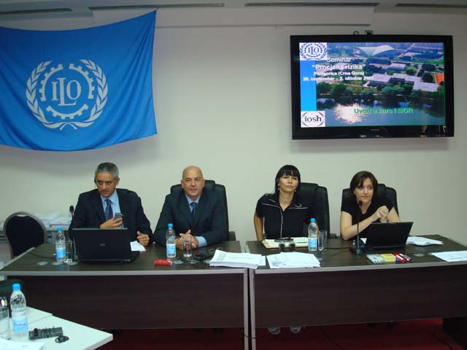
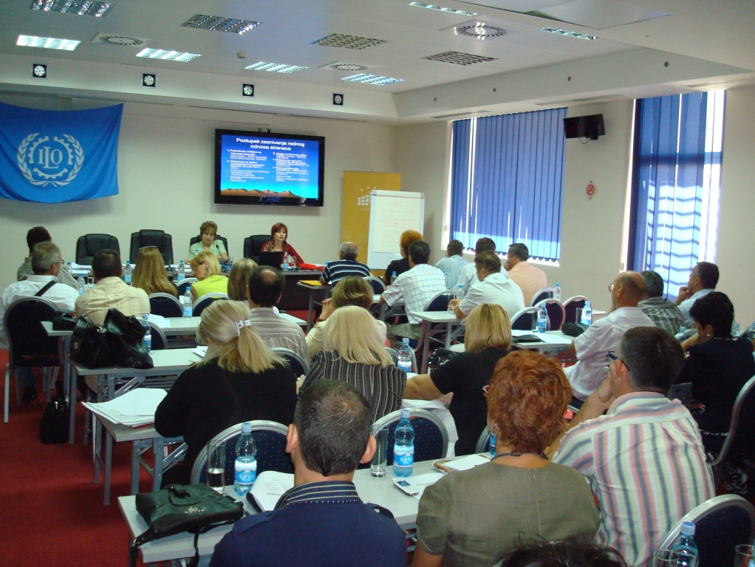
Chapter 19: Social Policy and Employment
What has been done in Montenegro?
Made a cooperation with:
ILO – International Labour Organization (audit of Labour Inspection, seminars, workshops related to labour relations risk assessment, efectiveness of Labour inspection, OSH Management in construction sector, Gender equaility ITC ILO Center in Turin, Italy..)
M O N T E N E G R O
Negotiating Team for the Accession of Montenegro to the European Union
Chapter 19: SOCIAL POLICY AND EMPLOYMENT

Slide 22
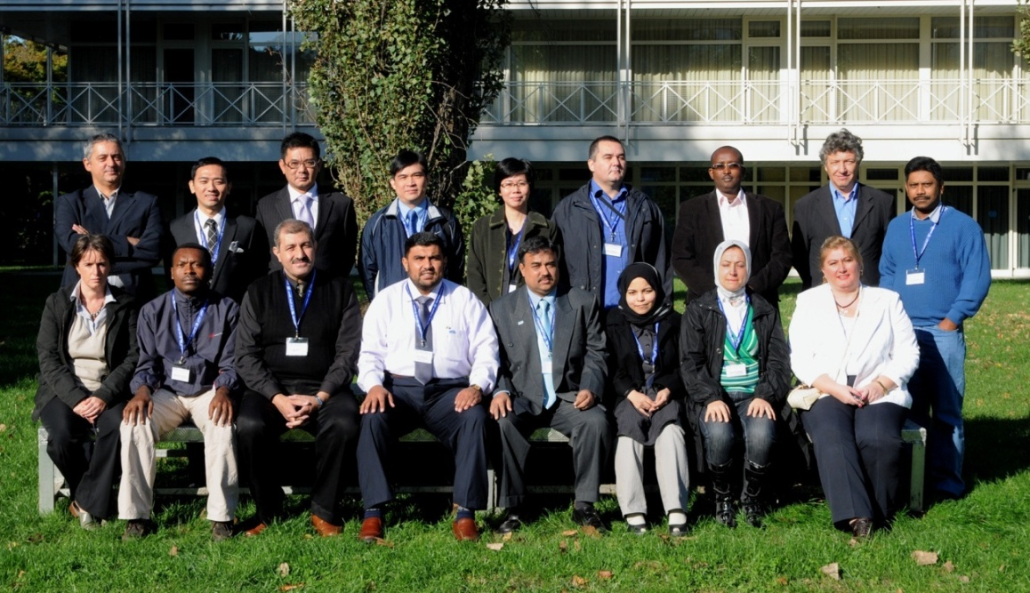
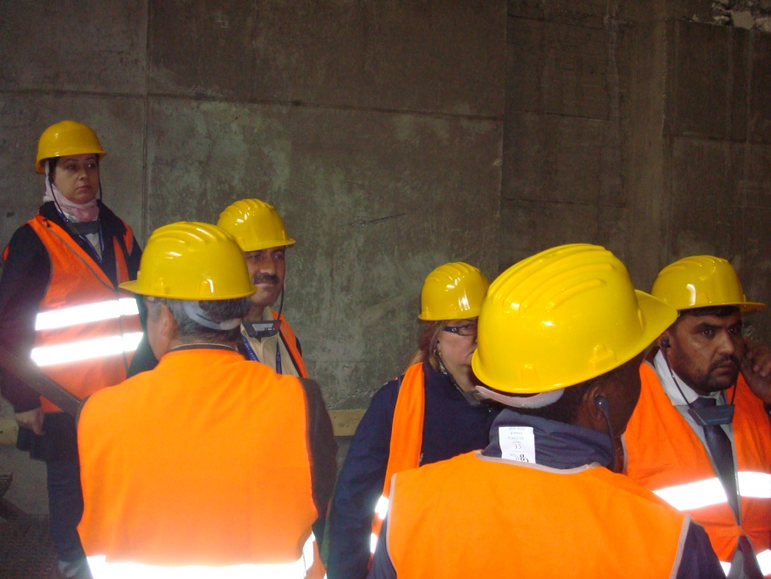
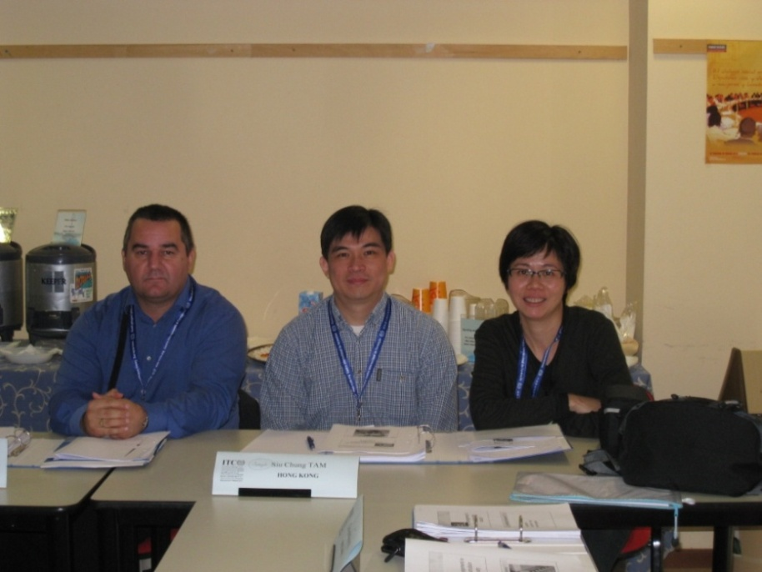
Chapter 19: Social Policy and Employment
M O N T E N E G R O
Negotiating Team for the Accession of Montenegro to the European Union
Chapter 19: SOCIAL POLICY AND EMPLOYMENT

Slide 23
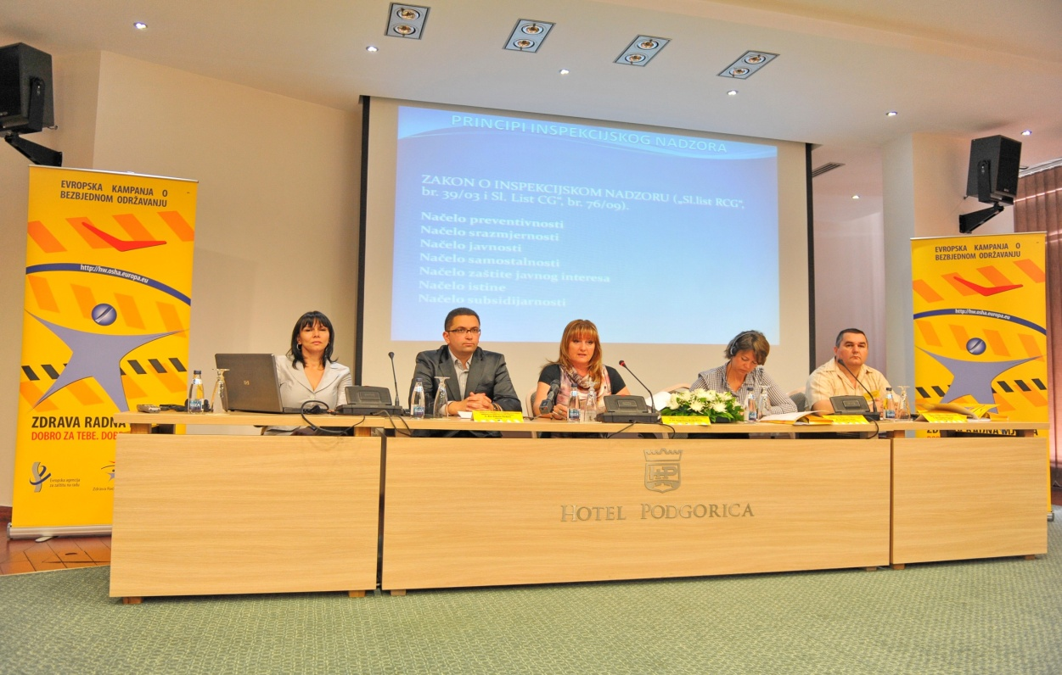
Chapter 19: Social Policy and Employment
2007 - EU-OSHA European Agency for Safety and Health at Work, Bilbao, Spain (Nominated Focal Point and Focal Point Manager for cooperation, translation of materials, printing of materials, organizing of seminars related to EU Campaigns, established OSH network, distribution of posters, flyers, NAPO DVD films, GPA on national level...)
2006 – GIP INTERNATIONAL France
M O N T E N E G R O
Negotiating Team for the Accession of Montenegro to the European Union
Chapter 19: SOCIAL POLICY AND EMPLOYMENT

Slide 24
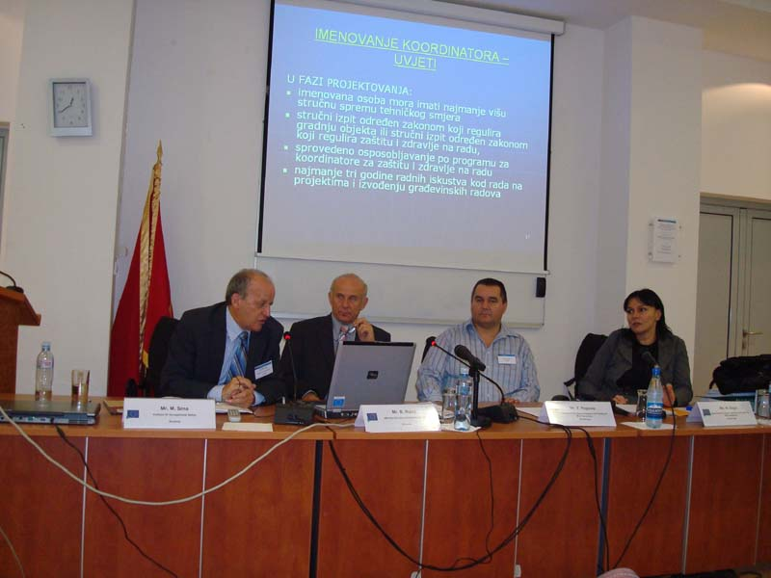
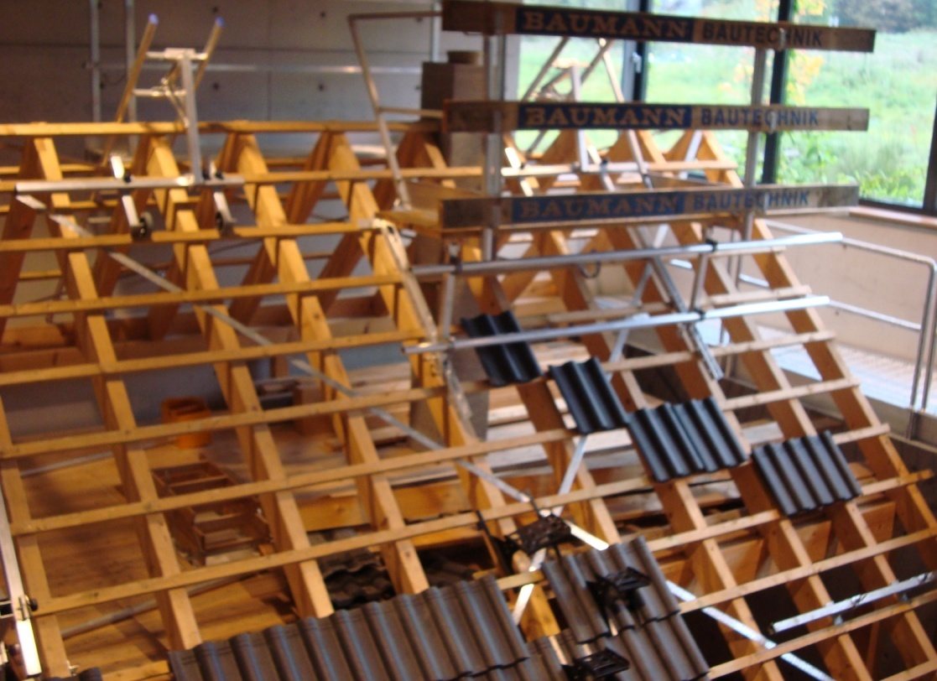
Chapter 19: Social Policy and Employment
2008 – TAIEX (INT MARKT 27237 - Workshop on education and training of Montenegro's inspectors engaged in the area of health and safety – October 2008, Podgorica (Montenegro), TAIEX Reference IND/STUD: 33111 - Study visit on implementation of safety and health measures on construction sites in EU countries – October 2009, Haan/Cologne (Germany). Hosting MS institution: BG BAU, Haan, INT MARKT 33110 - Workshop on New and Old Approach Directives EEC relating to personal protective equipment (PPE) – November 2010)
M O N T E N E G R O
Negotiating Team for the Accession of Montenegro to the European Union
Chapter 19: SOCIAL POLICY AND EMPLOYMENT

Slide 25
Chapter 19: Social Policy and Employment
IPA 2009 Project Fische - "Harmonization and implementation of regulation of Labour inspection and Safety at Work inspection in accordance with EU acquis"
Costs:
Overall cost (VAT excluded): 1.360.000 €
EU contribution: 1.180.000 €
Consist of:
Twinning
Service contract
2 Supply contract
Selection meeting was in March 2010
8 Project proposals: France, Austria-Slovakia, Germany, Finland, Netherland, Slovenia and Spain
M O N T E N E G R O
Negotiating Team for the Accession of Montenegro to the European Union
Chapter 19: SOCIAL POLICY AND EMPLOYMENT

Slide 26
Chapter 19: Social Policy and Employment
Twinning contract:
COMPONENT 1 „Assessment of institutional, administrative needs, capacities and recommendations“
COMPONENT 2 „Harmonization of legislation in the field of safety at work with EU acquis“
COMPONENT 3 „Activities related to Risk Assessment“
M O N T E N E G R O
Negotiating Team for the Accession of Montenegro to the European Union
Chapter 19: SOCIAL POLICY AND EMPLOYMENT

Slide 27
Chapter 19: Social Policy and Employment
Twinning contract:
COMPONENT 1 „Assessment of institutional, administrative needs, capacities and recommendations“
The Government of Montenegro adopted the conclusion no. 06-1333/3 of 21 June 2012. by which borrows Administration for Inspection that as soon as possible, plans to increase the number of labour inspectors in the field of safety at work, especially for the municipalities of Bar and Ulcinj, in accordance with the recommendation of the analytical report of the European Commission.
The Proposed Regulation on the internal organization of the Administration for Inspection Affairs prescribed places for three safety inspectors (inspectors working in the field of safety at work): Coordinator for the Safety at work, which would co-ordinate the work of inspectors in the entire territory of Montenegro, one inspector for the territory of Ulcinj and Bar and one inspector for the territory of Herceg Novi and Kotor.
Based on the forms used in Slovenia were made application forms, injuries at work, a short report on injury at work, as well as checklists that are given to inspectors safety for use. Have been carried out and a draft version of the brochure noise and young workers
Drafted a proposal Strategy Labour Inspectorates for Safety and Health at Work for the period 2013-2020.
M O N T E N E G R O
Negotiating Team for the Accession of Montenegro to the European Union
Chapter 19: SOCIAL POLICY AND EMPLOYMENT

Slide 28
Chapter 19: Social Policy and Employment
COMPONENT 2 „ Harmonization of legislation in the field of safety at work with EU acquis“
Draft versions of by-laws (regulations) are finished:
Regulation on use of the PPE;
Regulation on safety and health at work of pregnant employed women, who have recently given birth or are breastfeeding
Regulation on signs for safety and health at work
Regulation on safety and health at work on workplace
Regulation on safety and health at work on risk of the exposure of noise
Regulation on safety and health at work on risk of the exposure of vibration
Regulation on safety and health at work with the display screens
Regulation on safety and health at work with the work equipment
Regulation on safety and health at work on board fishing vessels
We realized the activities planned under the project of the EU, organized by the Ministry of Labour and Social Welfare, Administration for Inspection Activities - Department of Labour Inspection and the Chamber of Economy of Montenegro on 3 October 2012th The two held a seminar with the theme "Occupational Safety - EXPECTATIONS OF THE EUROPEAN UNION" and safety at work - regulation related to noise, vibration and working with the display screens as well as awareness-raising activities with over 60 participants - labour inspectors for safety at work, labour inspectors, professionals for safety at work in authorized organizations for safety at work and companies in Montenegro, managers, legal experts in the field of occupational health and representatives of the social partners in Montenegro. The subject of the seminar was to introduce labour inspectors for safety at work and other stakeholders with the EU legislation in the field of occupational safety, and health at work, inspection procedures and analysis of existing legislation on risk assessment in Montenegro. Speakers were experts from Slovenia which are twinning partners in project.
M O N T E N E G R O
Negotiating Team for the Accession of Montenegro to the European Union
Chapter 19: SOCIAL POLICY AND EMPLOYMENT

Slide 29
Chapter 19: Social Policy and Employment
The realization of the Component 3 relating to risk assessment in the workplace a team of experts from Slovenia, together with labour inspectors for safety at work from Montenegro is analyzed on the spot assessment of the risks specific to the workplace with a company in Montenegro.
Conducted workshops - training on the preparation of the risk assessment documents on the in terms of exposure to employees at risk of exposure to noise, vibration, lighting, microclimate and working with display screens, as well as the draft document on risk assessment for specific jobs with employers in different sectors
We realized the activities planned under the project of the EU, organized by the Ministry of Labour and Social Welfare, Administration for Inspection Activities - Department of Labour Inspection and the Chamber of Economy of Montenegro a seminar at which all stakeholders presented a draft version of regulations, experience and good practice of the Republic of Slovenia on the implementation plan these acts, as well as activities undertaken to raise public awareness of the EU, Slovenia and Montenegro
M O N T E N E G R O
Negotiating Team for the Accession of Montenegro to the European Union
Chapter 19: SOCIAL POLICY AND EMPLOYMENT

Slide 30
Chapter 19: Social Policy and Employment
31989L0654 (EUR-Lex: 05.20.20.10)
Council Directive 89/654/EEC of 30 November 1989 concerning the minimum safety and health requirements for the workplace (first individual directive within the meaning of Article 16 (1) of Directive 89/391/EEC)
(OJ L 393, 30.12.1989, p. 1)
Existing regulation:
Law on Safety at Work ("Official Gazette of the Republic of Montenegro", no. 79/04 i "Official Gazette of Montenegro", no. 26/10)
Regulation on special measures for safety at work for buildings designed for the working and auxiliary facilities ("Official Gazette of the Socialist Republic of Montenegro", no. 27/87)
Planned regulation:
Regulation on safety and health at work on workplace (draft finished)
M O N T E N E G R O
Negotiating Team for the Accession of Montenegro to the European Union
Chapter 19: SOCIAL POLICY AND EMPLOYMENT

Slide 31
Chapter 19: Social Policy and Employment
32009L0104 (EUR-Lex: 05.20.20.10)
Directive 2009/104/EC of the European Parliament and of the Council of 16 September 2009 concerning the minimum safety and health requirements for the use of work equipment by workers at work (second individual Directive within the meaning of Article 16(1) of Directive 89/391/EEC)
Existing regulation:
Law on Safety at Work ("Official Gazette of the Republic of Montenegro", no. 79/04 i "Official Gazette of Montenegro", no. 26/10)
Regulation on the measures and standards on health and safety for work equipment ("Official Gazette of SFRY", no. 18/91)
Planned regulation:
Regulation on safety and health at work with the work equipment (draft finished)
M O N T E N E G R O
Negotiating Team for the Accession of Montenegro to the European Union
Chapter 19: SOCIAL POLICY AND EMPLOYMENT

Slide 32
Chapter 19: Social Policy and Employment
31989L0656 (EUR-Lex: 05.20.20.10)
Council Directive 89/656/EEC of 30 November 1989 on the minimum health and safety requirements for the use by workers of personal protective equipment at the workplace (third individual directive within the meaning of Article 16 (1) of Directive 89/391/EEC)
(OJ L 393, 30.12.1989, p. 18)
Existing regulation:
Law on Safety at Work ("Official Gazette of the Republic of Montenegro", no. 79/04 i "Official Gazette of Montenegro", no. 26/10)
Regulation on the personal protective equipment ("Official Gazette of SFRY", no. 35/69)
Planned regulation:
Regulation on use of the PPE (draft finished)
M O N T E N E G R O
Negotiating Team for the Accession of Montenegro to the European Union
Chapter 19: SOCIAL POLICY AND EMPLOYMENT

Slide 33
Chapter 19: Social Policy and Employment
31992L0058 (EUR-Lex: 05.20.20.10)
Council Directive 92/58/EEC of 24 June 1992 on the minimum requirements for the provision of safety and/or health signs at work (ninth individual Directive within the meaning of Article 16 (1) of Directive 89/391/EEC)
(OJ L 245, 26.08.1992, p. 23)
Existing regulation:
Law on Safety at Work ("Official Gazette of R. Of Montenegro", no. 79/04 and "Official Gazette of Montenegro", no. 26/10)
Planned regulation:
Regulation on signs for safety and health at work (draft finished)
M O N T E N E G R O
Negotiating Team for the Accession of Montenegro to the European Union
Chapter 19: SOCIAL POLICY AND EMPLOYMENT

Slide 34
Chapter 19: Social Policy and Employment
32003H0134 (EUR-Lex: 05.20.20.10)
Council recommendation of 18 February 2003 concerning the improvement of the protection of the health and safety at work of self-employed workers
(OJ L 053, 28.02.2003, p. 45)
Existing regulation:
Law on Safety at Work ("Official Gazette of R. Of Montenegro", no. 79/04 and "Official Gazette of Montenegro", no. 26/10)
Planned regulation:
Law on Safety and Health at Work (draft finished)
M O N T E N E G R O
Negotiating Team for the Accession of Montenegro to the European Union
Chapter 19: SOCIAL POLICY AND EMPLOYMENT

Slide 35
Chapter 19: Social Policy and Employment
32003H0670 (EUR-Lex: 05.20.40 Social security)
Commission Recommendation of 19 September 2003 concerning the European schedule of occupational diseases (Text with EEA relevance) (notified under document number C(2003) 3297)
(OJ L 238, 25.09.2003, p. 28)
Existing regulation:
Law on Safety at Work ("Official Gazette of the Republic of Montenegro", no. 79/04 i "Official Gazette of Montenegro", no. 26/10)
Regulation on establish of professional diseases ("Official Gazette of R. Of Montenegro“, no. 66/04).
M O N T E N E G R O
Negotiating Team for the Accession of Montenegro to the European Union
Chapter 19: SOCIAL POLICY AND EMPLOYMENT

Slide 36
Chapter 19: Social Policy and Employment
31990L0269 (EUR-Lex: 05.20.20.10)
Council Directive 90/269/EEC of 29 May 1990 on the minimum health and safety requirements for the manual handling of loads where there is a risk particularly of back injury to workers (fourth individual Directive within the meaning of Article 16 (1) of Directive 89/391/EEC)
Existing regulation:
Law on Safety at Work ("Official Gazette of the Republic of Montenegro", no. 79/04 i "Official Gazette of Montenegro", no. 26/10)
Regulation on Safety in the loading and unloading ("Official Gazette of SRM", no. 13/88)
Planned regulation:
Regulation on safety and health at work on manual handling
M O N T E N E G R O
Negotiating Team for the Accession of Montenegro to the European Union
Chapter 19: SOCIAL POLICY AND EMPLOYMENT

Slide 37
Chapter 19: Social Policy and Employment
31990L0270 (EUR-Lex: 05.20.20.10)
Council Directive 90/270/EEC of 29 May 1990 on the minimum safety and health requirements for work with display screen equipment (fifth individual Directive within the meaning of Article 16 (1) of Directive 89/391/EEC)
(OJ L 156, 21.06.1990, p. 14)
Existing regulation:
Law on Safety at Work ("Official Gazette of the Republic of Montenegro", no. 79/04 i "Official Gazette of Montenegro", no. 26/10)
Planned regulation:
Regulation on safety and health at work with the display screens (draft finished)
M O N T E N E G R O
Negotiating Team for the Accession of Montenegro to the European Union
Chapter 19: SOCIAL POLICY AND EMPLOYMENT

Slide 38

Chapter 19: Social Policy and Employment
31992L0029 (EUR-Lex: 05.20.20.10)
Council Directive 92/29/EEC of 31 March 1992 on the minimum safety and health requirements for improved medical treatment on board vessels
(OJ L 113, 30.04.1992, p. 19)
Postojeća regulativa:
Article 50 of the draft Law on Maritime Safety is given a legal basis for the adoption of the regulation will be regulated conditions that must be met for a boat, equipment and devices in order to provide adequate medical treatment on board vessels, as well as equipment and required content of marine chemists (first aid box)
Planirana regulativa:
Law on Maritime Safety (draft finished)
It is anticipated that regulation, which will be fully implemented the Directive, been taken by the government body in charge of health in collaboration with the the government body in charge for labour
M O N T E N E G R O
Negotiating Team for the Accession of Montenegro to the European Union
Chapter 19: SOCIAL POLICY AND EMPLOYMENT

Slide 39
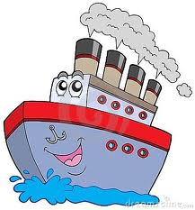
Chapter 19: Social Policy and Employment
31993L0103 (EUR-Lex: 05.20.20.10)
Council Directive 93/103/EC of 23 November 1993 concerning the minimum safety and health requirements for work on board fishing vessels (thirteenth individual Directive within the meaning of Article 16 (1) of Directive 89/391/EEC)
(OJ L 307, 13.12.1993, p. 1)
Existing regulation:
Law on Safety at Work ("Official Gazette of the Republic of Montenegro", no. 79/04 and "Official Gazette of Montenegro", no. 26/10)
The draft Law on Maritime Safety is given a legal basis for Technical rules for the ship, on which they would normally be determined by specific conditions to be met by fishing vessels, which will be fully implemented the Directive
Planned regulation:
Regulation on safety and health at work on board fishing vessels (draft finished)
M O N T E N E G R O
Negotiating Team for the Accession of Montenegro to the European Union
Chapter 19: SOCIAL POLICY AND EMPLOYMENT

Slide 40
Chapter 19: Social Policy and Employment
31992L0057 (EUR-Lex: 05.20.20.10)
Council Directive 92/57/EEC of 24 June 1992 on the implementation of minimum safety and health requirements at temporary or mobile construction sites (eighth individual Directive within the meaning of Article 16 (1) of Directive 89/391/EEC)
(OJ L 245, 26.08.1992, p. 6)
Existing regulation:
Law on Safety at Work ("Official Gazette of the Republic of Montenegro", no. 79/04 and "Official Gazette of Montenegro", no. 26/10)
Regulation on content of elaborate on planning at construction site ("Official Gazette of R. of Montenegro ", no. 4/99)
Regulation on special safety at work measures in construction sector ("Official Gazette of SFRY", no. 42/68 i 45/68)
Planned regulation:
Regulation on safety and health at work at temporary or mobile construction sites
M O N T E N E G R O
Negotiating Team for the Accession of Montenegro to the European Union
Chapter 19: SOCIAL POLICY AND EMPLOYMENT

Slide 41
Chapter 19: Social Policy and Employment
31992L0091 (EUR-Lex: 05.20.20.10)
Council Directive 92/91/EEC of 3 November 1992 concerning the minimum requirements for improving the safety and health protection of workers in the mineral-extracting industries through drilling (eleventh individual Directive within the meaning of Article 16 (1) of Directive 89/391/EEC)
(OJ L 348, 28.11.1992, p. 9)
31992L0104 (EUR-Lex: 05.20.20.10)
Council Directive 92/104/EEC of 3 December 1992 on the minimum requirements for improving the safety and health protection of workers in surface and underground mineral-extracting industries (twelfth individual Directive within the meaning of Article 16 (1) of Directive 89/391/EEC)
(OJ L 404, 31.12.1992, p. 10)
Existing regulation:
Law on Safety at Work ("Official Gazette of the Republic of Montenegro", no. 79/04 and "Official Gazette of Montenegro", no. 26/10)
Mining Law ("Official Gazette of Montenegro”, no. 65/08 74/10 40/11 )
The Law of Explosive Materials ("Official Gazette of Montenegro”, no. 49/08 58/08 40/11 )
Regulations on safety measures in handling explosives and blasting in mining ("Official Gazette of R. of Montenegro", no. 9/68 and 35/72)
Regulation on special measures for safety at work in making explosives and gunpowder, handling explosives and gunpowder ("Official Gazette of SFRY", no. 55/69)
Regulation on hygienic and technical safety measures when working in the quarries and brickyards, and the extraction of clay, sand and gravel ("Official Gazette of SFRY", no. 69/48)
Internal regulations of the employer (the statute, regulations, decisions) in mining companies-concessionaires have signed a concession agreement with the right to detailed geological exploration and exploitation of metallic and nonmetallic mineral resources
Planned regulation:
Regulation on safety and health at work in the mineral-extracting industries
M O N T E N E G R O
Negotiating Team for the Accession of Montenegro to the European Union
Chapter 19: SOCIAL POLICY AND EMPLOYMENT

Slide 42
Chapter 19: Social Policy and Employment
32004L0037 (EUR-Lex: 05.20.20.10)
Directive 2004/37/EC of the European Parliament and of the Council of 29 April 2004 on the protection of workers from the risks related to exposure to carcinogens or mutagens at work (Sixth individual Directive within the meaning of Article 16(1) of Council Directive 89/391/EEC) (codified version) (Text with EEA relevance)
(OJ L 158, 30.04.2004, p. 50)
Existing regulation:
Law on Safety at Work ("Official Gazette of the Republic of Montenegro", no. 79/04 and "Official Gazette of Montenegro", no. 26/10)
Law on Health Insurance ("Official Gazette of Montenegro", no. 39/04 and "Official Gazette of Montenegro", no. 14/2012)
Regulation on the content of specific measures of health care employees ("Official Gazette of Montenegro", no. 44/2006)
Regulations on the procedure for preliminary and periodic medical examinations of workers specialized ("Official Gazette of Montenegro", no. 25/80)
Planned regulation:
Regulation on safety and health at work on risks of exposure of carcinogens or mutagens substances
M O N T E N E G R O
Negotiating Team for the Accession of Montenegro to the European Union
Chapter 19: SOCIAL POLICY AND EMPLOYMENT

Slide 43
Chapter 19: Social Policy and Employment
32009L0148 (EUR-Lex: 05.20.20.10)
Directive 2009/148/EC of the European Parliament and of the Council of 30 November 2009 on the protection of workers from the risks related to exposure to asbestos at work
(OJ L 330, 16.12.2009, p. 28)
31998Y0507(01) (EUR-Lex: 05.20.20.10)
Council Conclusions of 7 April 1998 on the protection of workers against the risks from exposure to asbestos
(OJ C 142, 07.05.1998, p. 1)
Existing regulation:
Law on Safety at Work ("Official Gazette of the Republic of Montenegro", no. 79/04 and "Official Gazette of Montenegro", no. 26/10)
Law on Ratification of CO. 162 on safety use of asbestos, 1989
Law on Health Insurance ("Official Gazette of Montenegro", no. 39/04 and "Official Gazette of Montenegro", no. 14/2012)
Regulation on the content of specific measures of health care employees ("Official Gazette of Montenegro", no. 44/2006)
Regulations on the procedure for preliminary and periodic medical examinations of workers specialized ("Official Gazette of Montenegro", no. 25/80)
Planned regulation:
Regulation on safety and health at work on risks of exposure of asbestos
M O N T E N E G R O
Negotiating Team for the Accession of Montenegro to the European Union
Chapter 19: SOCIAL POLICY AND EMPLOYMENT

Slide 44
Chapter 19: Social Policy and Employment
31992L0085 (EUR-Lex: 05.20.20.10)
Council Directive 92/85/EEC of 19 October 1992 on the introduction of measures to encourage improvements in the safety and health at work of pregnant workers and workers who have recently given birth or are breastfeeding (tenth individual Directive within the meaning of Article 16 (1) of Directive 89/391/EEC)
(OJ L 348, 28.11.1992, p. 1)
Existing regulation:
Labour Law ("Official Gazette of the Republic of Montenegro", br. 49/08 i " Official Gazette of Montenegro ", br. 26/09 i 59/11)
Law on Safety at Work ("Official Gazette of the Republic of Montenegro", no. 79/04 and "Official Gazette of Montenegro", no. 26/10)
Law on Health Insurance ("Official Gazette of Montenegro", no. 39/04 and "Official Gazette of Montenegro", no. 14/2012)
Regulation on way and procedure for risk assessment ("Official Gazette of Montenegro", no. 43/07)
Regulation on the content of specific measures of health care employees ("Official Gazette of Montenegro", no. 44/2006)
Planned regulation:
Regulation on safety and health at work on of pregnant workers and workers who have recently given birth or are breastfeeding (draft finished)
M O N T E N E G R O
Negotiating Team for the Accession of Montenegro to the European Union
Chapter 19: SOCIAL POLICY AND EMPLOYMENT

Slide 45
Chapter 19: Social Policy and Employment
31991L0322 (EUR-Lex: 05.20.20.10)
Commission Directive 91/322/EEC of 29 May 1991 on establishing indicative limit values by implementing Council Directive 80/1107/EEC on the protection of workers from the risks related to exposure to chemical, physical and biological agents at work
(OJ L 177, 05.07.1991, p. 22)
31998L0024 (EUR-Lex: 05.20.20.10)
Council Directive 98/24/EC of 7 April 1998 on the protection of the health and safety of workers from the risks related to chemical agents at work (fourteenth individual Directive within the meaning of Article 16(1) of Directive 89/391/EEC)
(OJ L 131, 05.05.1998, p. 11)
32000L0039 (EUR-Lex: 05.20.20.10)
Commission Directive 2000/39/EC of 8 June 2000 establishing a first list of indicative occupational exposure limit values in implementation of Council Directive 98/24/EC on the protection of the health and safety of workers from the risks related to chemical agents at work (Text with EEA relevance)
(OJ L 142, 16.06.2000, p. 47)
32006L0015 (EUR-Lex: 05.20.20.10)
Commission Directive 2006/15/EC of 7 February 2006 establishing a second list of indicative occupational exposure limit values in implementation of Council Directive 98/24/EC and amending Directives 91/322/EEC and 2000/39/EC
(OJ L 38, 9.2.2006, p. 36)
32009L0161 (EUR-Lex: 05.20.20.10)
Commission Directive 2009/161/EU of 17 December 2009 establishing a third list of indicative occupational exposure limit values in implementation of Council Directive 98/24/EC and amending Commission Directive 2000/39/EC
(OJ L 338, 19.12.2009, p. 87)
32000L0054 (EUR-Lex: 05.20.20.10)
Directive 2000/54/EC of the European Parliament and of the Council of 18 September 2000 on the protection of workers from risks related to exposure to biological agents at work (seventh individual directive within the meaning of Article 16(1) of Directive 89/391/EEC)
(OJ L 262, 17.10.2000, p. 21)
M O N T E N E G R O
Negotiating Team for the Accession of Montenegro to the European Union
Chapter 19: SOCIAL POLICY AND EMPLOYMENT

Slide 46
Chapter 19: Social Policy and Employment
Existing regulation:
Law on Safety at Work ("Official Gazette of the Republic of Montenegro", no. 79/04 and "Official Gazette of Montenegro", no. 26/10)
Regulation on way and procedure for risk assessment ("Official Gazette of Montenegro", no. 43/07)
Regulation of procedure and timetable for periodic inspection and testing of work equipment and personal protection equipment and working conditions ("Official Gazette of the Republic of Montenegro", no. 71/05)
Law on Health Insurance ("Official Gazette of Montenegro", no. 39/04 and "Official Gazette of Montenegro", no. 14/2012)
Regulation on the content of specific measures of health care employees ("Official Gazette of Montenegro", no. 44/2006)
Regulations on the procedure for preliminary and periodic medical examinations of workers specialized ("Official Gazette of Montenegro", no. 25/80)
Planned regulation:
Regulation on safety and health at work on risks of exposure of chemical, physical and biological agents at work
M O N T E N E G R O
Negotiating Team for the Accession of Montenegro to the European Union
Chapter 19: SOCIAL POLICY AND EMPLOYMENT

Slide 47
Chapter 19: Social Policy and Employment
32002L0044 (EUR-Lex: 05.20.30.20)
Directive 2002/44/EC of the European Parliament and of the Council of 25 June 2002 on the minimum health and safety requirements regarding the exposure of workers to the risks arising from physical agents (vibration) (sixteenth individual Directive within the meaning of Article 16(1) of Directive 89/391/EEC) – Joint Statement by the European Parliament and the Council (OJ L 177, 06.07.2002, p. 13)
Existing regulation:
Law on Safety at Work ("Official Gazette of the Republic of Montenegro", no. 79/04 and "Official Gazette of Montenegro", no. 26/10)
Regulation on way and procedure for risk assessment ("Official Gazette of Montenegro", no. 43/07)
Regulation of procedure and timetable for periodic inspection and testing of work equipment and personal protection equipment and working conditions ("Official Gazette of the Republic of Montenegro", no. 71/05)
Law on Health Insurance ("Official Gazette of Montenegro", no. 39/04 and "Official Gazette of Montenegro", no. 14/2012)
Regulation on the content of specific measures of health care employees ("Official Gazette of Montenegro", no. 44/2006)
Regulations on the procedure for preliminary and periodic medical examinations of workers specialized ("Official Gazette of Montenegro", no. 25/80)
Planned regulation:
Regulation on safety and health at work on risks of exposure of vibration (draft finished)
M O N T E N E G R O
Negotiating Team for the Accession of Montenegro to the European Union
Chapter 19: SOCIAL POLICY AND EMPLOYMENT

Slide 48
Chapter 19: Social Policy and Employment
32003L0010 (EUR-Lex: 05.20.20.10)
Directive 2003/10/EC of the European Parliament and of the Council of 6 February 2003 on the minimum health and safety requirements regarding the exposure of workers to the risks arising from physical agents (noise) (Seventeenth individual Directive within the meaning of Article 16(1) of Directive 89/391/EEC) (OJ L 042, 15.02.2003, p. 38)
Postojeća regulativa:
Law on Safety at Work ("Official Gazette of the Republic of Montenegro", no. 79/04 and "Official Gazette of Montenegro", no. 26/10)
Regulation on way and procedure for risk assessment ("Official Gazette of Montenegro", no. 43/07)
Regulation of procedure and timetable for periodic inspection and testing of work equipment and personal protection equipment and working conditions ("Official Gazette of the Republic of Montenegro", no. 71/05)
Regulation on the measures and safety standards of the noise in the working environment ("Official Gazette of SFRY", no. 21/92)
Law on Health Insurance ("Official Gazette of Montenegro", no. 39/04 and "Official Gazette of Montenegro", no. 14/2012)
Regulation on the content of specific measures of health care employees ("Official Gazette of Montenegro", no. 44/2006)
Regulations on the procedure for preliminary and periodic medical examinations of workers specialized ("Official Gazette of Montenegro", no. 25/80)
Planned regulation:
Regulation on safety and health at work on risks of exposure of noise (draft finished)
M O N T E N E G R O
Negotiating Team for the Accession of Montenegro to the European Union
Chapter 19: SOCIAL POLICY AND EMPLOYMENT

Slide 49
Chapter 19: Social Policy and Employment
32004L0040 (EUR-Lex: 05.20.30.20)
Directive 2004/40/EC of the European Parliament and of the Council of 29 April 2004 on the minimum health and safety requirements regarding the exposure of workers to the risks arising from physical agents (electromagnetic fields) (18th individual Directive within the meaning of Article 16(1) of Directive 89/391/EEC) (OJ L 159, 30.04.2004, p. 1)
32006L0025 (EUR-Lex: 05.20.30.20
Directive 2006/25/EC of the European Parliament and of the Council of 5 April 2006 on the minimum health and safety requirements regarding the exposure of workers to risks arising from physical agents (artificial optical radiation) (OJ L 114, 27.4.2006, p. 38)
Existing regulation:
Law on Safety at Work ("Official Gazette of the Republic of Montenegro", no. 79/04 and "Official Gazette of Montenegro", no. 26/10)
Regulation on way and procedure for risk assessment ("Official Gazette of Montenegro", no. 43/07)
the part related to protection from ionising radiation is transposed in the Law on Ionising Radiation Protection and Radiation Safety (“OG of MNE”, 56/09, 58/09) and its bylows (17). Amendments to the Law on Ionising Radiation Protection and Radiation Safety in accordance with 89/391 and new directives from Energy Chapter (proposals) is planned to be developed and adopted after the adoption of new BSS Directive which will repeal 5 acting directives and 1 reccomendation
the part related to protection from non-ionising radiation is partly transposed in the Proposal of the Law on Non-Ionising Radiation Protection, which has been approved by the Government of Montenegro on its sesssion on 8 February 2013 and sent to Parliament procedure for final adoption. The full transposition is espected to be done by developing of rulebooks (18) on the basis on the Law on Non-Ionising Radiation Protection (Proposal) by 2015;
M O N T E N E G R O
Negotiating Team for the Accession of Montenegro to the European Union
Chapter 19: SOCIAL POLICY AND EMPLOYMENT

Slide 50
Chapter 19: Social Policy and Employment
Regulation of procedure and timetable for periodic inspection and testing of work equipment and personal protection equipment and working conditions ("Official Gazette of the Republic of Montenegro", no. 71/05)
Law on Health Insurance ("Official Gazette of Montenegro", no. 39/04 and "Official Gazette of Montenegro", no. 14/2012)
Regulation on the content of specific measures of health care employees ("Official Gazette of Montenegro", no. 44/2006)
Regulations on the procedure for preliminary and periodic medical examinations of workers specialized ("Official Gazette of Montenegro", no. 25/80)
Planned regulation:
Law on Ionising Radiation Protection and Radiation Safety ("Official Gazette of Montenegro", 56/09, 58/09) and its bylaws (17)
Proposal of the Law on Non-Ionising Radiation Protection (draft finished) and its rulebooks (18)
M O N T E N E G R O
Negotiating Team for the Accession of Montenegro to the European Union
Chapter 19: SOCIAL POLICY AND EMPLOYMENT

Slide 51
Chapter 19: Social Policy and Employment
31999L0092 (EUR-Lex: 05.20.20.10)
Directive 1999/92/EC of the European Parliament and of the Council of 16 December 1999 on minimum requirements for improving the safety and health protection of workers potentially at risk from explosive atmospheres (15th individual Directive within the meaning of Article 16(1) of Directive 89/391/EEC)(OJ L 023, 28.01.2000, p. 57)
Existing regulation:
Law on Safety at Work ("Official Gazette of the Republic of Montenegro", no. 79/04 and "Official Gazette of Montenegro", no. 26/10)
Law on Protection and Rescue ("Official Gazette of Montenegro", no. 13/07 and "Official Gazette of Montenegro", no. 5/08)
Regulation on way and procedure for risk assessment ("Official Gazette of Montenegro", no. 43/07)
Regulation of procedure and timetable for periodic inspection and testing of work equipment and personal protection equipment and working conditions ("Official Gazette of the Republic of Montenegro", no. 71/05)
Regulation on the measures and safety standards of the noise in the working environment ("Official Gazette of SFRY", no. 21/92)
Law on Health Insurance ("Official Gazette of Montenegro", no. 39/04 and "Official Gazette of Montenegro", no. 14/2012)
Regulation on the content of specific measures of health care employees ("Official Gazette of Montenegro", no. 44/2006)
Regulation on the procedure for preliminary and periodic medical examinations of workers specialized ("Official Gazette of Montenegro", no. 25/80)
Planirana regulativa:
Regulation on safety and health at work on exposure of explosive atmospheres
M O N T E N E G R O
Negotiating Team for the Accession of Montenegro to the European Union
Chapter 19: SOCIAL POLICY AND EMPLOYMENT

Slide 52
Chapter 19: Social Policy and Employment
Council Directive 2010/32/EU of 10 May 2010 implementing the Framework Agreement on prevention from sharp injuries in the hospital and healthcare sector concluded by HOSPEEM and EPSU
Existing regulation:
Law on Safety at Work ("Official Gazette of the Republic of Montenegro", no. 79/04 and "Official Gazette of Montenegro", no. 26/10)
Regulation on way and procedure for risk assessment ("Official Gazette of Montenegro", no. 43/07)
Regulation of procedure and timetable for periodic inspection and testing of work equipment and personal protection equipment and working conditions ("Official Gazette of the Republic of Montenegro", no. 71/05)
Regulation on the measures and safety standards of the noise in the working environment ("Official Gazette of SFRY", no. 21/92)
Law on Health Insurance ("Official Gazette of Montenegro", no. 39/04 and "Official Gazette of Montenegro", no. 14/2012)
Regulation on the content of specific measures of health care employees ("Official Gazette of Montenegro", no. 44/2006)
Regulation on the procedure for preliminary and periodic medical examinations of workers specialized ("Official Gazette of Montenegro", no. 25/80)
M O N T E N E G R O
Negotiating Team for the Accession of Montenegro to the European Union
Chapter 19: SOCIAL POLICY AND EMPLOYMENT

Slide 53
Chapter 19: Social Policy and Employment
Regulation on Data Collections in health care ("Official Gazette of Montenegro", br.80/2008 and Official Gazette of Montenegro ", no. 40/2011)
Regulation of specific health data registers include diseases of major socio-medical importance, infectious diseases and other conditions related to public health ("Official Gazette of Montenegro", no. 24/2012)
Regulation of the formation and sending reports on the established disease or condition for which registers are kept ("Official Gazette of Montenegro", no. 24/2012)
Regulatin on how to fill in, submission deadlines and application forms of the disease as determined by the Register ("Official Gazette of Montenegro", no. 24/2012)
Regulation on detailed content, form and manner of keeping registers of diseases of major importance of social-medical, infectious diseases and other conditions related to public health (" Official Gazette of Montenegro", no. 24/2012)
Law on Emergency Medical Services ("Official Gazette of Montenegro", no. 49/2008)
Law on Provision of blood ("Official Gazette of Montenegro", no. 11/2007)
Planned legislation:
The Ministry of Health in collaboration with the Ministry of Labour and Social Welfare will transpose this directive into national legislation
M O N T E N E G R O
Negotiating Team for the Accession of Montenegro to the European Union
Chapter 19: SOCIAL POLICY AND EMPLOYMENT

Slide 54
Chapter 19: Social Policy and Employment
INSTITTIONAL FRAMEWORK
MINISTRY OF LABOUR AND SOCIAL WELFARE
Ministry of Labour and Social Welfare carries out the tasks related to, among other things, and the Occupational Safety and Health
M O N T E N E G R O
Negotiating Team for the Accession of Montenegro to the European Union
Chapter 19: SOCIAL POLICY AND EMPLOYMENT

Slide 55
Chapter 19: Social Policy and Employment
ADMINISTRATION FOR INSPECTION AFFAIRS
Administration for Inspection Affairs - Department of Labour Inspection, which has 15 offices throughout Montenegro and operates within the Sector of Public Procurement, gambling and protection of markets and economics
There are 35 inspectors: 1 Chief Labour Inspector, 1 Labour inspector - Coordinator for Labour relations, 1 Labour inspector for ​​Safety at Work - Coordinator for for ​​Safety at Work , 24 Labour inspectors (lawyers - supervising labour relations) and 8 Labour inspectors for ​​Safety at Work (different professions engineers - supervising safety at work)
Administration for Inspection Affairs has other inspections which supervise some parts of safety at work in certain sectors: Department of Health and Sanitary inspection, Department for Trade Market inspection, Department of mining, geological and inspected for hydrocarbons, Department of thermo Inspection, Department of thermo-inspection, Department of fisheries inspection
The Port Authority oversees the safety of navigation, the Administrative Inspection supervise the state administration, Environmental Protection Agency issues various licences...
M O N T E N E G R O
Negotiating Team for the Accession of Montenegro to the European Union
Chapter 19: SOCIAL POLICY AND EMPLOYMENT

Slide 56
Chapter 19: Social Policy and Employment
INSTITUTIONAL FRAMEWORK
Ministry of Health
Department of Emergency
Department of Blood Transfusion
Health care facilities (health centers, hospitals, Clinical Centre of Montenegro, Institute of Public Health, wholesalers)
Ministry of Economy
Ministry of Sustainable Development and Tourism
Ministry of Shipping and Transport
The Ministry responsible for environmental protection is competent for supervision of the Law on Ionising Radiation Protection and Radiation Safety (“Official Gazette of Montenegro” no. 56/09, 58/09)
Ministry of Internal Affairs is responsible for emergency cases
M O N T E N E G R O
Negotiating Team for the Accession of Montenegro to the European Union
Chapter 19: SOCIAL POLICY AND EMPLOYMENT

Slide 57
Thank you for your attention.
QUESTIONS

