Slide 1

Control of cross-border transfer of cash
M O N T E N E G R O
Negotiating Team for the Accession of Montenegro to the European Union
Working Group for Chapter 29 – Customs union
Bilateral screening: Chapter 29
PRESENTATION OF MONTENEGRO
Brussels, May 2013

Slide 2
Legal framework for control of transborder transfer of cash
CUSTOMS UNION
Chapter 29:
Law on Foreign Current and Capital Operations Official Gazette 45/2005, 62/2008; 73/2010; 40/2011,
Law on prevention of money laundering and terrorism financing, Official Gazette 14/2012,
Decision on the amount of cash that can brought in or out of Montenegro without declaring Official Gazette 38/2010,
Customs Service Law, OG 2/2002, 29/2005
Rulebook on keeping records of conducted controls of physical entry and exit of means of payment across the state border, Official Gazette 35/2011,
Rulebook on method for providing data on transfer of money to the Administration for the prevention of money laundering and terrorism financing, Official Gazette 79/2008,
Cooperation agreement between the Customs Administration and APMLFT.
M O N T E N E G R O
Negotiating Team for the Accession of Montenegro to the European Union
Chapter 29:
Customs union

Slide 3
Obligation of reporting
(Law on Foreign Current and Capital Operations, Article 10)
CUSTOMS UNION
Chapter 29:
Residents and non-residents are obliged to declare physical import or export of means of payment at the point of entry or exit to or out of Montenegro;
The declaration on transfer of the means of payment across the state border shall be submitted to the Customs Administration at the border crossing point;
The Central Bank shall prescribe the amount of cash which can be brought in and out of Montenegro without declaring;
Control of physical import or export of means of payment shall be conducted by the Customs Administration
-;
M O N T E N E G R O
Negotiating Team for the Accession of Montenegro to the European Union
Chapter 29:
Customs union

Slide 4
Decision on the amount of cash that can brought in or out of Montenegro without declaring, OG 38/2010
CUSTOMS UNION
Chapter 29:
Article 1
A resident/non-resident may physically bring into or take out of Montenegro cash in euro and/or currency other than euro in the total amount or the counter value of the amount of EUR 10,000 without reporting the amount to the administrative authority in charge of customs affairs.
Notice of how to apply physical import and export of means of payment is set in a prominent place at border crossings.
M O N T E N E G R O
Negotiating Team for the Accession of Montenegro to the European Union
Chapter 29:
Customs union

Slide 5
Customs administration Central Bank of Montenegro
CUSTOMS UNION
Chapter 29:
Rulebook on keeping records of conducted controls of physical entry and exit of means of payment across the state border, Official Gazette 35/2011
Article 2:
Means of payment, in the sense of this Rulebook are:
- Cash (bank notes and coins) which are in circulation as means of payment;
Payment instruments (including checks, bills of exchange and orders for money transfers), as bearer negotiable instruments, endorsed without restriction, written in the name of a fictitious client or in another form and incomplete instruments (checks, bills of exchange and orders for money transfers) that have been signed, without specifying the names of clients
Records on conducted control of physical entry and exit of means of payment is done in the reporting form, making the integral part to this Rulebook. One copy of the Report is submitted by the customs administration to the Central Bank of Montenegro.
M O N T E N E G R O
Negotiating Team for the Accession of Montenegro to the European Union
Chapter 29:
Customs union

Slide 6
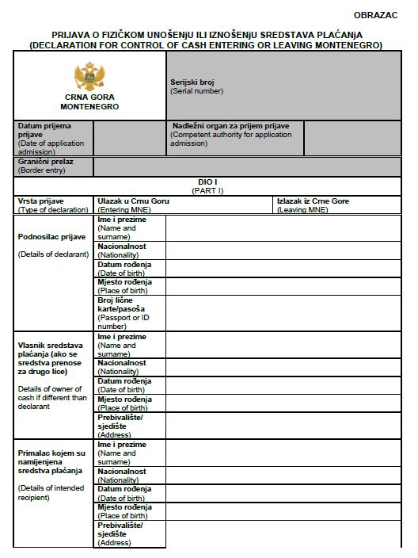
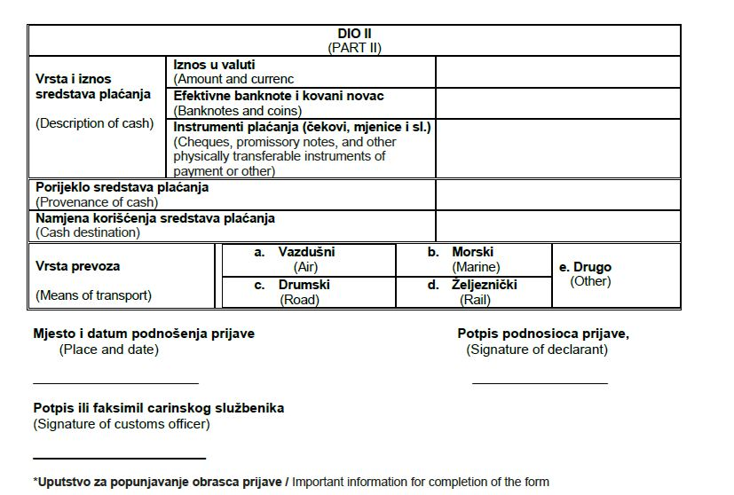
CUSTOMS UNION
Chapter 29:
M O N T E N E G R O
Negotiating Team for the Accession of Montenegro to the European Union
Chapter 29:
Customs union

Slide 7
The administration body competent for custom affairs shall provide data or enable electronic access, to the competent administration body, on each money, check, bearer securities, precious metals and precious stones transport across the state border, exceeding value or amount of EUR 10.000 or more, within 3 days from the date of transporting.
The customs administration shall provide data to the competent administration body on transportation even in value or amount lower than EUR 10,000, if in accordance with such person there are reasons for suspicion of money laundering or terrorist financing.
CUSTOMS UNION
Chapter 29:
Customs Administration APMLFT
Law on prevention of money laundering and terrorism financing, OG 14/2012 Article 66
M O N T E N E G R O
Negotiating Team for the Accession of Montenegro to the European Union
Chapter 29:
Customs union

Slide 8
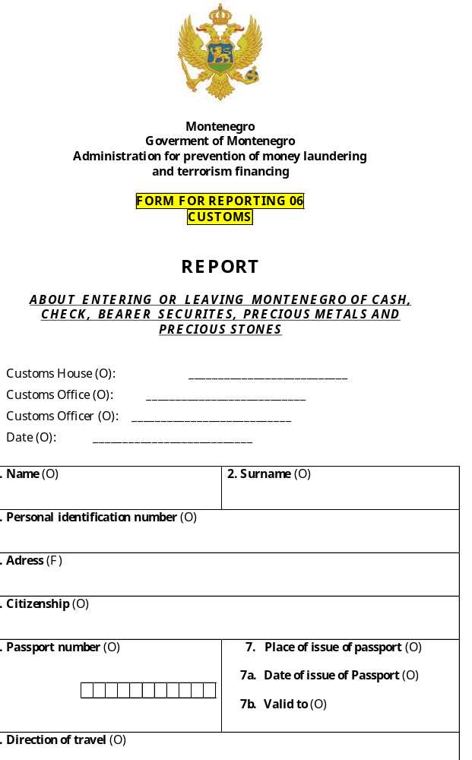
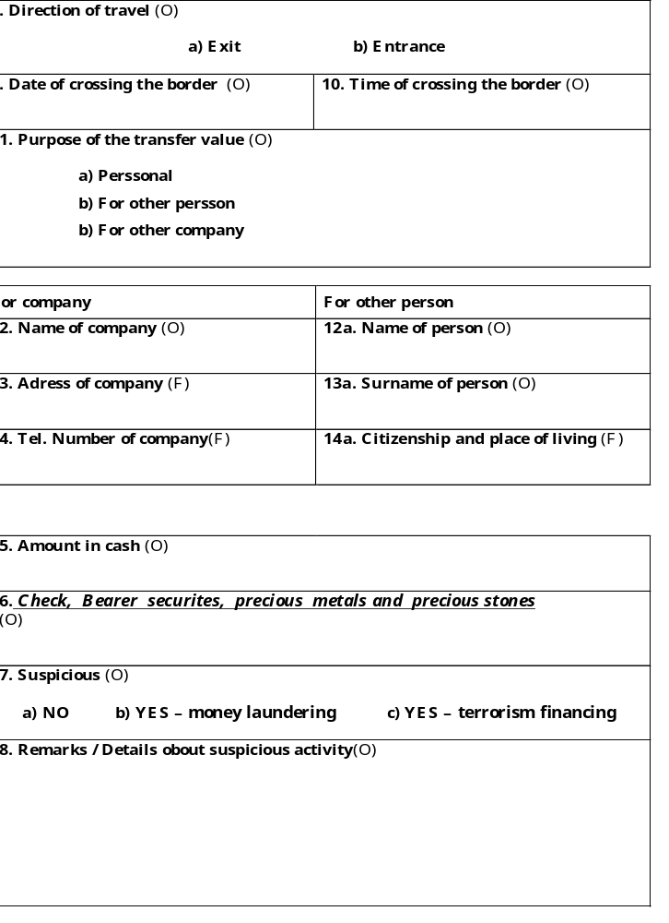
CUSTOMS UNION
Chapter 29:
Customs Officer
M O N T E N E G R O
Negotiating Team for the Accession of Montenegro to the European Union
Chapter 29:
Customs union

Slide 9
Consequences of non-declaring transfer of cash in the amount above the legally prescribed amount
CUSTOMS UNION
Chapter 29:
Law on Foreign Current and Capital Operations Official Gazette 45/2005, 62/2008; 73/2010; 40/2011, Article 15:
A pecuniary fine in the amount of EUR 2,500.00 to EUR 16,500.00 shall be imposed on a legal entity who fail to declare physical import or export of the means of payment
A pecuniary fine in the amount of EUR 550.00 to EUR 2,000.00 shall be imposed on a responsible person in the legal entity and natural person who fail to declare physical import or export of the means of payment
A pecuniary fine in the amount of EUR 300.00 to EUR 6,000.00 shall be imposed on an entrepreneur who fail to declare physical import or export of the means of payment
M O N T E N E G R O
Negotiating Team for the Accession of Montenegro to the European Union
Chapter 29:
Customs union

Slide 10
Elements of customs control
Law on Customs Service, OG 2/2002, 29/2005 Articles 5 - 35
CUSTOMS UNION
Chapter 29:
Customs are conducting control and search of vehicles at whole customs territory.
Customs are controlling and searching passengers in passenger traffic as well as baggage an other items carried by the passengers.
Customs are filing misdemeanour report or initiates misdemeanour procedure.
Customs are evidencing declaration on transfer of cash and forwards the information to the APMLFT and Central Bank of Montenegro
2012 Statistical data
Declared at entry | Declared at exit | Report on suspicious transaction | Feedback | Misdemeanour of non-declaring currency
173 | 224 | 5 | 3 | 3
M O N T E N E G R O
Negotiating Team for the Accession of Montenegro to the European Union
Chapter 29:
Customs union

Slide 11
THANK YOU FOR YOUR ATTENTION !
QUESTIONS milan.radulovic@uspnft.gov.me
CUSTOMS UNION
Chapter 29:
M O N T E N E G R O
Negotiating Team for the Accession of Montenegro to the European Union
Chapter 29:
Customs union

