Slide 1

M O N T E N E G R O
Negotiating Team for the Accession of Montenegro to the European Union
Working Group for Chapter 29 – Customs union
Bilateral screening: Chapter 29
PRESENTATION OF MONTENEGRO
Electronic Customs
Brussels, June 2013

Slide 2
ELECTRONIC CUSTOMS
Chapter 29:
Content
E-Customs service of Montenegro: definition and vision
Objectives
Approach and Projects
Gaps(*)
M O N T E N E G R O
Negotiating Team for the Accession of Montenegro to the European Union
Chapter 29:
Customs union

Slide 3
ELECTRONIC CUSTOMS
Chapter 29:
Definition
Definition
  Customs Law – ME Official gazette 7/2002, 38/2002, 72/2002, 21/2003, 29/2005, 66/2006 and 21/2008 –
  ( article 65 )
  Business Strategy
  IT Strategy
M O N T E N E G R O
Negotiating Team for the Accession of Montenegro to the European Union
Chapter 29:
Customs union

Slide 4
ELECTRONIC CUSTOMS
Chapter 29:
Vision
Vision
  Business Strategy 2013-2015
  (Customs administration of Montenegro)
  IT Strategy till 2020
  (Customs administration of Montenegro)
  Strategy for development of information society 2012-2016 (Ministry of information society and telecommunication)
  Strategy for implementation of disaster recovery 2010-2013
  (Ministry of information society and telecommunication)
  Law for electronic signature – ME Official gazette (41/2010)
  Regulations in 2010 on:
    procedures for issuing certificates
    keeping records and registry certification service provider
    protection of certificates
M O N T E N E G R O
Negotiating Team for the Accession of Montenegro to the European Union
Chapter 29:
Customs union

Slide 5
ELECTRONIC CUSTOMS
Chapter 29:
Objectives
Facilitating and speeding up the transport over borders crossings and reducing non-customs expenditures
Fighting against smuggling and illicit trafficking
Timely and efficient collection of import duties
Cooperation with other national state authorities and data exchange
Exchange data with neighborhood countries
E- Service for trade and citizens
M O N T E N E G R O
Negotiating Team for the Accession of Montenegro to the European Union
Chapter 29:
Customs union

Slide 6

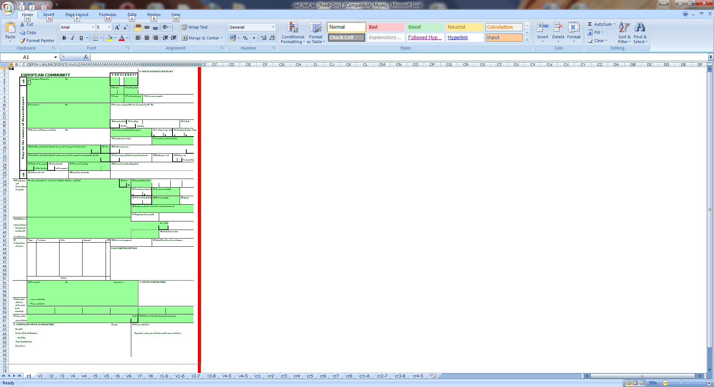



CUSTOMS UNION
Chapter 29:
Approach and new projects (1)
Broker
CIS System
Existing projects
  Custom clearance
  National Transit
  Finance Module
  Risk Management System
  Electronic exchange of pre-arrival data with neighborhood countries
Preparation of SAD
E- lodgment
E-reply with errors
Control process
Correction of SAD
E- lodgment
Control process
Customs officer
E-reply RRP:1852
RRP number and SAD is printed
Control and registration
M O N T E N E G R O
Negotiating Team for the Accession of Montenegro to the European Union
Chapter 29:
Customs union

Slide 7
ELECTRONIC CUSTOMS
Chapter 29:
Approach and new projects (2)
New Projects
  Simplification paperless procedures
  NCTS First phase: Twinning program with Austrian and Slovenian experts
  Customs 2013/2020 program
  It Strategy 2020
M O N T E N E G R O
Negotiating Team for the Accession of Montenegro to the European Union
Chapter 29:
Customs union

Slide 8
ELECTRONIC CUSTOMS
Chapter 29:
Gaps
*AS-IS / TO-BE
Twinning with Austrian and Slovenian experts
  Gap analyses
  BCMP
EU Delegation of Montenegro supported procurement of 3 experts who will create new IT strategy based on Business Strategy with concept to the EU customs systems
IT Strategy
  IT Tactical plan for next 3 years
  IT strategy plan up to 2020
M O N T E N E G R O
Negotiating Team for the Accession of Montenegro to the European Union
Chapter 29:
Customs union

Slide 9
ELECTRONIC CUSTOMS
Chapter 29:
Contact:
Danilo Minić
Customs Administration of Montenegro - Sector 02
danilo.minic@carina.gov.me
M O N T E N E G R O
Negotiating Team for the Accession of Montenegro to the European Union
Chapter 29:
Customs union

