Slide 1

M O N T E N E G R O
Negotiating Team for the Accession of Montenegro to the European Union
Working Group for Chapter 29 – Customs union
Bilateral screening: Chapter 29
PRESENTATION OF MONTENEGRO
Computerization
Brussels, June 2013

Slide 2
COMPUTERIZATION
Chapter 29:
Content
Customs information system (CIS)
  Resources
  Definition
Architecture
Network
Customs information system (CIS):
  Applications
    E-customs
    Clearance and National transit
    Finance module
    TARICG
    Risk management system
    Systematic Electronic Exchange of Data (SEED)
Economic operators national level
Montenegro customs IT: The way forward
M O N T E N E G R O
Negotiating Team for the Accession of Montenegro to the European Union
Chapter 29:
Customs union

Slide 3
COMPUTERIZATION
Chapter 29:
CIS: Resources
Systematization of employees
  Sector for customs information system and revenue collection
    Department for exploitation - 3
    Department for development of CIS and statistics - 4
    Department for revenue collection and disposal of custom good -7
Outsourcing core partner: Slovenian company that support Slovenian Customs
M O N T E N E G R O
Negotiating Team for the Accession of Montenegro to the European Union
Chapter 29:
Customs union

Slide 4
COMPUTERIZATION
Chapter 29:
CIS: Definition
CIS is based on processes, applications, and national infrastructure, to be a support for business activity
CIS is tri tier based concept
  Central database – Oracle 10g
  Central Application Server –Oracle App 10g
  WEB interface for users – J2EE
CIS is result from
  Legal framework
  Technical specification
  Decision of Management
M O N T E N E G R O
Negotiating Team for the Accession of Montenegro to the European Union
Chapter 29:
Customs union

Slide 5
COMPUTERIZATION
Chapter 29:
CIS: Arhitecture
M O N T E N E G R O
Negotiating Team for the Accession of Montenegro to the European Union
Chapter 29:
Customs union

Slide 6
Custom network Application layer
Internet
Providers
XML
ERP
RMS
business environment
DELL Power Edge R710
VMware ESXi 5.0
Windows 2000 Server,
IBM MQSeries,
PGP and decryption
J2EE
DELL PowerEdge R710
Vmware ESXi 5.0
Red Hat Enterprise Linux
App server Oracle 10g
XML
Central Bank
Clearance, Transit & TIR
XML
Rules & Procedures (R&P)
J2EE
DELL PowerEdge R710
Vmware ESXi 5.0
Red Hat Enterprise Linux
App server Oracle 10g
Delphi
DELL PowerEdge R710
Vmware ESXi 5.0
Windows Server 2003
XML
XML / AQ process
ICM
Web
Traders depths and payments
Finance module
Claims, Guarantees & Payment
Dot Net
DELL PowerEdge R710
Vmware ESXi 5.0
Windows Server 2003
J2EE
DELL PowerEdge R710
Vmware ESXi 5.0
Red Hat Enterprise Linux
App server Oracle 10g
Web TARIC
TARICG
R&P
driver
Rms
driver
J2EE
DELL PowerEdge R710
Vmware ESXi 5.0
Red Hat Enterprise Linux
App server Oracle 10g
SEED
Bosnia and Herzegovina, Serbia, Kosovo, Albania
DMZ
Apache WEB server
Data base
Oracle 10g
Relational database
SEED
Oracle Discovery reports
Dot Net
DELL PowerEdge R710
Vmware ESXi 5.0
Windows Server 2003

Slide 7
COMPUTERIZATION
Chapter 29:
CIS: Network
M O N T E N E G R O
Negotiating Team for the Accession of Montenegro to the European Union
Chapter 29:
Customs union

Slide 8
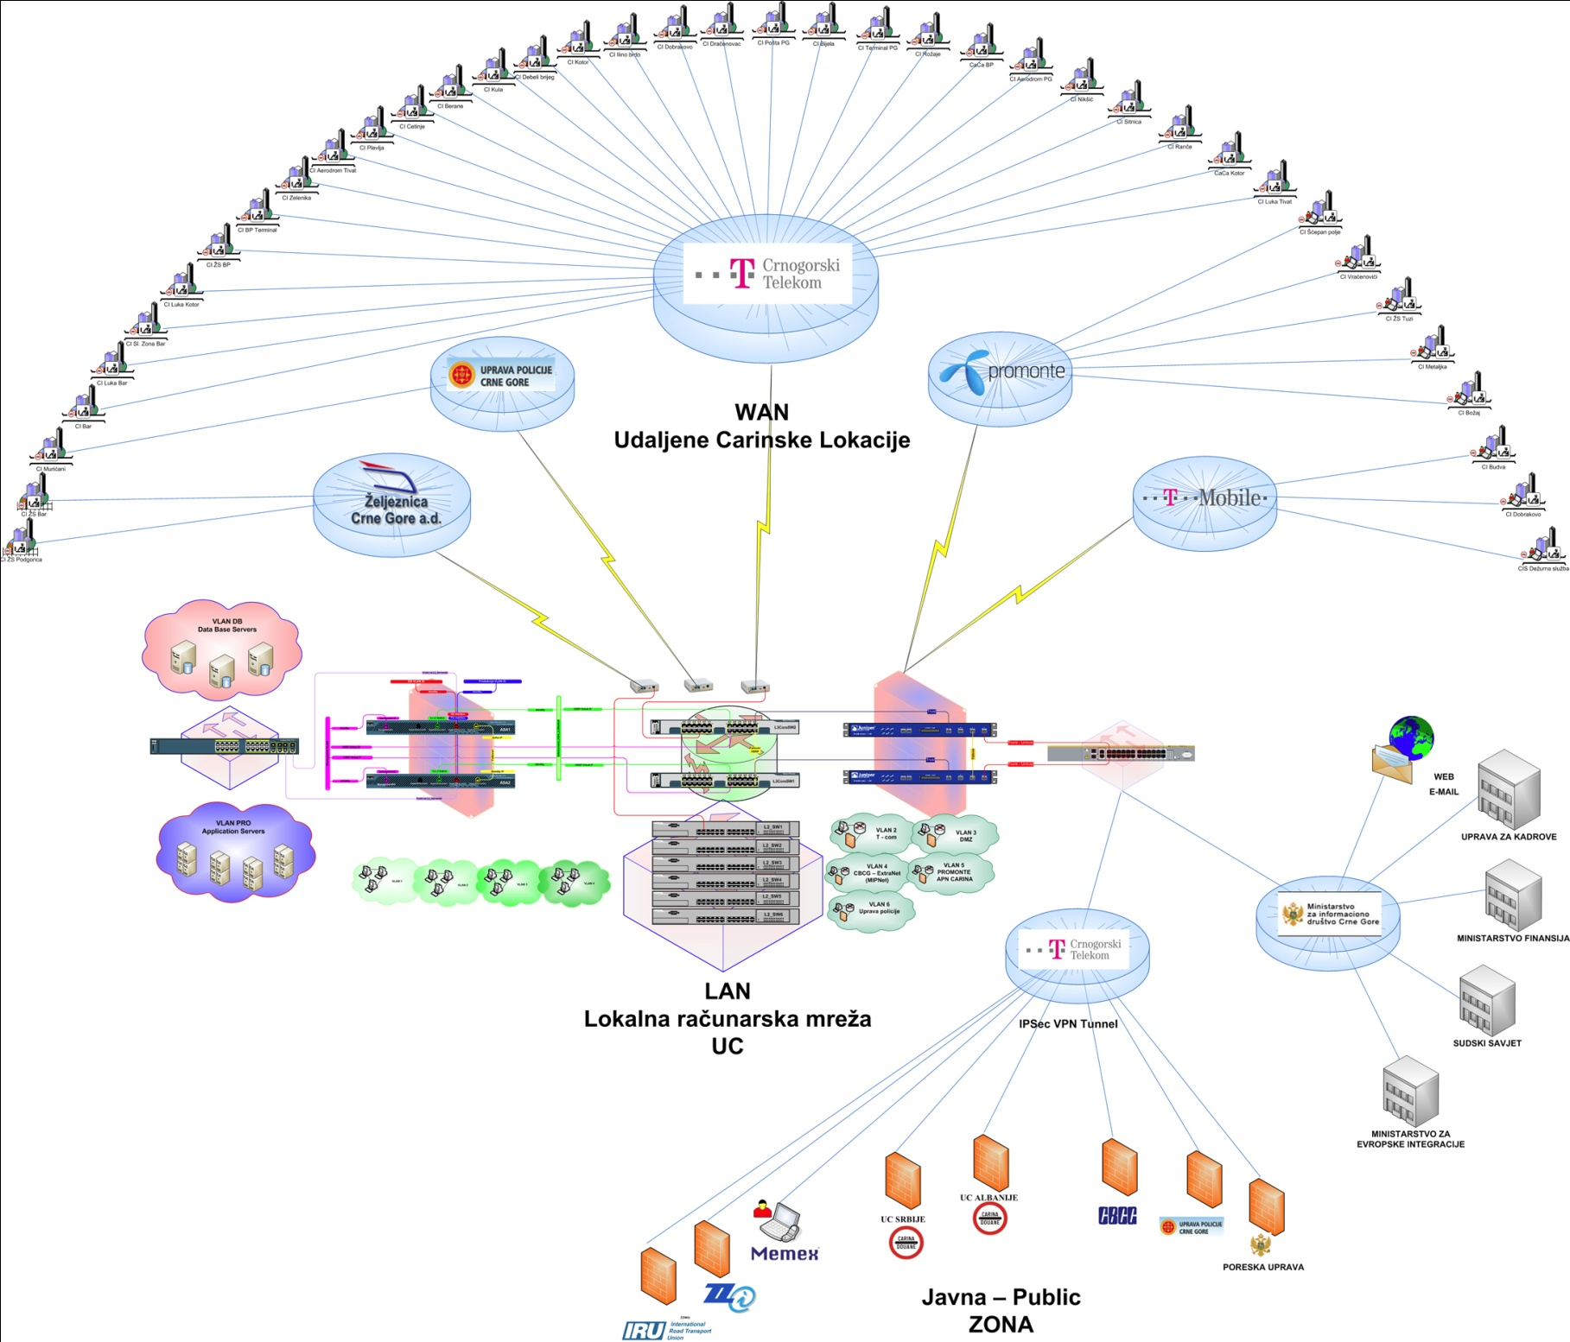
COMPUTERIZATION
Chapter 29:
M O N T E N E G R O
Negotiating Team for the Accession of Montenegro to the European Union
Chapter 29:
Customs union

Slide 9
COMPUTERIZATION
Chapter 29:
CIS: Applications
M O N T E N E G R O
Negotiating Team for the Accession of Montenegro to the European Union
Chapter 29:
Customs union

Slide 10
COMPUTERIZATION
Chapter 29:
Clearance
e-service
TIR
Finanse modul
TARIC
RMS
Transit
e-servis
SEED
Reporting module
Simplification procedure
Claims, Garanties
e-service
CIS
M O N T E N E G R O
Negotiating Team for the Accession of Montenegro to the European Union
Chapter 29:
Customs union

Slide 11
COMPUTERIZATION
Chapter 29:
CIS: Applications
System and dates
  01.04.2003 – Clearance and Transit implemented
  Every 1st January new CN (harmonized on 8 level)
  25.05.2006 – e-lodgment for Clearance with PKI
  01.07.2007 – Finance module (electronic payments)
  15.01.2008 – TIR
  03.12.2008 – Claims, Guarantees and payments (e-service for trade)
  17.08.2009 – SEED (Systematic electronic exchange of data from SAD between Customs administrations (Bosnia and Herzegovina, Serbia, Kosovo, Albania, Montenegro))
  01.01.2010 – TARICG (v2)
  11.05.2010 – e-lodgment for Transit with PKI
  10.06.2011 – ICM (Internal control management)
  01.06.2012 - SPP (Business rules and procedures, control system for SAD)
  1.3.2013 – Risk management system RMS
    24.04.2007 – RMS (only for import procedures)
  01.06.2013 - Simplification procedures paperless
M O N T E N E G R O
Negotiating Team for the Accession of Montenegro to the European Union
Chapter 29:
Customs union

Slide 12

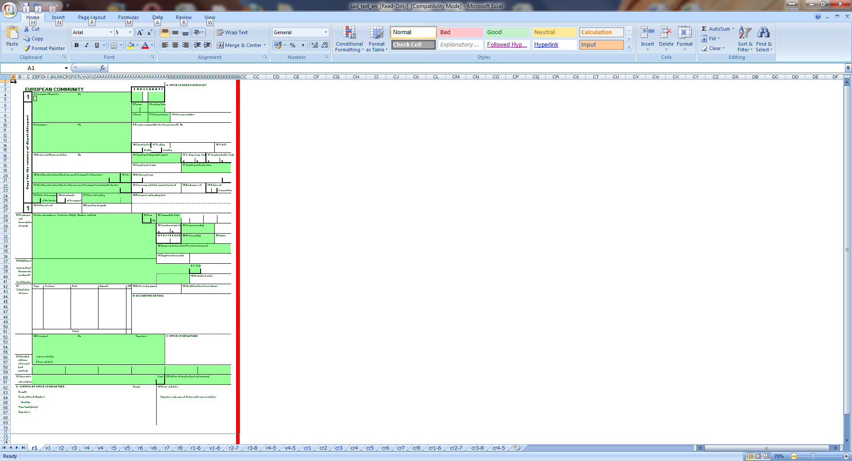



COMPUTERIZATION
Chapter 29:
CIS: E-customs
Broker
CIS System
Preparation of SAD
E- lodgment
E-reply with errors
Control process
Correction of SAD
E- lodgment
Control process
Customs officer
E-reply RRP:1852
RRP number and SAD is printed
Control and registration
M O N T E N E G R O
Negotiating Team for the Accession of Montenegro to the European Union
Chapter 29:
Customs union

Slide 13
ELECTRONIC CUSTOMS
Chapter 29:
CIS: Clearance and National Transit
AVG(No of SAD in 2010, 2011, 2012) & e-SAD(%)
Clearance |  |  | Transit
SAD | Items | e-Sad | SAD | Items | e-Sad
189.672 | 685.644 | 99,1% | 184.986 | 211.538 | 54,7%
Clearance and National Transit
  Covers all procedures (import, export, national transit, TIR)
  XML exchange messages (internal, external)
  Fallback procedure
  Unscheduled downtime for DB : less then 1h per month
M O N T E N E G R O
Negotiating Team for the Accession of Montenegro to the European Union
Chapter 29:
Customs union

Slide 14
ELECTRONIC CUSTOMS
Chapter 29:
CIS: Finance Modul
Finance Module
  Covers (SAD claims, payments, guaranties)
  XML exchange messages (internal, external)
  Data is used also for e-Service for trade
  Automatic matching of payments with calculated duties is 98%
M O N T E N E G R O
Negotiating Team for the Accession of Montenegro to the European Union
Chapter 29:
Customs union

Slide 15
ELECTRONIC CUSTOMS
Chapter 29:
CIS: TARICG
http://taric.carina.co.me/TariCG/
  TARICG allows insight of:
  Data tariff nomenclature
  Instruments and measures
  Regulations
  Data for quotas (levels of utilization)
  Calculator for customs duties
Used as internal need and as e-service for trade
M O N T E N E G R O
Negotiating Team for the Accession of Montenegro to the European Union
Chapter 29:
Customs union

Slide 16
ELECTRONIC CUSTOMS
Chapter 29:
CIS: Risk Management System
Application RMS
Risk Analysis System includes : Selectivity and Targeting
Three levels of scoring
Customs officers - Inspection report (RMS channels)
Administrators of RMS :
  e-mail notification
  SMS over mobile network
Present
CIS
driver
5%
3%
92%
Future
Engine SAT
driver
NCTS
Table – rules, parameters of risk
Rules
Data
.xml
driver
ICS/ECS
SQL
driver
EMCS
M O N T E N E G R O
Negotiating Team for the Accession of Montenegro to the European Union
Chapter 29:
Customs union

Slide 17
ELECTRONIC CUSTOMS
Chapter 29:
CIS: SEED
  Founded by European Commission
  Exchange of pre-arrival information with
    Automatic data matching
    Analysis of pre-arrival data and alarm functions
  XML exchange of messages
  Exchange of data with:
    Bosnia and Herzegovina
    Serbia
    Kosovo
    Albania
M O N T E N E G R O
Negotiating Team for the Accession of Montenegro to the European Union
Chapter 29:
Customs union

Slide 18
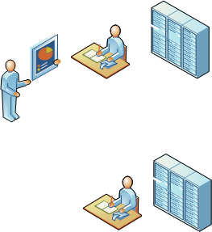
ELECTRONIC CUSTOMS
Chapter 29:
CIS: EO national registration
Previous
Now
TIME
TIME
Tax Administration
Tax Administration
Customs Administration
Customs Administration
M O N T E N E G R O
Negotiating Team for the Accession of Montenegro to the European Union
Chapter 29:
Customs union

Slide 19

COMPUTERIZATION
Chapter 29:
Ministry of information society
- WEB
- Mail
Central bank of Montenegro
Ministry of Finance
- Treasury
- SAP
Remote customs location
- Customs houses
- Customs offices
Police administration
SEED
Customs administration of
SR, AL, B&H, KS
24x7x365
MONSTAT
ERP
Electronic exchange of data
24x7x365
Administration for Human resource
- KIS
Outsourcing maintenance CIS-a
ZZI Ljubljana
24x7x365
Ministry of Justice
- RNKiPE
T-MOBILE
APN
IRU Geneve
TIR
TELENOR CG
APN
M O N T E N E G R O
Negotiating Team for the Accession of Montenegro to the European Union
Chapter 29:
Customs union

Slide 20
COMPUTERIZATION
Chapter 29:
The way forward
M O N T E N E G R O
Negotiating Team for the Accession of Montenegro to the European Union
Chapter 29:
Customs union

Slide 21
COMPUTERIZATION
Chapter 29:
The way forward: EU Assistance
DG TAXUD
TWINNING –
GAP ANALYSIS
TAIEX, ...
Regional project
Bilateral
BUISNESS STRATEGY Doc – Roadmap to EU
IT SRATEGY Doc – Roadmap to EU
M O N T E N E G R O
Negotiating Team for the Accession of Montenegro to the European Union
Chapter 29:
Customs union

Slide 22
COMPUTERIZATION
Chapter 29:
The way forward: Applications to be prepared
PROJECTS | PRIORITY
Common Communications Network (CCN) / Common Systems Interface (CSI) | M
Integrated Tariff Management System (ITMS) which will incorporate the following systems: Tarif Intégré Communautaire (TARIC) Tariff Quotas and Surveillance (TQS) European Binding Tariff Information (EBTI) Specimen Management System (SMS) Information System for Processing Procedures (ISPP) Risk Information Framework () European Customs Inventory of Chemical Substances (ECICS) Binding Origin Information (BOI) Tariff Suspensions | H H H M M M L L L L
New Computerised Transit System (NCTS) and Export Control System (ECS) and Import Control System (ICS) | H
Excise Movement Control System (EMCS) and Authorised Economic Operators (AEO) | H
M O N T E N E G R O
Negotiating Team for the Accession of Montenegro to the European Union
Chapter 29:
Customs union

Slide 23
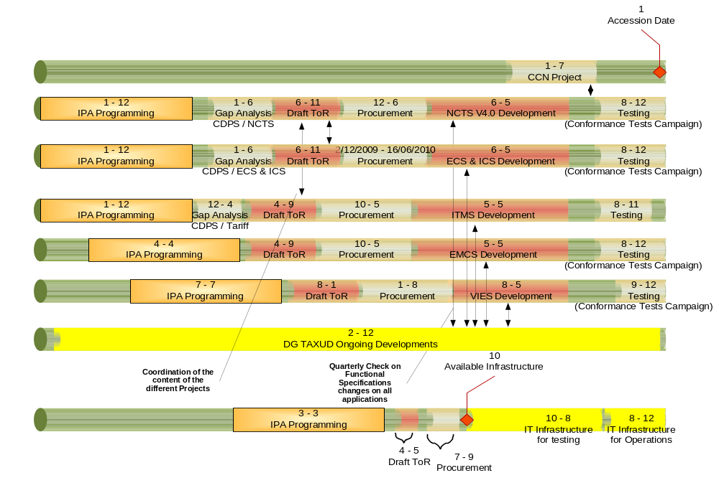
COMPUTERIZATION
Chapter 29:
The way forward: Moving Target
M O N T E N E G R O
Negotiating Team for the Accession of Montenegro to the European Union
Chapter 29:
Customs union

Slide 24
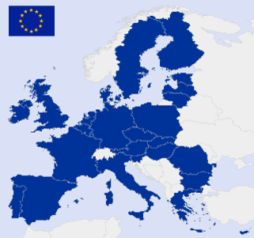
COMPUTERIZATION
Chapter 29:
The way forward: Moving target
How to catch a “moving target” and in the same time have optimal ratio of invested financial resources and time during which the functionting of application is expected?
Great number of parallel projects
Synchronisation in its drafting
Resurces for implementation (human and financial,
Projects related to EU customs tenders exceed €1 m value..)
M O N T E N E G R O
Negotiating Team for the Accession of Montenegro to the European Union
Chapter 29:
Customs union

Slide 25
COMPUTERIZATION
Chapter 29:
Support in the development of IT strategy aligned to the Business Strategy
AS-IS / TO-BE
Support from EU Delegation of Montenegro
3 experts who will create new IT strategy based on Business Strategy with concept to the EU customs systems IIS
IT Strategy
  IT Tactical plan for next 3 years
  IT strategy plan up to 2020
M O N T E N E G R O
Negotiating Team for the Accession of Montenegro to the European Union
Chapter 29:
Customs union

Slide 26
COMPUTERIZATION
Chapter 29:
The way forward: Updates & Ongoing activities
Dubrovnik 2013.
e-Customs should rely on project management (team, methodology and plans) in order to deliver the different projects in MASP. Consideration should be given to developing common reference architecture and to making Business Process Models mandatory;
Enlargement countries need to have full access to information on e-customs developments and MASP; the development of different scenarios for collaboration is essential (regional cooperation, MS – MS, EC – MS and MS – EC; enlargement countries – EC/MS); common trainings are to be organized
M O N T E N E G R O
Negotiating Team for the Accession of Montenegro to the European Union
Chapter 29:
Customs union

Slide 27

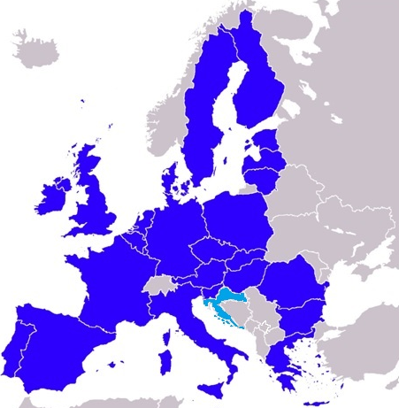
COMPUTERIZATION
Chapter 29:
Montenegro in EU, fully implementing EU standards
Creating steps in cooperation with EU and careful selection of projects taking care of optimal ratio of time and invested money
M O N T E N E G R O
Negotiating Team for the Accession of Montenegro to the European Union
Chapter 29:
Customs union

Slide 28
COMPUTERIZATION
Chapter 29:
Thank you for your attention
Q & A
Contact:
Danilo Minić
Milan Martinović
Customs Administration of Montenegro – Sector 02
danilo.minic@carina.gov.me
milan.martionovic@carina.gov.me
M O N T E N E G R O
Negotiating Team for the Accession of Montenegro to the European Union
Chapter 29:
Customs union

