Slide 1

M O N T E N E G R O
Negotiating Team for the Accession of Montenegro to the European Union
Working Group for Chapter 29 – Customs union
Bilateral screening: Chapter 29
Customs rules and procedures
Presenter: Ana Stamatović
Brisel, June 2013

Slide 2
CUSTOMS UNION
.
Chapter 29:
Customs rules and procedures
Topics:
Definition of customs debt
Inccurrence of custom dept
Security for paymant(guarantee)
Recovery/payment of customs duties
Repayment and remission of customs duties
Extinguishment of customs debt
M O N T E N E G R O
Negotiating Team for the Accession of Montenegro to the European Union
Chapter 29:
Customs union

Slide 3
CUSTOMS UNION
.
Chapter 29:
Customs rules and procedures
Legal framework:
Customs Law (Official Gazette of the Republic of Montenegro 7/02, 38/02, 72/02, 21/03, 31/03, 29/05, 66/06, 21/08)
Implementing provisions to the Customs Law (Official Gazette of the Republic of Montenegro 15/03, 81/06, 38/08)
Rulebook on form, contents, method of lodging and filling of
customs declaration and summary declaration (Official Gazette of the Republic of Montenegro 16/03, 43/04, 2/05, 14/05, 48/07)
Law on General Administrative Procedure (Official Gazette of the Republic of Montenegro 60/03)
M O N T E N E G R O
Negotiating Team for the Accession of Montenegro to the European Union
Chapter 29:
Customs union

Slide 4
CUSTOMS UNION
Chapter 29:
Customs rules and procedures
CUSTOMS DEBT
Definition of customs debt -The obligation of a person to pay the calculated amount of duties (customs debt on import or export) and other charges which apply for specific goods in accordance with the provisions in force.
M O N T E N E G R O
Negotiating Team for the Accession of Montenegro to the European Union
Chapter 29:
Customs union

Slide 5
CUSTOMS UNION
Chapter 29:
Customs rules and procedures
Incurrence of customs debt
Ar.201-217CL
Bases for the incurrence of the customs debt on importation:
release for free circulation or placing of goods under the temporary importation procedure with partial relief from import duties;
unlawful introduction of goods into the customs territory or from free zone or a free warehouse to the rest of customs territory;
unlawful removal of goods from customs supervision
M O N T E N E G R O
Negotiating Team for the Accession of Montenegro to the European Union
Chapter 29:
Customs union

Slide 6
CUSTOMS UNION
Chapter 29:
Customs rules and procedures
Incurrence of customs debt
non-fulfilment of the obligations arising from temporary storage or from the use of the customs procedure or non-compliance with the conditions governing the placing of goods under the customs procedure or the granting of a reduced rate of import duties(by virtue of the end-use of the goods)under condition of goods for special purposes)
use of goods in a free zone or a free warehouse under conditions or in a way which is not in accordance with the provisions;
- When the customs debt shall not incur
M O N T E N E G R O
Negotiating Team for the Accession of Montenegro to the European Union
Chapter 29:
Customs union

Slide 7
.
CUSTOMS UNION
Chapter 29:
Customs rules and procedures
Ar.184-200CL;459-470DOICL;581-593DIOCL
Guarantee for potential or existing debt
Security for payment- Of already incurred customs debt, debt that could arise and interests
For customs debt under 500€, no security for payment is required.
Person required to provide a security for payment - customs debtor or person who can become customs debtor, authorized representative
Forms of security:
cash deposit;
- undertaking of a guarantor;
Guarantor- Authorised comercial banks with headquarters in Montenegro (operations approved by the Central Bank of Montenegro)
M O N T E N E G R O
Negotiating Team for the Accession of Montenegro to the European Union
Chapter 29:
Customs union

Slide 8
CUSTOMS UNION
Chapter 29:
Customs rules and procedures
Ar.223,a,b,c CL
Guarantee for potential or existing debt
Kinds of security :
Individual
General and
Comprehensive.
Number of procedure | Security for payment / procedure | Types of security | Code
4 | Security for deferred payment of customs debt at release of goods for free circulation (*) | comprehensive | 6
 |  | Individual | 3
T | Transit | general | 2
 |  | individual | 3
7 | Security for payment in procedure of customs warehousing of goods | comprehesive | 7
4 | Simplified customs clearance | comprehesive | 6
3 | Security for payment for re-export of goods | general | 2
 |  | individual | 3
5 | Security for payment of temporary admission and inward processing | comprehesive | 7
 |  | individual | 3
* -
M O N T E N E G R O
Negotiating Team for the Accession of Montenegro to the European Union
Chapter 29:
Customs union

Slide 9
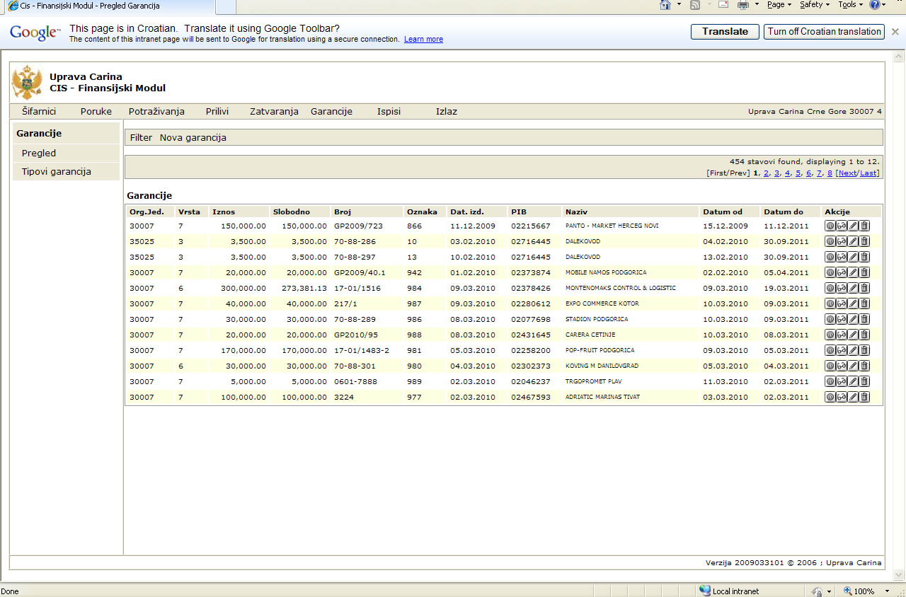
CUSTOMS UNION
Chapter 29:
Customs rules and procedures
FM-modul
Guarantee for potential or existing debt
View on guarantees in Financial Module
M O N T E N E G R O
Negotiating Team for the Accession of Montenegro to the European Union
Chapter 29:
Customs union

Slide 10
CUSTOMS UNION
Chapter 29:
Customs rules and procedures
Ar.462 and 585 DOICL
Guarantee for potential or existing debt
Procedure on accepting and evidencing
Decision on excepting security for paymant- (solvency, existing dept, violations of rules)
Determining the amount of security for payment for :- gap*:
-Comprehensive
-General
The amount of security for payment cannot be lower than 5,000 €, and in case of transit of cigarettes and spirits it cannot be lower than 300,000 €.
*gap – EU practice
M O N T E N E G R O
Negotiating Team for the Accession of Montenegro to the European Union
Chapter 29:
Customs union

Slide 11
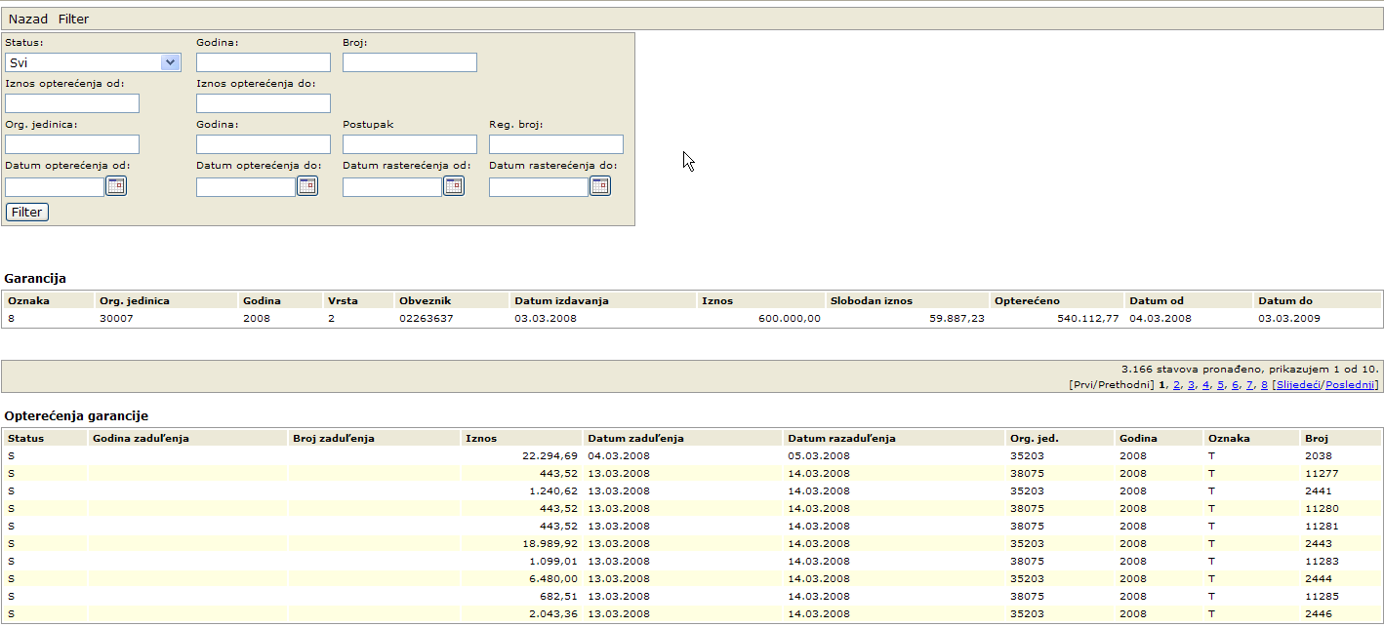
CUSTOMS UNION
Chapter 29:
Customs rules and procedures
FM- modul
Guarantee for potential or existing debt
Monitoring of deadlines and usage of guarantees.
Validity period of guarantee can not be shorter than three mounths.
Application enables review of usage of guarantees for users of bank guarantees through WEB application of the MCA .
M O N T E N E G R O
Negotiating Team for the Accession of Montenegro to the European Union
Chapter 29:
Customs union

Slide 12
CUSTOMS UNION
Chapter 29:
Customs rules and procedures
Guarantee for potential or existing debt
Taking necessery actions for security for paymant:
warning and
enforcement collection sent to guarantor(bank) and deptor
Release of security –when customs debt or duty for which the security for payment was lodged, can no longer arise i.e is extinguished.
M O N T E N E G R O
Negotiating Team for the Accession of Montenegro to the European Union
Chapter 29:
Customs union

Slide 13
CUSTOMS UNION
Chapter 29:
Customs rules and procedures
Guarantee for potential or existing debt
Analysis of guarantees and its usage (active on 01/07/2012)
Type of security | Title of security | Number of issued guarantees | Total value of issued guarantees | Total number of declarations secured with guarantees | Total amount of duties secured with guarantees
2 | General guarantee (transit procedure) | 49 | 6,648,000.00 | 147,305 | 579,352,622.09
3 | Individual guarantee | 6 | 29,000.00
6 | Comprehensive guarantee (deferred payment of customs debt) | 215 | 10,363,000,00 | 112,532 | 182,601,249.84
7 | Security (all procedure apart from import) | 217 | 15,446,481.08
M O N T E N E G R O
Negotiating Team for the Accession of Montenegro to the European Union
Chapter 29:
Customs union

Slide 14
CUSTOMS UNION
Chapter 29:
Customs rules and procedures
Recovery/payment of customs duties Ar.218-22GCL,609DOICL
Entry in the accounts:
Customs authority is booking the amount of customs duties in the accounting records, as soon as it gets the necessary particulars for calculation of the amount;
In simplified procedure total amount of customs debt for goods released to one person(for more procedures at once), could be calculated at once during the deadline determined by the authority (not longer than 31 days)
subsequent - 2 (and maximum 14) days from the date on which the custom authority determines the debtor and to calculate the amount:
Possibility of the extention of deadline for entry into the accounts to 14 days
M O N T E N E G R O
Negotiating Team for the Accession of Montenegro to the European Union
Chapter 29:
Customs union

Slide 15
CUSTOMS UNION
Chapter 29:
Customs rules and procedures
Ar.609CL
Recovery/payment of customs duties
Communication of the customs debt – as soon as its amount has been entered in the accounts and not later than within 3 years from the date of the incurrence of the customs debt(unless an appeal has been lodged)
Time limits for payment:
regular – not exceeding 8 days following the communication of the debt and 10 days in case of entering account at once;
deferred (with mandatory depositing security for payment)
maximum 30 days after the entry in the accounts (for single operation)
- for debt entered into the account at once
1. On 24th day – for expiry period of calendar week
2. On 16th day- for expiry period of calendar month
Consequences of no or late payment:
-enforcement of payment
- interest on arrears;
M O N T E N E G R O
Negotiating Team for the Accession of Montenegro to the European Union
Chapter 29:
Customs union

Slide 16
CUSTOMS UNION
Chapter 29:
Customs rules and procedures
Ar.227-227aCL
Extinguishment of customs debt
payment of custom depts
remission of custom depts
If the declaration has been cancelled for the goods declared for procedure for which the obligation of payment of customs duties exists, or if the goods were confiscated or destroyed following the order from the customs house, given away in favour of the state or irretrievably lost
seizure and confiscation of goods upon their unlawful introduction
M O N T E N E G R O
Negotiating Team for the Accession of Montenegro to the European Union
Chapter 29:
Customs union

Slide 17
CUSTOMS UNION
Chapter 29:
Customs rules and procedures
Repayment and remission of customs duties
Ar.228-234CL
Repayment- total or partial refund of customs duties which have been paid.
Remission – waiver or annulation of the entry in the accounts of an amount of customs duties (total or partial) which have not been paid
Time limit for repayment or remission in cases of:
Payment of customs debt in the amount which was not necessary at the moment of payment(repayment) or if it was entered into the accounts contrary to the regulations(remission) – 3 years;
Return of goods which at the moment of acceptance of declaration had defect or it did not correspond to contractual terms(repayment or remission) – 12 months
If the customs declaration was cancelled, and customs duty paid (repayment)– stipulated deadline for submission of request for cancellation of customs declaration
M O N T E N E G R O
Negotiating Team for the Accession of Montenegro to the European Union
Chapter 29:
Customs union

Slide 18
CUSTOMS UNION
Chapter 29:
Customs rules and procedures
Thank you for your attention
Q & A
Contact:
Ana Stamatović
Customs Administration of Montenegro – Sector 02
ana.stamatovic@carina.gov.me
M O N T E N E G R O
Negotiating Team for the Accession of Montenegro to the European Union
Chapter 29:
Customs union

