Slide 1

M O N T E N E G R O
Negotiating Team for the Accession of Montenegro to the European Union
Working Group for Chapter 29 – Customs union
Bilateral screening: Chapter 29
PRESENTATION OF MONTENEGRO
Customs Administration of Montenegro
Introduction
- Milan Martinovic -
Brussels, May 2013

Slide 2

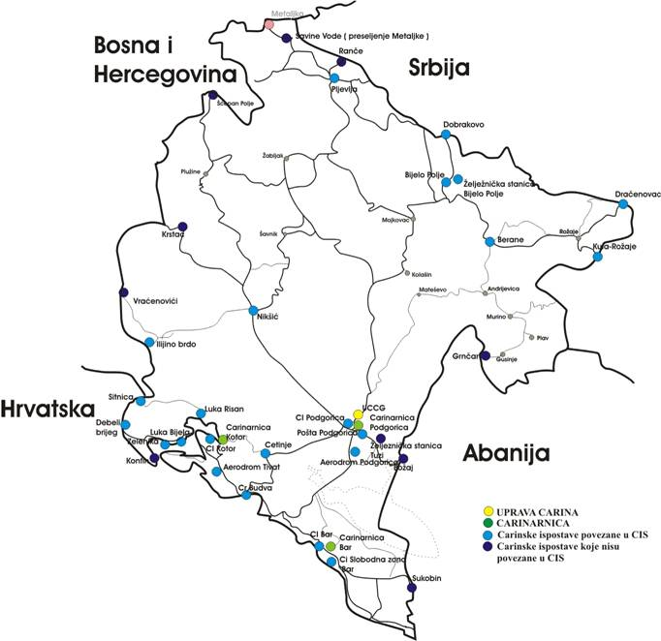






CUSTOMS UNION
Chapter 29:
Montenegro
Total length of border : 840.4 km,
land 571.6 km
sea 137;
lakes 50.5 km
river border 81.3 km.
Pursuant to the specific regulations – decisions, agreements, decrees, protocols:
24 border crossing points were established on territory
12 Inland terminals
Kosovo*
M O N T E N E G R O
Negotiating Team for the Accession of Montenegro to the European Union
Chapter 29:
Customs union

Slide 3
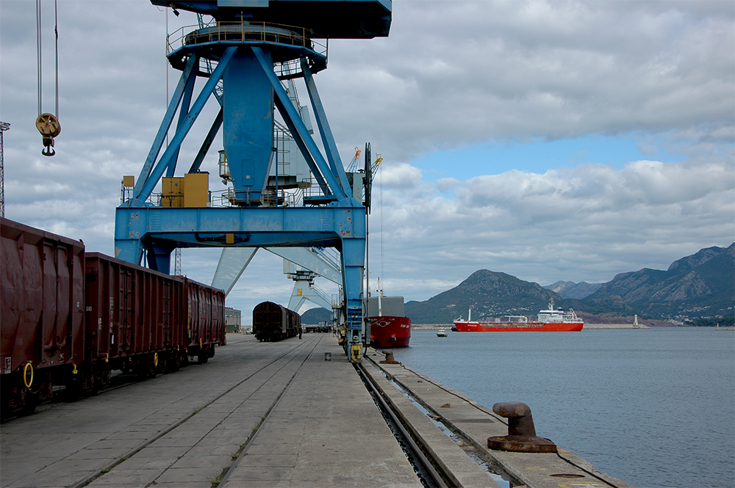
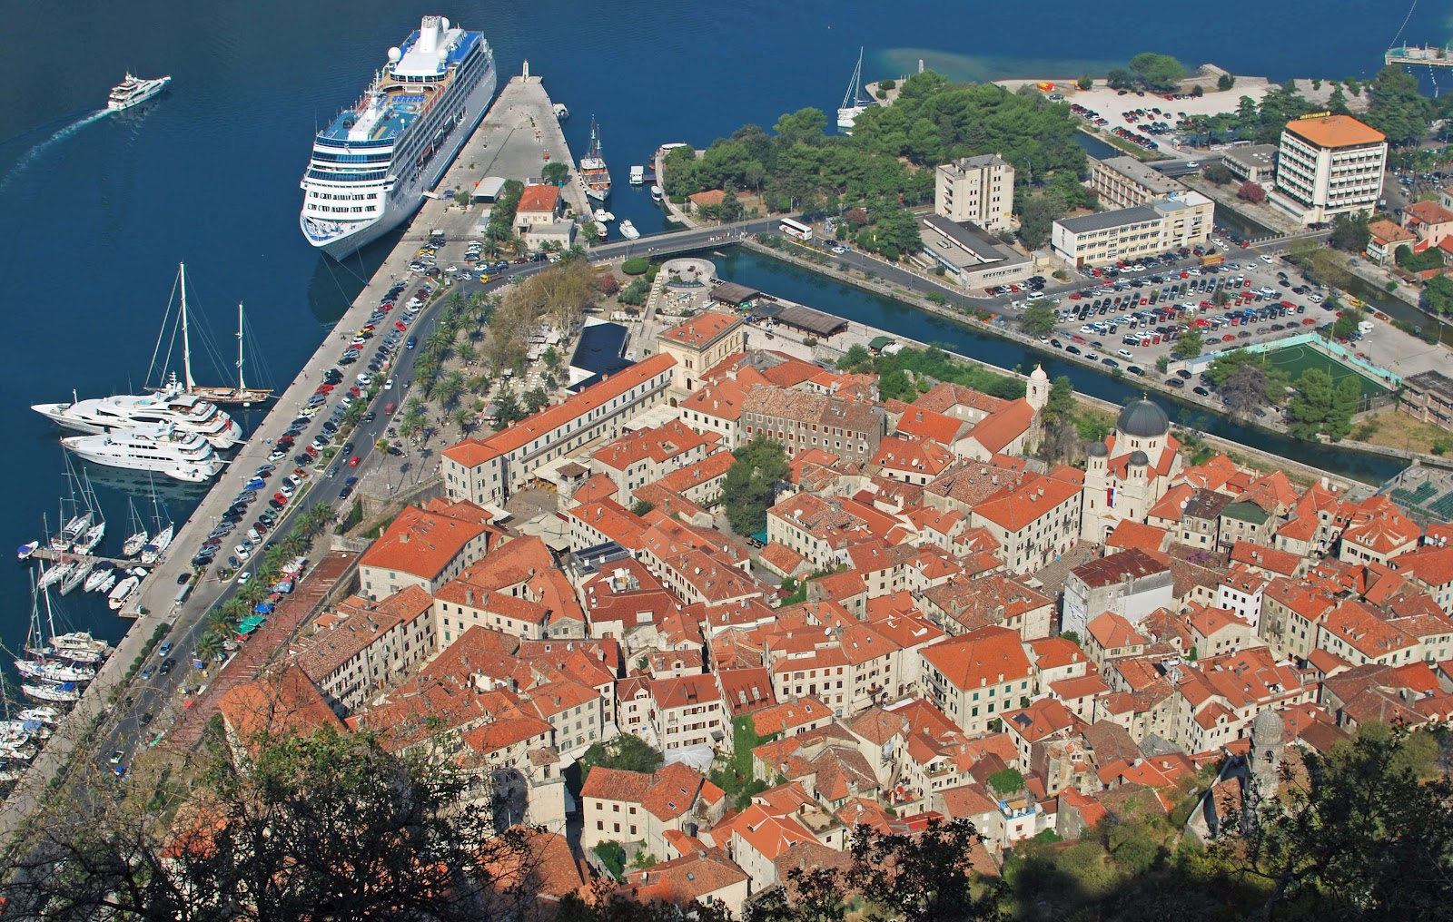
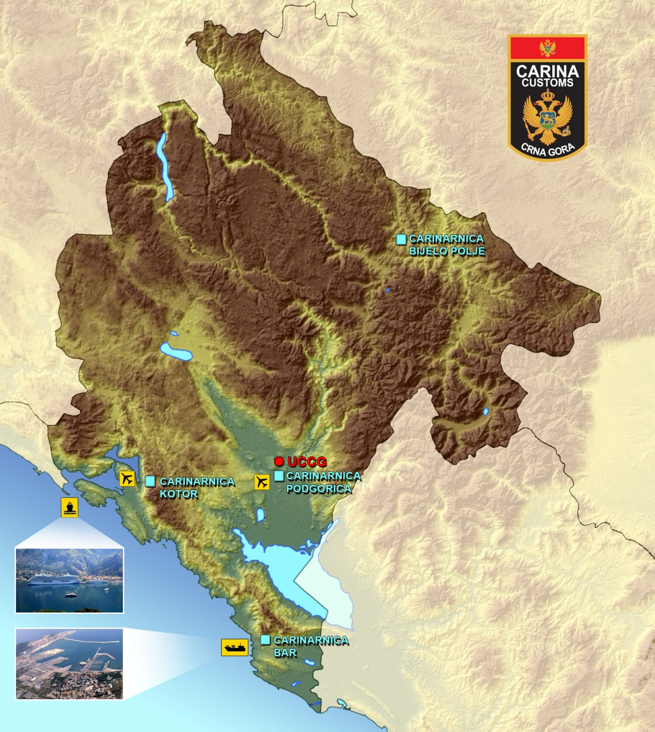
CUSTOMS UNION
Chapter 29:
AVAILABLE STAFF:
systematized 385 work posts with 721 employees.
At the moment :
546 employees in the customs administration
  120 Central Administration
  320 Customs Houses
2 INTERNATIONAL AIRPORTS
1 MAJOR COMMERCIAL PORT (BAR)
1 MAJOR PASSENGER PORT (KOTOR)
M O N T E N E G R O
Negotiating Team for the Accession of Montenegro to the European Union
Chapter 29:
Customs union

Slide 4
CUSTOMS UNION
Chapter 29:
Strategic goals
Business strategy
Align Customs Legislation and Regulations with the EU Acquis
Strengthen Customs Cooperation and Enhance Trade Facilitation (develop close-partnerships with the Traders and Business Community)
Further strengthen Border and Inland Controls, including Intelligence-led Risk Analysis, with a strong and effective Investigation and Enforcement capability
Enhance Revenue Collection
Continue the Modernisation of the Customs Service, including the development of the Human Resources and Information Technology capacities, and the enhancement of Infrastructure and Equipment
M O N T E N E G R O
Negotiating Team for the Accession of Montenegro to the European Union
Chapter 29:
Customs union

Slide 5
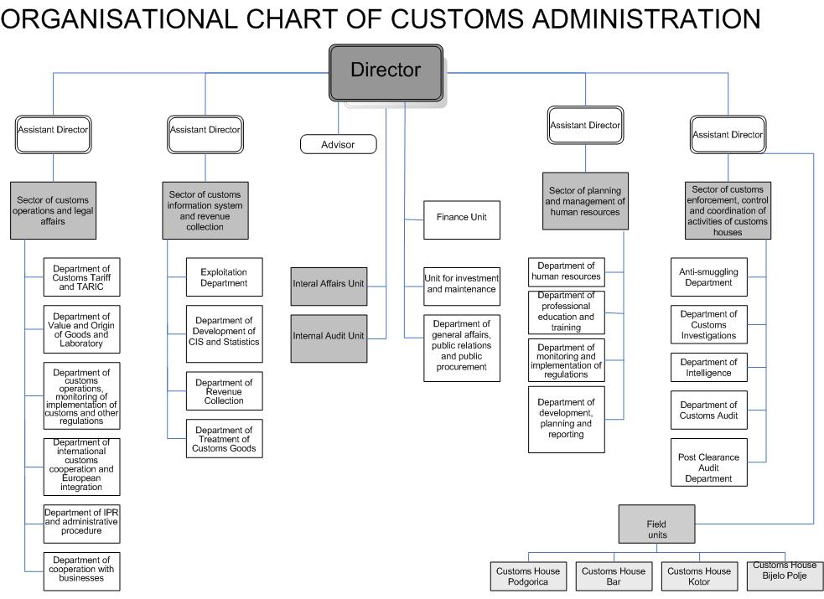

CUSTOMS UNION
Chapter 29:
CRNA GORA
MINISTARSTVO FINANSIJA
M O N T E N E G R O
Negotiating Team for the Accession of Montenegro to the European Union
Chapter 29:
Customs union

Slide 6


Chapter 30: External Relations
Institutions responsible for Customs policy
The Government of Montenegro and the Ministry of Finance (Department for Tax and Custom System) are responsible for customs policy.
Within the Department for Tax and Customs System, managed by the Deputy Minister, there are 6 divisions:
Division for analysis, supervision and coordination;
Division for the tax system and tax policy (direct and indirect taxes);
Division for the customs system and customs policy;
Division for second instance tax- and customs-related administrative procedures;
Division of local government financing system;
Division of accounting and auditing.
CRNA GORA
MINISTARSTVO FINANSIJA
M O N T E N E G R O
Negotiating Team for the Accession of Montenegro to the European Union
Chapter 30:
External Relations

Slide 7
Chapter 30: External Relations
CRNA GORA
MINISTARSTVO FINANSIJA
Division for the customs system and customs policy performs tasks with regards to:
Preparation of laws and other regulations governing the customs system and customs policy and operation of duty free zones;
Preparation of opinions on draft international treaties and conventions;
Participation in the preparation of the expert papers serving to undertake and implement the economic policy measures in the field of customs system and customs policy;
Participation in the preparation of proposals for accepting the recommendations of the World Customs Organization and other international organizations in the field of customs;
Coordination over the execution of the commitments made in the framework of the European integration processes;
Participation in the negotiations on rules of origin and methods of administrative cooperation provided for free trade agreements, etc.
This Division employs 3 advisers.
M O N T E N E G R O
Negotiating Team for the Accession of Montenegro to the European Union
Chapter 30:
External Relations

Slide 8
Chapter 30: External Relations
CRNA GORA
MINISTARSTVO FINANSIJA
Division for second instance tax and customs administrative procedure performs tasks with regard to:
Conducting the appeals procedure and other legal remedies for taxpayers and customs payers against the first instance decisions of the tax and customs authorities and bodies of local self-government in administrative proceedings;
Preparation of Second-instance appeal decisions;
Preparation of answers to the complaint in administrative court disputes;
Monitoring of regulations from within the scope of work and participation in the preparation of different opinions with regard to positions concerning the application of tax and customs regulations, etc.
.
M O N T E N E G R O
Negotiating Team for the Accession of Montenegro to the European Union
Chapter 30:
External Relations

Slide 9
CUSTOMS UNION
Chapter 29:
CRNA GORA
MINISTARSTVO FINANSIJA
Min of Fin
NCTS
M O N T E N E G R O
Negotiating Team for the Accession of Montenegro to the European Union
Chapter 29:
Customs union

Slide 10
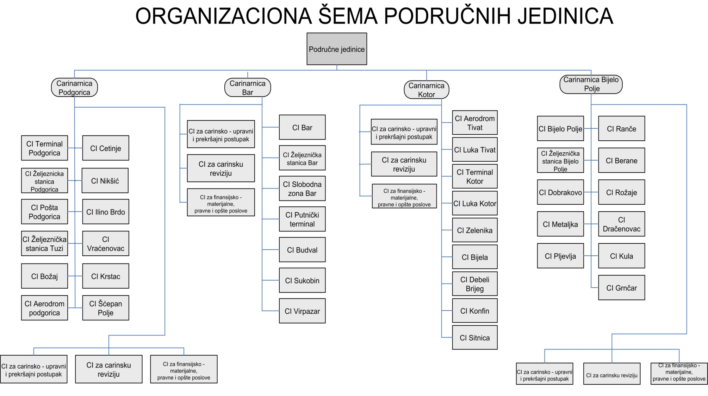
CUSTOMS UNION
Chapter 29:
M O N T E N E G R O
Negotiating Team for the Accession of Montenegro to the European Union
Chapter 29:
Customs union

Slide 11
CUSTOMS UNION
Chapter 29:
Major imported/exported goods in 2012
Import
HS Code | Trademark of goods
2710 | Petroleum oils
2716 | Electrical energy
8703 | Motor cars
3004 | Medicaments
0203 | Meat of swine, fresh, chilled or frozen
Export
HS Code | Trademark of goods
7601 | Aluminum, unwrought
2716 | Electrical energy
2204 | Wine of fresh grapes
7204 | Ferrous waste & scrap
4407 | Wood sawn or chipped lengthwise, sliced or peeled, whether or not planed
M O N T E N E G R O
Negotiating Team for the Accession of Montenegro to the European Union
Chapter 29:
Customs union

Slide 12
CUSTOMS UNION
Chapter 29:
Results
2012 | Total number of declarations | Total value of goods
Customs clearance | 216,002 | 2,667,095,391.81
Transit | 153,948 | 2,422,961,678.04
Type of duties | Collected duties in 2012
VAT | 290,090,480.27
Customs duty | 26,926,687.13
Excise duty | 31,204,188.20
Other duties | 2,790,155.36
TOTAL | 351,011,510.96
M O N T E N E G R O
Negotiating Team for the Accession of Montenegro to the European Union
Chapter 29:
Customs union

Slide 13
CUSTOMS UNION
Chapter 29:
Responsibility – Budget, principal revenues
MCA is every morning transferring complete amount of collected revenues to the State treasury of the Ministry of Finance
M O N T E N E G R O
Negotiating Team for the Accession of Montenegro to the European Union
Chapter 29:
Customs union

Slide 14

CUSTOMS UNION
Chapter 29:
Responsibility – Customs enforcement
We are successfully protecting customs territory and enforcing respect of the law, with cooperation with other state authorities and applying following instruments:
Initiation of offence proceedings
Filing misdemeanor reports
Confiscation of goods subject of customs offences
Seizure of excise goods (cigarettes, rolling tobacco etc.)
Collection of sentenced pecuniary fines
Initiate filing criminal charges
Post clearance audit
Subsequent recovery of customs debt
M O N T E N E G R O
Negotiating Team for the Accession of Montenegro to the European Union
Chapter 29:
Customs union

Slide 15
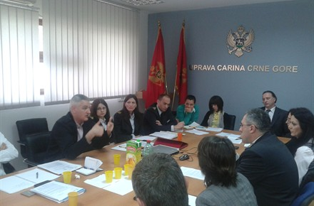



CUSTOMS UNION
Chapter 29:
COOPERATION WITH BUSINESS COMMUNITY
Regular communication with economic operators and their associations:
Chamber of commerce of Montenegro,
Employers union,
Montenegro business alliance…
Customs administration has established ‘OPEN DOOR DAY', which is organized on Wednesdays on topics proposed by the economic operators in advance, related to the conduct of customs procedures and interoperation of regulations.
We have issued 15 authorizations for simplified procedure of declaring goods as follows: 13 on the basis of commercial or official document (invoice) and 2 on the basis of entry into the bookkeeping records.
M O N T E N E G R O
Negotiating Team for the Accession of Montenegro to the European Union
Chapter 29:
Customs union

Slide 16
CUSTOMS UNION
Chapter 29:
ONGOING ACTIVITIES
CONDITIONED BY THE CHANGES IN LEGISLATION, CUSTOMS ADMINISTRATION HAS PREPARED:
  New Rulebook on internal organization and systematization of customs administration,
  New Code of Conduct
  New Business strategy – ADOPTED
  New IT strategy – Ongoing activity
  Customs laboratory -final phase of adaptation and we have initiated activities on procurement of the equipment
M O N T E N E G R O
Negotiating Team for the Accession of Montenegro to the European Union
Chapter 29:
Customs union

Slide 17
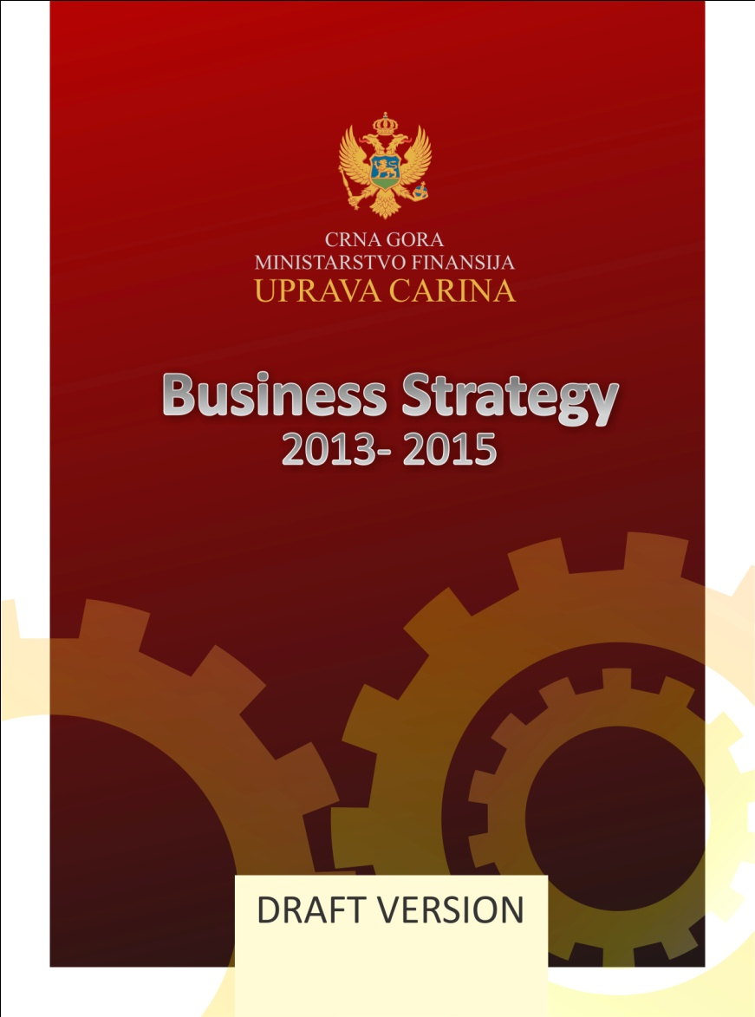

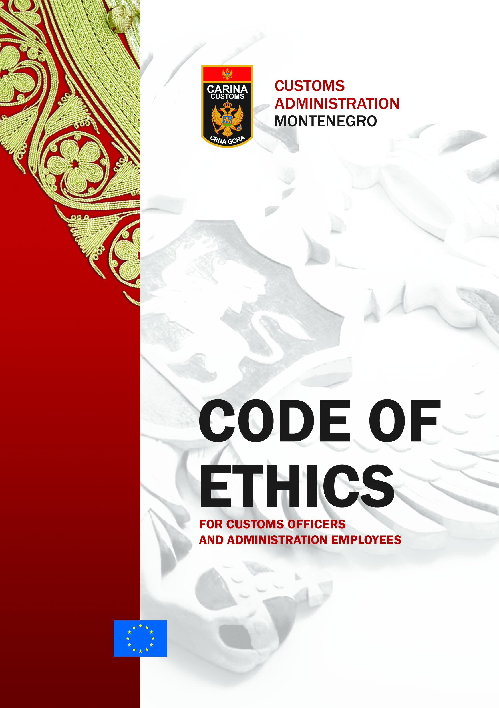
CUSTOMS UNION
Chapter 29:
From2013-2015.
Vision, Mission and
Strategic Objectives
Standards of provided services to the business community and public; operational performance..
From 2013-2020.
Tactical plan 2013 -15
Ongoing activity till Oct 2013
Code of ethics and Code of conduct of customs officers
Customs integrity program
M O N T E N E G R O
Negotiating Team for the Accession of Montenegro to the European Union
Chapter 29:
Customs union

Slide 18
CUSTOMS UNION
Chapter 29:
MAIN ONGOING PROJECTS
SIMPLIFICATION...
Electronic support to the
Simplified procedure of declaring goods on the basis of entry into the bookkeeping records
IPA 2011
Twinning Light Contract
“Preparation of Customs Administration of Montenegro for implementation of New Computerised Transit System – NCTS”
NCTS – TWINNING LIGHT
MODERNISE E-CUSTOMS SUBMITION -STREAMLINE DECLARATION
New phase in implementing Electronic SAD and communication with Traders. Speed up the standard customs procedures and at the same time to remove the existing business barriers in the flow of goods
M O N T E N E G R O
Negotiating Team for the Accession of Montenegro to the European Union
Chapter 29:
Customs union

Slide 19
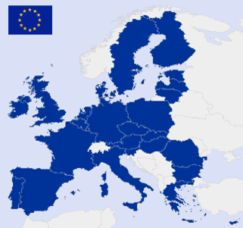
CUSTOMS UNION
Chapter 29:
Challenges of EU Accession
How to catch a “moving target” and in the same time have optimal ratio of invested financial resources and time during which the functioning of application is expected?
Great number of parallel projects
Synchronisation in its drafting
Resurces for implementation (human and financial,
Projects related to EU customs tenders exceed €1 m value..)
M O N T E N E G R O
Negotiating Team for the Accession of Montenegro to the European Union
Chapter 29:
Customs union

Slide 20
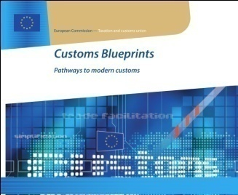
CUSTOMS UNION
Chapter 29:
EU Assistance
DG TAXUD
TWINNING –
GAP ANALYSIS
TAIEX, ...
Regional project
Bilateral
Customs 20xx
IPA 2014 - ..
BUISNESS STRATEGY Doc – Roadmap to EU
IT STRATEGY Doc – Roadmap to EU
M O N T E N E G R O
Negotiating Team for the Accession of Montenegro to the European Union
Chapter 29:
Customs union

Slide 21


CUSTOMS UNION
Chapter 29:
Participation in NEGOTIATING CHAPTERS for the accession to the EU:
  Protection of intellectual property rights – C 7
  Agriculture and rural development – C 11
  Taxation – C 16
  Statistics – C 18
  JUSTICE, FREEDOM AND SECURITY – C 24
  Environmental protection – C 27
  Customs union – C 29
  External relations – C 30
  Financial and budgetary provisions – C 33
M O N T E N E G R O
Negotiating Team for the Accession of Montenegro to the European Union
Chapter 29:
Customs union

Slide 22
CUSTOMS UNION
Chapter 29:
CUSTOMS COMPETENCY FRAMEWORK
Capacity building and skills are important to ensure the required high level performance of Customs staff as well as an EU-wide consistency in operational customs performance; effective training structures should be put in place in customs administrations taking into account the forthcoming EU competency framework; targeted enlargement focused training activities should continue.
Dubrovnik 2013
M O N T E N E G R O
Negotiating Team for the Accession of Montenegro to the European Union
Chapter 29:
Customs union

Slide 23

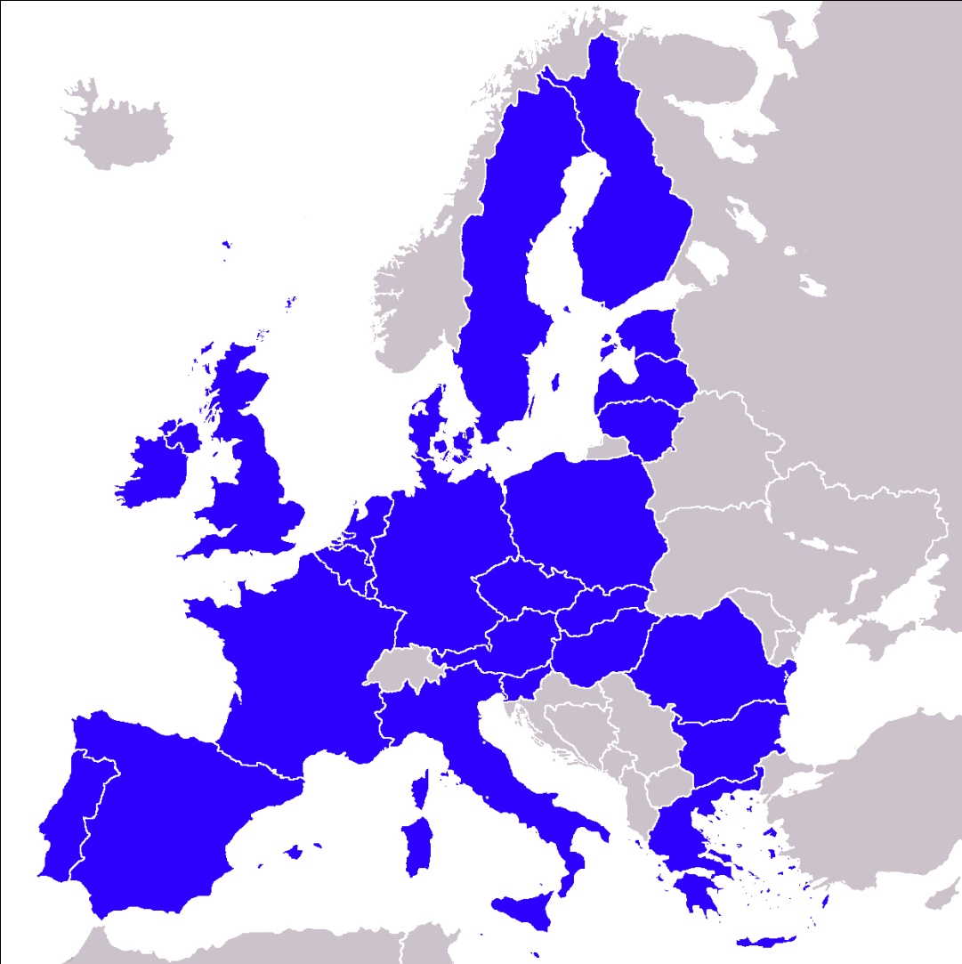
CUSTOMS UNION
Chapter 29:
Clear goal
Montenegro in EU, fully implementing EU standards
Creating steps in cooperation with the EU and careful selection of projects taking care of optimal ratio of time and invested money
M O N T E N E G R O
Negotiating Team for the Accession of Montenegro to the European Union
Chapter 29:
Customs union

Slide 24
CUSTOMS UNION
Chapter 29:
THANK YOU FOR YOUR ATTENTION!
Q & A ...
Milan Martinovic
milan.martinovic@carina.gov.me
M O N T E N E G R O
Negotiating Team for the Accession of Montenegro to the European Union
Chapter 29:
Customs union

