Slide 1


M O N T E N E G R O
Negotiating Team for the Accession of Montenegro to the European Union
Working Group for Chapter 3 – FREEDOM TO PROVIDE SERVICES
Bilateral screening: Chapter 3
PRESENTATION OF MONTENEGRO
Brussels, 29 – 30 October 2012

Slide 2

Chapter 03: Right of establishment and freedom to provide services
Working Group for Chapter 3
ADMINISTRATIVE SIMPLIFICATION
Bilateral screening: Chapter 3
Presentation of Montenegro
Brussels, 29 – 30 October 2012
M O N T E N E G R O
Negotiating Team for the Accession of Montenegro to the European Union
Chapter 3

Slide 3
Chapter 03: Right of establishment and freedom to provide services
Points of Single Contact
Montenegro
Bojana Bajić
Advisor to the Minister
Ministry for Information Society and Telecommunication
bojana.bajic@mid.gov.me
M O N T E N E G R O
Negotiating Team for the Accession of Montenegro to the European Union
Chapter 3

Slide 4
Chapter 03: Right of establishment and freedom to provide services
LEGAL FRAMEWORK
Compani Law
(Official Gazette of Montenegro 06/02, 17/07, 80/08, 40/10, 36/11, 40/11)
Law on General Administrative Procedure
(Official Gazette of Montenegro br. 60/03, 73/10, 32/11)
Law on electronic Signature http://www.mid.gov.me/en/library/zakoni
(Official Gazette of Montenegro 55/03, 31/05 and 41/10)
Law on electronic Commerce http://www.mid.gov.me/en/library/zakoni
(Official Gazette of Montenegro 80/04 and 41/10)
Law on electronic Document http://www.mid.gov.me/en/library/zakoni
(Official Gazette of Montenegro 5/08 )
Law on Information security
(Official Gazette of Montenegro 14/10 )
Decree of licencing
(Official Gazette of Montenegro 51/12)
Chapter 3
M O N T E N E G R O
Negotiating Team for the Accession of Montenegro to the European Union
Poglavlje 25
Nauka i istraživanje

Slide 5
Chapter 03: Right of establishment and freedom to provide services
STRATEGIES
Information Society Development Strategy (2012-2016)
The strategy of establishing a certification body
The strategy of using open source technologies in Montenegro
National Interoperability Framework of Montenegro
M O N T E N E G R O
Negotiating Team for the Accession of Montenegro to the European Union
Chapter 3

Slide 6
Chapter 03: Right of establishment and freedom to provide services
Relevant acquis
DIRECTIVE 2006/123/EC OF THE EUROPEAN PARLIAMENT AND OF THE COUNCIL of 12 December 2006 on services in the internal market
Decision 2009/767/EC, as amended by 2010/425/EU
Proposal for a REGULATION OF THE EUROPEAN PARLIAMENT AND OF THE COUNCIL on electronic identification and trust services in the internal market
M O N T E N E G R O
Negotiating Team for the Accession of Montenegro to the European Union
Chapter 3

Slide 7
Chapter 03: Right of establishment and freedom to provide services
Points for contacts in Montenegro
Web portal of Government of Montenegro
eGoverment portal
Central Business Register (CRPS)
Municipality Web sites
Other sites
M O N T E N E G R O
Negotiating Team for the Accession of Montenegro to the European Union
Chapter 3

Slide 8
Chapter 03: Right of establishment and freedom to provide services
Company Law provides that:
Central Business Register (CRPS) leads the Tax Administration.
Enrollment in CRPS is done on the basis of the Tax Administration registration application shall be accompanied by the documentation stipulated by this law.
Registration application can be filed in all Branch Offices.
Information and documents submitted CRPS water in the united informational database.
Chapter 3
M O N T E N E G R O
Negotiating Team for the Accession of Montenegro to the European Union
Poglavlje 25
Nauka i istraživanje

Slide 9
Chapter 03: Right of establishment and freedom to provide services
Law on General Administrative Procedure:
Law on General Administrative Procedure Act provides that the Authority shall ensure that a natural person, legal person or other party be provided with information, advice and other assistance, as well as the prescribed forms to achieve their rights or legitimate interest within the jurisdiction of that agency.
In the event that the rights of a party to achieve a number of organs involved, authorities are obliged to conclude an agreement that will determine the body and provide a single point of contact and coordination.
Chapter 3
M O N T E N E G R O
Negotiating Team for the Accession of Montenegro to the European Union
Poglavlje 25
Nauka i istraživanje

Slide 10
Chapter 03: Right of establishment and freedom to provide services
The main characteristics of the system and data licensing in Montenegro :
We identified a total of 33 regulatory bodies for 455 different administrative requirements - licenses, permits, approvals, etc., which are classified into three groups:
First group - 166 administrative requirements which are based on only a declaration is made, or a purely formal procedure
Second group - 204 administrative requirements which are based on previous inspections and verification of compliance with technical requirements (MTU)
Third group – 85 administrative requirements which are based on testing procedures, public auction or tender or any other method experts, audit or evaluation.
Chapter 3
M O N T E N E G R O
Negotiating Team for the Accession of Montenegro to the European Union
Poglavlje 25
Nauka i istraživanje

Slide 11
Chapter 03: Right of establishment and freedom to provide services
Regulation on Licensing provides:
The process of establishing the content and method of updating the register of licenses necessary for the conduct of economic activities, the registration, registration, modification, and deletion of licenses issued by state authorities, administrative organizations and other institutions under its jurisdiction.
License is considered approval, license, permit, certificate, authorization or other appropriate document required to carry out commercial activities, issued by the competent authority.
Based on Decree of licensing Ministry of finance will, under a special act, delegate tasks of management that register to the Chamber of Economy of Montenegro.
Website www.licence.me will start working on 08.decembar 2012. godine.
Chapter 3
M O N T E N E G R O
Negotiating Team for the Accession of Montenegro to the European Union
Poglavlje 25
Nauka i istraživanje

Slide 12
Chapter 03: Right of establishment and freedom to provide services
Law on Electronic Signature provides that:
Certification services in the Montenegro may be performed also by certification service providers that have head offices abroad.
Qualified certificates issued by certification service providers with head office in one of the Member States of the European Union have the same legal force as qualified certificates issued in the Montenegro.
Qualified certificates issued by certification service providers with head office abroad, outside the European Union, have the same legal force as qualified certificates issued in the Montenegro, in accordance with the Law on Electronic Signature
Law on Electronic Signature article 21
Chapter 3
M O N T E N E G R O
Negotiating Team for the Accession of Montenegro to the European Union
Poglavlje 25
Nauka i istraživanje

Slide 13
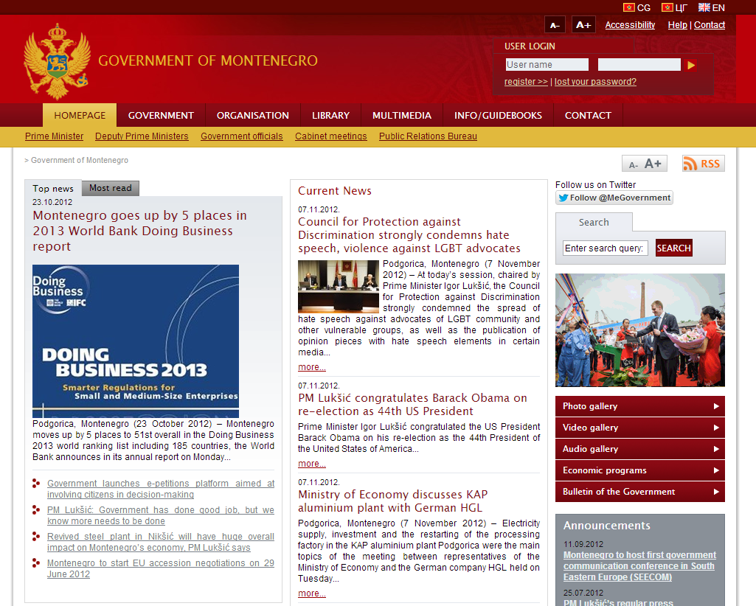
Chapter 03: Right of establishment and freedom to provide services
Providing information, advice and other assistance www.gov.me
M O N T E N E G R O
Negotiating Team for the Accession of Montenegro to the European Union
Chapter 3

Slide 14
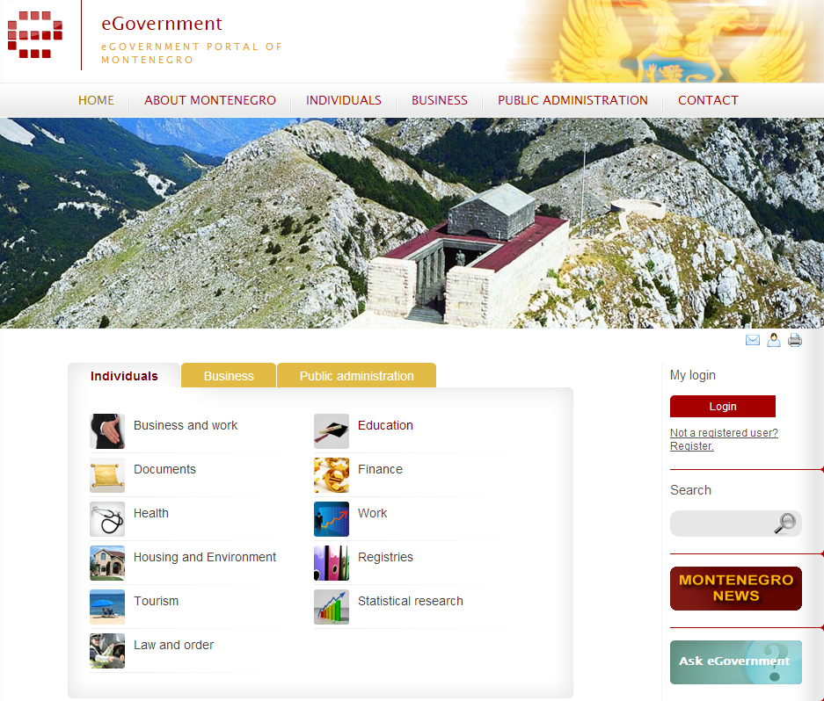
Chapter 03: Right of establishment and freedom to provide services
eGovernment Portal
www.euprava.me
M O N T E N E G R O
Negotiating Team for the Accession of Montenegro to the European Union
Chapter 3

Slide 15
Chapter 03: Right of establishment and freedom to provide services
Chapter 03: Right of establishment and freedom to provide services
eGovernment Portal
www.euprava.me
Natural or Legal person
Search electronic services
Qualified certificate authentication
Filling out the online form
End
Electronic payment
eSignature
Attach documents
M O N T E N E G R O
Negotiating Team for the Accession of Montenegro to the European Union
Chapter 3

Slide 16
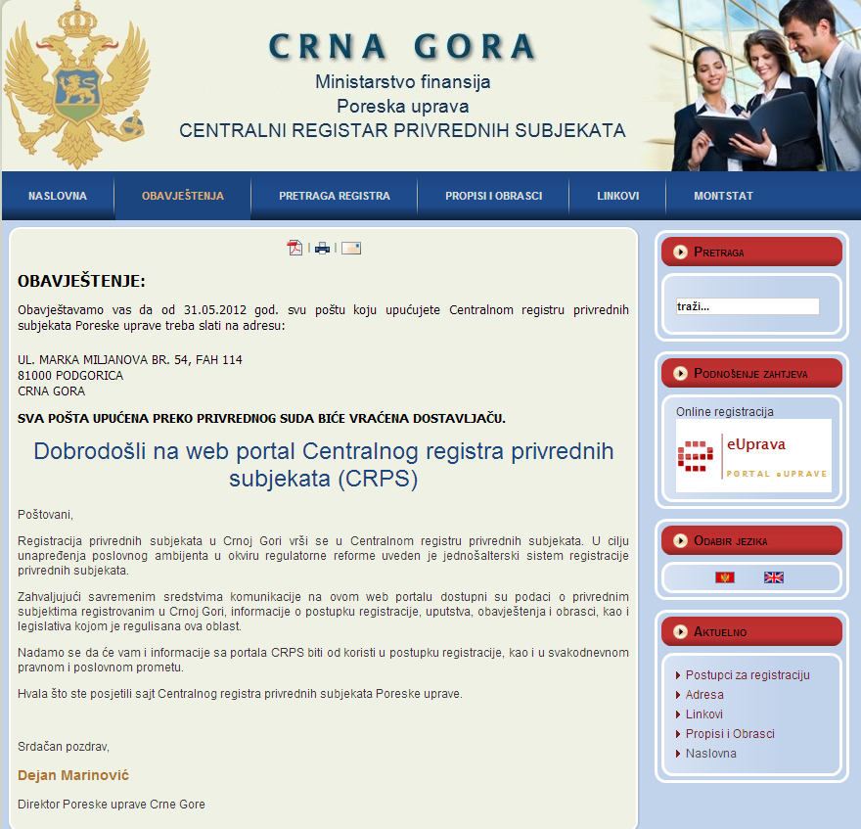
Chapter 03: Right of establishment and freedom to provide services
Central Business Register
www.crps.me
M O N T E N E G R O
Negotiating Team for the Accession of Montenegro to the European Union
Chapter 3

Slide 17
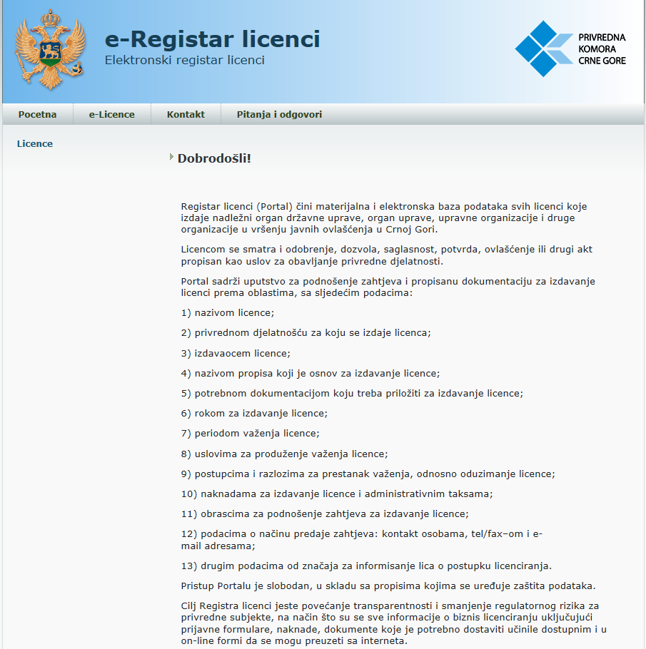
Chapter 03: Right of establishment and freedom to provide services
Registar licenci
www.licence.me
Chapter 3
M O N T E N E G R O
Negotiating Team for the Accession of Montenegro to the European Union
Poglavlje 25
Nauka i istraživanje

Slide 18
Chapter 03: Right of establishment and freedom to provide services
Certification bodies in The Montegro
Montenegro Post
http://www.postacg-ca.me
Ministry for Information Society and Telecommunication
www.pki.gov.me
M O N T E N E G R O
Negotiating Team for the Accession of Montenegro to the European Union
Chapter 3

Slide 19
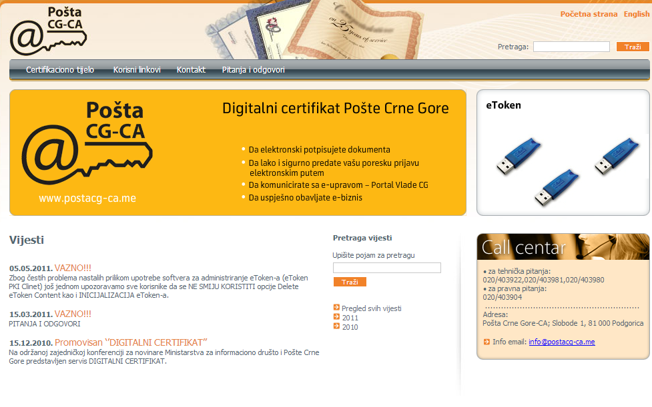
Chapter 03: Right of establishment and freedom to provide services
Montenegro Post
http://www.postacg-ca.me
M O N T E N E G R O
Negotiating Team for the Accession of Montenegro to the European Union
Chapter 3

Slide 20
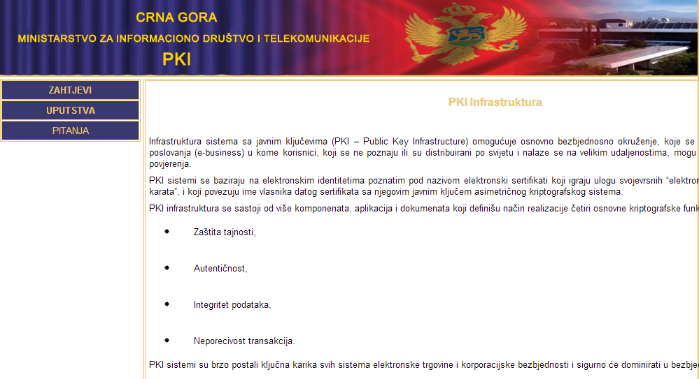
Chapter 03: Right of establishment and freedom to provide services
Ministry for Information Society and Telecommunication
www.pki.gov.me
M O N T E N E G R O
Negotiating Team for the Accession of Montenegro to the European Union
Chapter 3

Slide 21
Thank you for your attention!
QUESTIONS

