Slide 1


M O N T E N E G R O
Negotiating Team for the Accession of Montenegro to the European Union
Working Group for Chapter 9 – Financial Services
Bilateral screening: Chapter 9
PRESENTATION OF MONTENEGRO
Brussels, 10 - 11 june 2013

Slide 2


Financial Services
Chapter 9:
Securities and Exchange Commission
of Montenegro
- institutional and administrative capacities -
Aleksandar Djuričković
Securities and Exchange Commission of Montenegro
adjurickovic@scmn.me
M O N T E N E G R O
Negotiating Team for the Accession of Montenegro to the European Union
Chapter 9:
Financial Services

Slide 3
OUTLINE OF PRESENTATION
Financial Services
Chapter 9:
            Legal framework
            Institutional framework
            Commission Responsibilities
            Personal independence
            Financial independence
            Cooperation
            Market structure
            Supervisory practice
M O N T E N E G R O
Negotiating Team for the Accession of Montenegro to the European Union
Chapter 9:
Financial Services

Slide 4
LEGAL FRAMEWORK
Financial Services
Chapter 9:
Law on Securities (OGRM no. 59/00 and 28/06 and OGRM no. 53/09, 73/10, 40/11 and 06/13 )
Article 1
This Law regulates the types of securities, the issue of securities and trade in those securities, the rights and obligations of entities on the securities market, and the organisation, scope of work and responsibilities of the Securities and Exchange Commission of Montenegro.
Law on investmend funds (OGM, No. 54/11 of 17November, 2011)
Law on voluntary pension funds (OGRM, no. 78/06 and OGM no 40/11)
M O N T E N E G R O
Negotiating Team for the Accession of Montenegro to the European Union
Chapter 9:
Financial Services

Slide 5
INSTITUTIONAL FRAMEWORK
Financial Services
Chapter 9:
Establishment and Status of
Securities and Exchange Commission of Montenegro
Law on Securities (Article 7)
The Commission is an organization of the Montenegro, with the status of a legal person, established for the purpose of regulating and supervising the issue of and trade in securities.
The headquarters of the Commission shall be in Podgorica.
The Commission shall be independent and autonomous in the conduct of its activities as specified in the law and shall report to the Parliament of Montenegro.
M O N T E N E G R O
Negotiating Team for the Accession of Montenegro to the European Union
Chapter 9:
Financial Services

Slide 6
Commission Responsibilities
Financial Services
Chapter 9:
The Commission shall have the following responsibilities:
to make Rules with respect to implementation of this Law, when authorised therefore;
to ensure that this Law and any Rules made under this Law are complied with;
to approve public offers of securities and keep records of issues of securities which are not sold by public offer;
to supervise public offers of securities;
to license and approve relevant acts of securities markets, authorised market participants and Central Depository Agency;
to authorise and regulate collective investment schemes established in accordance with a separate Law and approve adequate acts;
to approve nomination of executive directors of the persons licensed by the Commission;
keep records and registers in accordance with provisions of this Law that are freely available to the interested persons for inspection;
to set general requirements to be met by natural persons professionally engaged in trade in securities;
to promote and encourage high standards of investor protection and integrity among licensees;
to monitor and enforce Rules for the conduct of business by licensees including the suspension and revocation of licenses;
to undertake measure and support the operation of an orderly, fair and properly informed securities market;
to regulate the manner and scope of trading on a securities market;
13a. to determine highest value of commissions and other fees collected by the stock exchange for its services, when it determines that their amount discourages development of securities market;
13b. to regulate issuance and trade in short-term securities in more details.
15. to take all steps to safeguard the interests of persons who invest in securities and to suppress illegal, dishonourable and improper practices in relation to dealings in securities;
16. to take actions and perform control and examination to prevent any frauds on the securities
market;
to co-operate with other related authorities in Montenegro or elsewhere; and
to take other actions and perform other duties under the law.
M O N T E N E G R O
Negotiating Team for the Accession of Montenegro to the European Union
Chapter 9:
Financial Services

Slide 7
Personal independence
Financial Services
Chapter 9:
Membership and Nomination of the Commission Members
Law on Securities (Article 11)
The Commission shall consist of 5 members: the chairman, the deputy chairman, and three members.
The Commission shall be appointed by the Parliament from persons nominated by the Government of the Montenegro.
The persons with university education and professional experience of more than 5 years in the areas of law, monetary, economic or financial systems and with a recognized standing eligible for this position may be nominated as a member of the Commission.
The following persons shall not be eligible for appointment as members of the Commission:
the persons elected, nominated or employed in government bodies;
members of governing and managing boards, executive bodies and secretaries of the securities issuers,
shareholders and employees of Stock Exchanges, licensees, Central Depository Agency; and
persons in matrimony with each other or in kinship either in an ascendant line, or in a collateral line, or in-laws up to the third degree.
M O N T E N E G R O
Negotiating Team for the Accession of Montenegro to the European Union
Chapter 9:
Financial Services

Slide 8
Personal independence
Financial Services
Chapter 9:
Term of Office
Law on Securities (Article 12)
A member of the Commission shall be appointed for the term of five years and may be re-appointed.
The office of a member shall be vacated:
if he is performing his duties as a member of the Commission in a negligent and inefficient manner;
if he becomes permanently incapable of performing his duties as a member;
if he is convicted with an unconditional custodial sentence or of an offence that makes him unworthy of the position of a member;
if he is absent from three consecutive meetings of the Commission without the Commission's permission.
A member may resign his office by letter sent to the Parliament.
M O N T E N E G R O
Negotiating Team for the Accession of Montenegro to the European Union
Chapter 9:
Financial Services

Slide 9
Personal independence
Financial Services
Chapter 9:
Conflict of Interest
Law on Securities (Article 15)
Members of the Commission and employees of the expert body of the Commission shall be obliged to comply with the highest professional standards and act in accordance with the Code of Ethics to be established by the Commission, in order to avoid a possible conflict of interest
If the chairman, deputy chairman or a member of the Commission have been connected in any way with the subject matter of deciding or have been directly or indirectly interested in such subject matter, they shall as soon as practicable after the commencement of the meeting, disclose the interest and shall not, unless the Commission otherwise directs, take part in any consideration or discussion of, or vote on, any question touching that matter.
M O N T E N E G R O
Negotiating Team for the Accession of Montenegro to the European Union
Chapter 9:
Financial Services

Slide 10
Financial independence
Financial Services
Chapter 9:
Funding
Law on Securities (Article 19)
The Commission shall be funded from:
the fees and charges paid along with applications submitted to the Commission;
the fees and charges paid with respect to registration and transfer of securities with the competent registration authority.
The amount of the fees and charges mentioned above shall be prescribed by the Commission. The Commission may also be funded from other sources.
Financial Year
Law on Securities (Article 20)
The financial year of the Commission shall be the period of twelve months ending on 31 December in each year, and its first financial year shall begin on the date of enforcement of this Law and end on 31 December of that year.
Excess of revenues over expenditures of the Commission is contributed to the budget of Montenegro.
M O N T E N E G R O
Negotiating Team for the Accession of Montenegro to the European Union
Chapter 9:
Financial Services

Slide 11
Cooperation
Financial Services
Chapter 9:
Law on Securities (Article 8, paragraph 17)
The Commission shall have the responsibilities to co-operate with other related authorities in Montenegro or elsewhere
Cooperation of the Commission with other Regulatory Authorities
Law on Securities (Article 18a)
At the request of competent state body or foreign body competent for supervision of trade in securities, the Commission shall be obliged to submit necessary data and information.
Exchange of data and information referred to in paragraph 1 of this Article shall not be considered as disclosure of business secret.
M O N T E N E G R O
Negotiating Team for the Accession of Montenegro to the European Union
Chapter 9:
Financial Services

Slide 12
Organizational chart
Financial Services
Chapter 9:
Commission
General secretary
Corporate governance department
Development and cooperation department
Investment and pension funds department
Capital market department
The secretariat
Cabinet of the Chairman
M O N T E N E G R O
Negotiating Team for the Accession of Montenegro to the European Union
Chapter 9:
Financial Services

Slide 13
Market structure
Financial Services
Chapter 9:
CENTRAL DEPOSITARY AGENCY
Central registry
Depositing of dematerialized securities
Clearing and settlement
MONTENEGRO STOCK EXCHANGE
Official market
  A list
  B list
Free market
free share market
investment funds share market
government bonds
municipal bonds
corporate bonds
short-term securities
primary sales
a special list (share for bonds, state-owned securities, special state funds offer, public offer-takeover) and
sub - segment of free share market.
M O N T E N E G R O
Negotiating Team for the Accession of Montenegro to the European Union
Chapter 9:
Financial Services

Slide 14
Turnover and number of transactions
Financial Services
Chapter 9:
M O N T E N E G R O
Negotiating Team for the Accession of Montenegro to the European Union
Chapter 9:
Financial Services

Slide 15
Market capitalization
Financial Services
Chapter 9:
M O N T E N E G R O
Negotiating Team for the Accession of Montenegro to the European Union
Chapter 9:
Financial Services

Slide 16
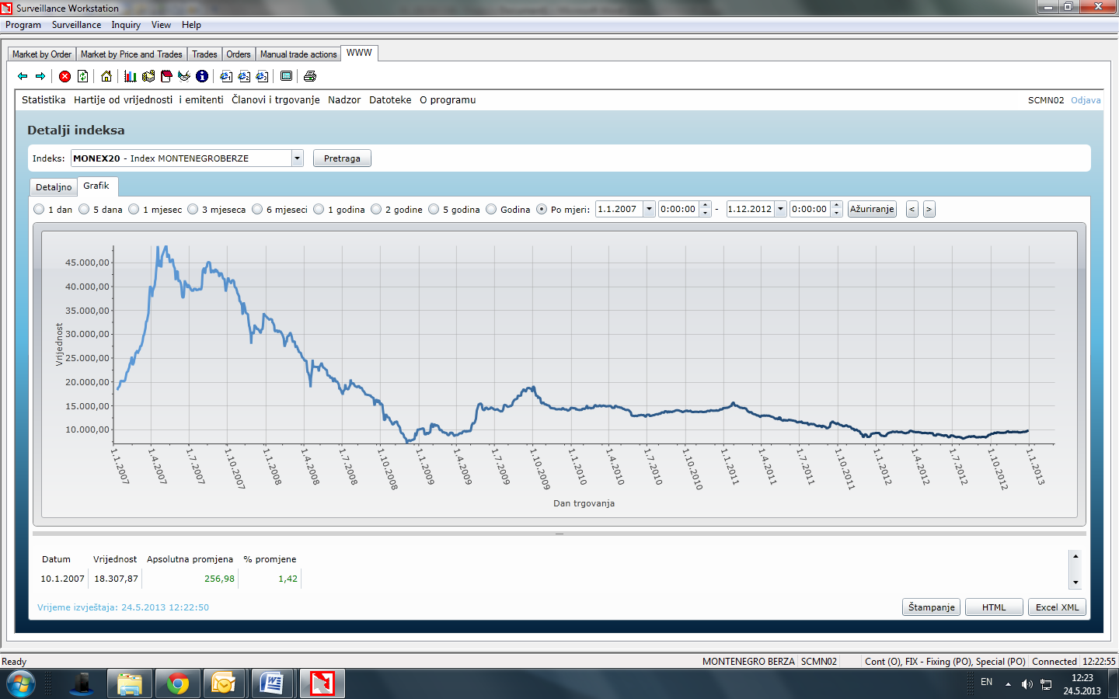
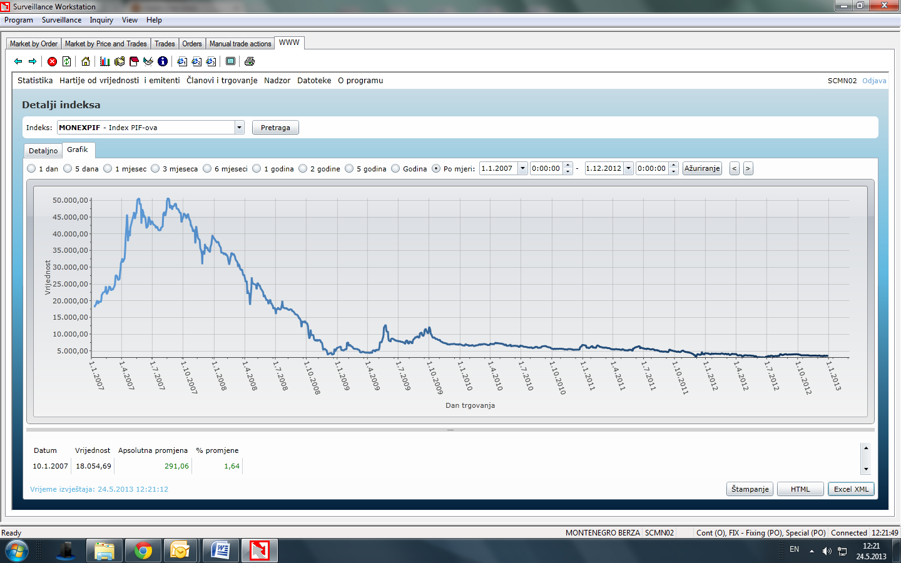
Indices of Montenegro Stock Exchange
Financial Services
Chapter 9:
MONEX20 from 2007 to 2012
MONEXPIF from 2007 to 2012
M O N T E N E G R O
Negotiating Team for the Accession of Montenegro to the European Union
Chapter 9:
Financial Services

Slide 17
Issuance of new capital
Financial Services
Chapter 9:
M O N T E N E G R O
Negotiating Team for the Accession of Montenegro to the European Union
Chapter 9:
Financial Services

Slide 18
Investment intermediaries
Financial Services
Chapter 9:
M O N T E N E G R O
Negotiating Team for the Accession of Montenegro to the European Union
Chapter 9:
Financial Services

Slide 19
Investment and voluntary pension funds
Financial Services
Chapter 9:
M O N T E N E G R O
Negotiating Team for the Accession of Montenegro to the European Union
Chapter 9:
Financial Services

Slide 20
Supervisory practice
Financial Services
Chapter 9:
- Law on Securities (Article 7)
The Commission is an organization of the Montenegro, with the status of a legal person, established for the purpose of regulating and supervising the issue of and trade in securities.
- Rules on control over securities business (OGRM no. 28/07, OGM no. 19/12 and 09/13)
- Annual plan of supervision
M O N T E N E G R O
Negotiating Team for the Accession of Montenegro to the European Union
Chapter 9:
Financial Services

Slide 21
Thank you for your attention!
QUESTIONS

