Slide 1


M O N T E N E G R O
Negotiating Team for the Accession of Montenegro to the European Union
Working Group for Chapter 13 –Fisheries
Bilateral screening: Chapter 13
INSPECTION AND CONTROL
Dragana Kandic Perovic
Brussels, 5 – 6 June 2013

Slide 2

Institutional Capacity
Chapter 13: Fisheries
Ministry of Agriculture and Rural Development,
Unit for Fisheries
  Directly in charge of administrative and technical issues in fisheries, develops and implements laws, secondary legislation and an annual plan of use of funds for measures of support to development of agriculture and fisheries
Administration for Inspection Affairs – Marine Fisheries Inspectorate
  Carries out inspectorial surveillance and control in marine fisheries
Administration for Inspection Affairs – Veterinary Inspectorate
  Carries out inspectorial supervision over imports/exports of fish and fish products, controls implementation of all hygiene requirements concerning the farming, catch, transport, processing and trade in fish and fish products, including the control of facilities and taking of samples for analysis
Ministry of Interior – Border Marine Police
  With its vessels, provides assistance to the Marine Fisheries Inspectorate in inspection and control
Institute of Marine Biology Kotor
- scientific institution
Chapter 13:
Fisheries
M O N T E N E G R O
Negotiating Team for the Accession of Montenegro to the European Union
Poglavlje 25
Nauka i istraživanje

Slide 3
Fisheries Inspectorate organigram under the Administration
Chapter 13: Fisheries
Administration for Inspection Affairs
Department for Food Safety
Veterinary Inspectorate
Inspectorate for Marine Fisheries
Agricultural
Inspectorate
Phytosanitary
Inspectorate
Water Management Inspectorate
Forestry Inspectorate
Sanitary Inspectorate
Chapter 13:
Fisheries
M O N T E N E G R O
Negotiating Team for the Accession of Montenegro to the European Union
Poglavlje 25
Nauka i istraživanje

Slide 4
Administrative Capacity for Inspection and Control
Chapter 13: Fisheries
5 inspectors are authorised for inspectorial surveillance in freshwater fisheries
3 inspectors are authorised for inspectorial surveillance in marine fisheries
  Inspectors for marine fisheries are based in Bar, Herceg Novi and Kotor
  They have more than 15 year experience in inspection and control activities
  All inspectors have university degrees – engineers of agriculture, maritime engineers and biologist
  Under the CARDS project and IPA 2009 project ‘’Sustainable Management of Marine Fisheries’ seminars, workshops and direct work with experts were organized for inspectors in order to build their capacity for more efficient control, monitoring and supervision activities.
Chapter 13:
Fisheries
M O N T E N E G R O
Negotiating Team for the Accession of Montenegro to the European Union
Poglavlje 25
Nauka i istraživanje

Slide 5
Technical Capacity for Inspection and Control
Chapter 13: Fisheries
All inspectors for marine fisheries are provided with:
Adequate office facilities with internet connection
Lap top computers
Multifunction color printers
Mobile telephones
Digital cameras
Binoculars
Ichthyometers
Official vehicles
Mesh size measuring device (Omega Gauge: OMG09071070)
Inspectorate does not have its own vessel, so it makes use of the assistance from the Border Maritime Police.
Border Maritime Police has 8 patrol vessels at disposal for assisting the Fisheries Inspectorate, of which 6 are in the Adriatic aquatorium and 2 in the aquatorium of the Lake of Skadar
Chapter 13:
Fisheries
M O N T E N E G R O
Negotiating Team for the Accession of Montenegro to the European Union
Poglavlje 25
Nauka i istraživanje

Slide 6
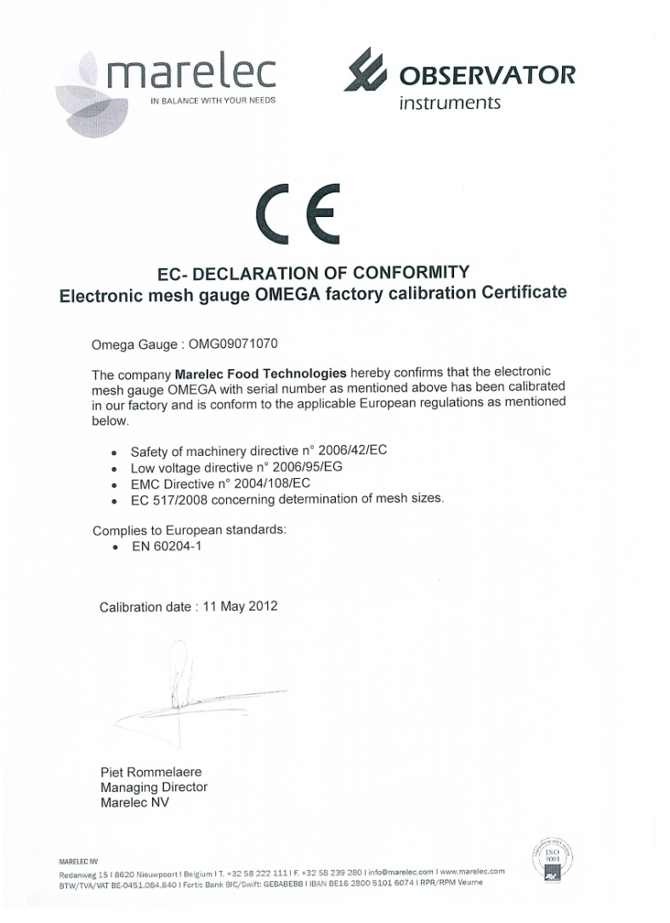
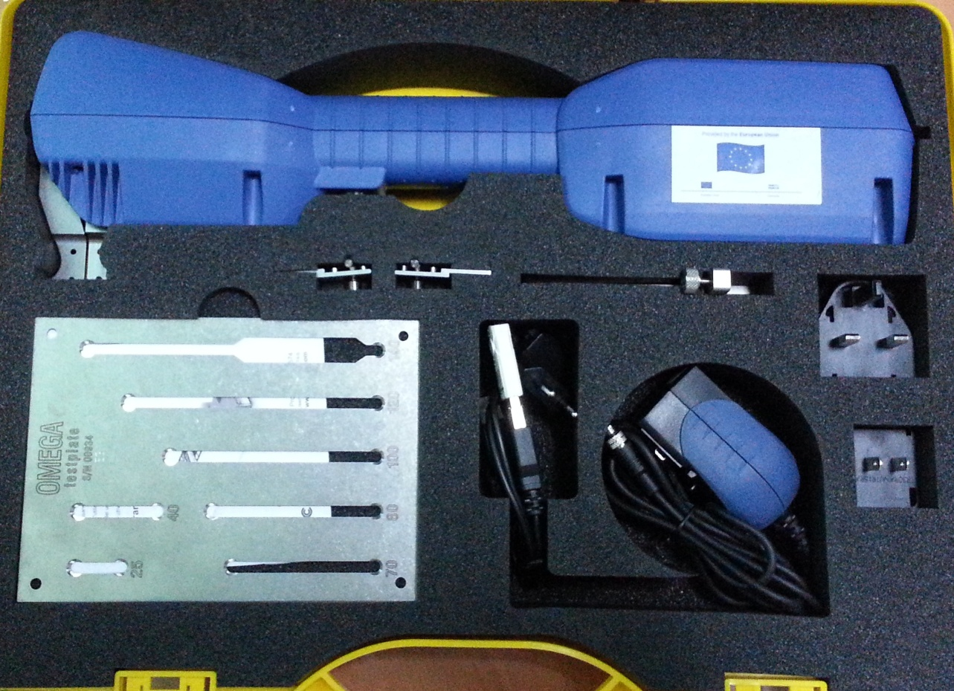
Chapter 13: Fisheries
COMMISSION REGULATION (EC) No 517/2008
of 10 June 2008
laying down detailed rules for the implementation of Council Regulation (EC) No 850/98 as regards
the determination of the mesh size and assessing the thickness of twine of fishing nets
Omega Gauge: OMG09071070
M O N T E N E G R O
Negotiating Team for the Accession of Montenegro to the European Union
Chapter 13:
Fisheries

Slide 7
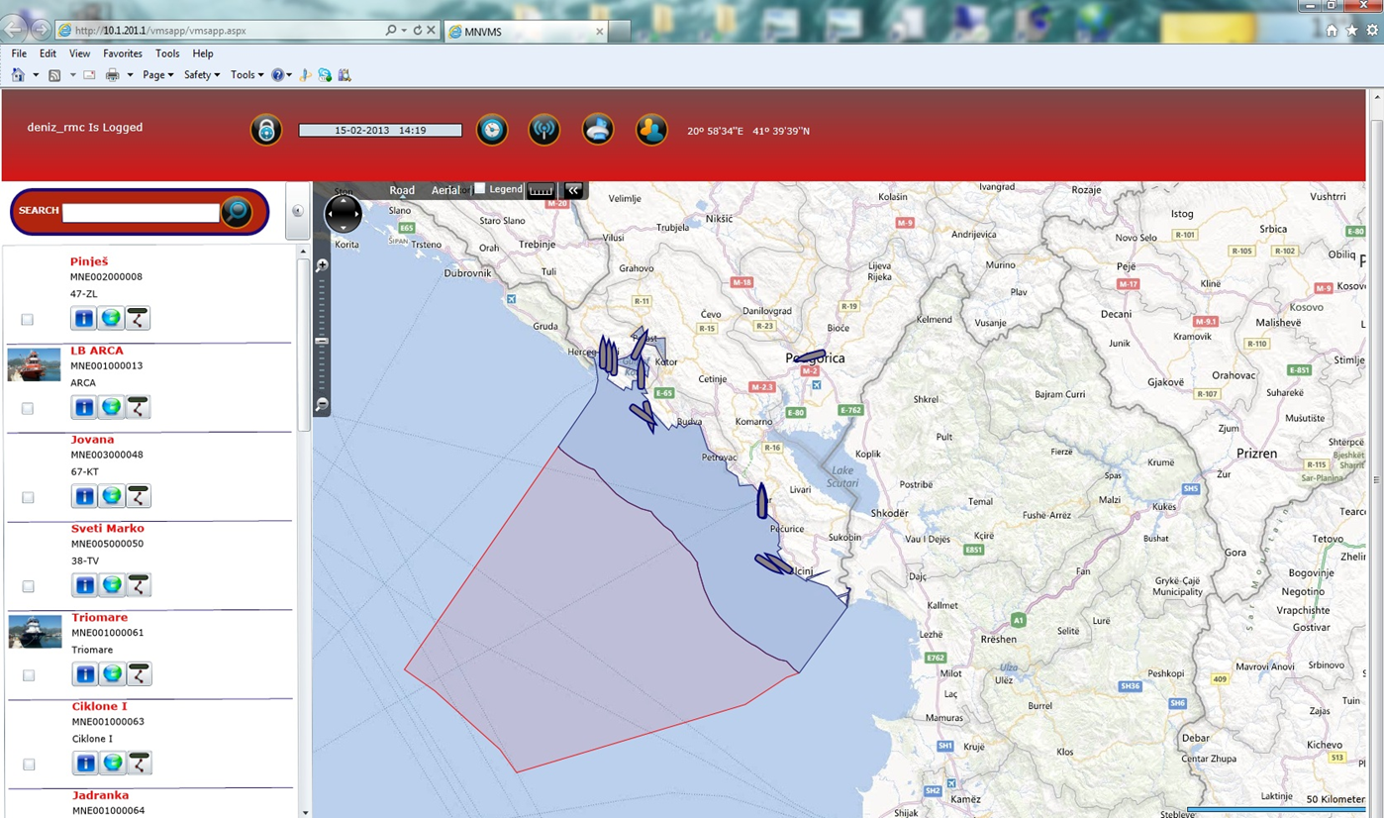

M O N T E N E G R O
Negotiating Team for the Accession of Montenegro to the European Union
Vessel Monitoring System
Chapter 13 Fisheries

Slide 8
Legal Framework
Chapter 13: Fisheries
Law on Marine Fisheries and Mariculture (OG MNE 56/09)
Law on Freshwater Fisheries (OG MNE 14/07)
Law on Inspectorial Surveillance (OG RMNE 39/03, OG MNE 76/09, 57/11)
Veterinary Law (OG MNE 30/2012)
Law on Food Safety (OG MNE 14/07, 40/11)
Law on Consumer Protection (OG MNE 26/2007, 40/2011)
Law on General Administrative Procedure (OG RMNE 60/03, OG MNE 32/11)
Law on Misdemeanours (OG MNE 1/11, 6/11, 39/11)
Law on amendments to the Law laying down pecuniary fines for misdemeanours (OG MNE 40/2011)
Criminal Code (OG RMNE 70/03, 13/04, 47/06, OG MNE 40/08, 25/10, 32/11)
Secondary legislation (rulebooks, orders)
Chapter 13:
Fisheries
M O N T E N E G R O
Negotiating Team for the Accession of Montenegro to the European Union
Poglavlje 25
Nauka i istraživanje

Slide 9
Competencies of marine fishery inspectors(I)
Chapter 13: Fisheries
In addition to the powers of inspector as laid down by the Law on Inspectorial Supervision, a fisheries inspector is authorised, in accordance with Article 113 of the Law on Marine Fisheries and Mariculture to:
  monitor and control fishing and the use of fishing tools and gear in such fishing;
  inspect whether commercial, sport-recreational and the fishing for the purpose of science and researches is conducted in approved fishing areas, mariculture zones and protected fishing areas by approved tools, at approved time and in the approved manner;
  inspect and control markets, storages, restaurants, harbours-ports, moles and similar facilities that are important for trading of fish and fishery products;
  monitor and control implementation of the Strategy, Plan, Programme for monitoring the condition of settlements of economically important fish and other marine organisms in the seabed and in the sea waters, implementation of Annual Operational Plan for the implementation of the Strategy and the Annual Programme for monitoring, control and surveillance of the fishing sea of Montenegro.
Chapter 13:
Fisheries
M O N T E N E G R O
Negotiating Team for the Accession of Montenegro to the European Union
Poglavlje 25
Nauka i istraživanje

Slide 10
Competencies of marine fishery inspectors(II)
Chapter 13: Fisheries
  shall go onboard of the fishing vessel and inspect that facility, fishing gear, load, storage, fish, documents and other objects, and to stop the fishing vessel;
  enter rooms next to the boar house, or the vehicle in which the fish or fishing gear is kept or transported and inspect rooms or vehicles and to stop the vehicle used for the transport of fish;
  stop the vehicle for inspecting whether it carries fish and other marine organisms;
  inspect fishing gear or objects reasonably suspected to be used or intended for collecting, treating or processing fish;
  interrogate the person, who in his/her opinion may provide information that he/she needs for inspection surveillance;
  request from a person employed at the fishing vessel to assist in inspecting containers, fishing gear, fish or documents on or in such a vessel;
  request from the captain to ensure appropriate boarding to the ship;
  stop and inspect the vehicle reasonably suspected of carrying fish that is caught illegally or by using prohibited fishing gear;
  inspect fishing vessel regardless whether it was engaged in fishing or other activity related to fishing at the time.
Chapter 13:
Fisheries
M O N T E N E G R O
Negotiating Team for the Accession of Montenegro to the European Union
Poglavlje 25
Nauka i istraživanje

Slide 11
Competencies of marine fishery inspectors(III)
Chapter 13: Fisheries
Powers of fishery inspectors for conducting inspection, which are stipulated by Law on Marine Fisheries and Mariculture and the Law on Inspectorial Supervision apply to:
  fishing vessels flying Montenegrin flag within and beyond the fishing waters of Montenegro;
  foreign fishing vessels flying a foreign flag in the fishing waters of Montenegro and under authorizations stipulated by international agreement outside the fishing waters of Montenegro.
Chapter 13:
Fisheries
M O N T E N E G R O
Negotiating Team for the Accession of Montenegro to the European Union
Poglavlje 25
Nauka i istraživanje

Slide 12
Objectives and Methodology of Inspectorial Control(I)
Chapter 13: Fisheries
Currently, Montenegro does not have in place a separate strategy for inspectorial control in the fisheries sector
Objectives of the inspectorial control are set on the basis of the analysis of previous inspectorial activities, at the orders of the competent authority for marine fisheries and on the basis of reports of legal and natural persons on the irregularities noted
Inspectorial surveillance procedure includes:
  Carrying out of control,
  Deciding on rights and obligations of the entity under surveillance in the course of the inspection
  Undertaking of administrative measures and activities
  Execution of administrative measures and activities
Chapter 13:
Fisheries
M O N T E N E G R O
Negotiating Team for the Accession of Montenegro to the European Union
Poglavlje 25
Nauka i istraživanje

Slide 13
Objectives and Methodology of Inspectorial Control(II)
Chapter 13: Fisheries
The course of the inspection and control procedure:
Inspector presents himself and shows ID
  Informs the controlled entity of the rights and obligations as well as of the objective of the control
  Where a vessel is controlled, the identity of the person responsible is established as well as the purpose of the vessel and possession of the fishing permit
  Checks of fishing tools and gear, whether they are registered in the permit and checking whether their technical-construction characteristics are in line with those prescribed (mesh size, hook number and size, net length, etc.)
  Control of accuracy of data entered into the catch logbook and size of fish caught
  Making the protocol on inspection performed on the spot, signed by inspector and controlled entity
  In case irregularities are established, the inspector adopts decision on measures, activities and deadlines for elimination of irregularities
  In case of failure to eliminate the irregularities within the deadline set, the inspector issues a misdemeanour report in line with the Law on amendments to the Law laying down the pecuniary fines for misdemeanours (Official Gazette of Montenegro 40/2011).
Chapter 13:
Fisheries
M O N T E N E G R O
Negotiating Team for the Accession of Montenegro to the European Union
Poglavlje 25
Nauka i istraživanje

Slide 14
Statistical data on inspections and controls performed
Chapter 13: Fisheries
 | 2010 | 2011 | 2012
Controls | 968 | 1063 | 1090
Misdemeanour reports | 10 | 11 | 11
Gear seized | / | / | /
As of 2012, misdemeanour reports are issued. Total amount of pecuniary fines collected in fisheries amounts to EUR 5550
Chapter 13:
Fisheries
M O N T E N E G R O
Negotiating Team for the Accession of Montenegro to the European Union
Poglavlje 25
Nauka i istraživanje

Slide 15
Administrative Sanctions
Chapter 13: Fisheries
Inspector for marine fisheries may by a decision:
  prohibit fishing without a fishing permit or fishing by means and tools which are contrary to the permit, or order removal of any irregularity which is contrary to provisions of the Law on Marine Fisheries and Mariculture or some auxiliary regulation from the area of marine fisheries;
  seize a vessel, means of transportation, fishing gear, documents and other objects used in committing an offence;
  prohibit use of or attempt to use explosive, fire arms, poison or other harmful substances for the purpose of killing, stunning or incapacitating or catching fish and facilitation of catching fish;
  prohibit use of gear from the List of prohibited fishing gear and practices;
  prohibit fishing in marked areas in the fishing area on sea where there are telephone, telegraph or electric power cables, pipes or other devices, as well as archeological sites and objects or to use fishing tools and gear which might damage them;
  prohibit disembarking, display for sale, trade, transport and possession of fish and other marine organisms and fish products, as well as use of fish and other marine organisms and fish products in restaurants contrary to this law;
  order anchorage of a fishing vessel which has been seized, confiscated or kept for the purpose of prevention of its use until adoption of a decision on release;
  order turnover of objects for which there is reasonable doubt that they were used in a misdemeanor.
Chapter 13:
Fisheries
M O N T E N E G R O
Negotiating Team for the Accession of Montenegro to the European Union
Poglavlje 25
Nauka i istraživanje

Slide 16
Pecuniary Fines
Chapter 13: Fisheries
In accordance with the Law on Marine Fisheries and Mariculture and in line with the Law on amendments to the Law laying down the pecuniary fines for misdemeanours (Official Gazette of Montenegro 40/2011), the amount of pecuniary fines depends on: misdemeanour type, whether the offender is a natural person, an entrepreneur, a business organisation or a ship master
The pecuniary fines range:
Fines for natural persons – from €200 to € 750
Fines for business organisations and entrepreneurs - from € 400 to € 750
Fines for a person responsible in the business organisation range from € 250 to € 750
Fines for a ship master range from € 750 to € 1500
Chapter 13:
Fisheries
M O N T E N E G R O
Negotiating Team for the Accession of Montenegro to the European Union
Poglavlje 25
Nauka i istraživanje

Slide 17
Montenegro’s current status with regard to fishing with foreign fishing vessels
Chapter 13: Fisheries
In accordance with Article 42 of the Law on Marine Fisheries and Mariculture (Official Gazette of Montenegro 56/09) fishing with fishing vessels flying the flag of a foreign country is prohibited in the territorial waters of Montenegro.
Notwithstanding the provisions of this article, in accordance with Article 95, a foreign fishing vessel may fish in the fishing sea of Montenegro in accordance with a ratified international agreement based on the permit issued in accordance with that agreement and conditions laid down by the law.
Where there is no ratified international agreement on fishing in the fishing sea of Montenegro, a foreign fishing vessel may engage in fishing only for the scientific-research purposes in accordance with the approved scientific-research project of national interest, with permission from the administration authority in charge of marine fisheries.
Chapter 13:
Fisheries
M O N T E N E G R O
Negotiating Team for the Accession of Montenegro to the European Union
Poglavlje 25
Nauka i istraživanje

Slide 18
Montenegro’s current status concerning landing and transhipping from foreign fishing vesssels
Chapter 13: Fisheries
In accordance with Article 111 of the Law on Marine Fisheries and Mariculture (Official Gazette of Montenegro 56/09), a foreign fishing vessel, when landing and transhipping fish and other marine organisms and fish products enjoys the same treatment as a third-country fishing vessel.
Landing and transhipment from a foreign fishing may be done only in a port, a harbour or other places meeting the technical requirements prescribed for inspection of foreign fishing vessel, i.e. the site for landing and transhipment.
Montenegro has not yet designated a port for third countries ships, that is, it has not yet designated the site for landing and transhipment.
We have not yet had cases of landing and transhipment from foreign fishing vessels.
Chapter 13:
Fisheries
M O N T E N E G R O
Negotiating Team for the Accession of Montenegro to the European Union
Poglavlje 25
Nauka i istraživanje

Slide 19
Montenegro’s current status concerning the IUU fishing
Chapter 13: Fisheries
Montenegro does not have a definition for IUU fishing as laid down by the Regulation 1005/2008.
The Law on Marine Fisheries and Mariculture (Official Gazette of Montenegro 56/09) recognises the illegal, unregulated and unreported fishing as fishing without a permit, fishing with tools and gear not allowed, fishing in sites not allowed for fishing, as well as fishing of juvenile fish, etc
Appropriate misdemeanour or criminal penalty is provided for all activities that are not allowed or are prohibited
Chapter 13:
Fisheries
M O N T E N E G R O
Negotiating Team for the Accession of Montenegro to the European Union
Poglavlje 25
Nauka i istraživanje

Slide 20
Challenges
Chapter 13: Fisheries
Further harmonisation of legislation with the EU Acquis particularly with regard to the IUU fishing
Further building of administrative and technical capacities of the Fisheries Inspectorate
Further development of the system of control of catch logbook, the declaration of landing and the sales note declaration, that is, establishing of data cross-checking
Setting up of a list and register of serious offences
Setting up of the system of standard operational procedure and standard reporting procedures
Setting up of a system of recognition of catch report
Chapter 13:
Fisheries
M O N T E N E G R O
Negotiating Team for the Accession of Montenegro to the European Union
Poglavlje 25
Nauka i istraživanje

Slide 21
Thank you for your attention!
QUESTIONS

