Slide 1


MANAGEMENT OF RESOURCES
M O N T E N E G R O
Negotiating Team for the Accession of Montenegro to the European Union
Working Group for Chapter 13 - Fishery
Ana Pesic, Aleksandar Joksimovic
pesica@ac.me
Brussels, 5 – 6 June, 13

Slide 2

Resources management
M O N T E N E G R O
Negotiating Team for the Accession of Montenegro to the European Union
Institutional framework
Ministry of Agriculture and Rural development
MARD
Institute of Marine Biology, Kotor
IMBK
Administration for Inspection Affairs
Fisheries Inspectorate
2
Chapter 13
Fishery

Slide 3
MARD - Ministry of Agriculture and Rural development
The Ministry of Agriculture, and Rural Development - MARD is directly in charge of the fishery-related administrative and technical issues.
The MARD proposes, develops and implements laws and bylaws and carries out supervision and control over the enforcement of regulations governing the sector of fisheries and aquaculture.
In January 2009 a Fisheries Unit was established in the MARD

Slide 4
IMBK – Institute of marine biology
M O N T E N E G R O
Negotiating Team for the Accession of Montenegro to the European Union
National scientific institution in charg for monitoring of marine fisheries is Institute of marine biology, Kotor – IMBK. For the purpose of sustainable exploitation and development of marine resources and marine environment, Article 38. of Law on marine fisheries and aquaculture defines that IMBK shall perform the following tasks:
Research and assessment of fish stocks;
Monitoring the condition and assessment for the purpose of sustainable exploitation of fish and other marine organisms;
Monitoring the population dynamics of fish;
Preparing of professional bases for the Strategy, Management Plan and mariculture development;
Monitoring of the water quality and biomonitoring;
Setting of technical and technological terms for fishing;
Providing expert assistance in implementation of activities related to fisheries and mariculture and reporting on activities implemented, at the request of the administration authority.
4
Chapter 13
Fishery

Slide 5
Fisheries Inspectorate
M O N T E N E G R O
Negotiating Team for the Accession of Montenegro to the European Union
The Administration for Inspection Affairs, i.e. the Fisheries Inspectorate under the Department for Protection and Safety of Human, Animal and Plant Health is in charge of implementation of activities of inspectorial supervision in fisheries (established in January 12).
Three inspectors are authorised for inspectorial supervision in marine fisheries and five agricultural inspectors carry out inspections in freshwater fisheries.
The Inspectorate for Marine Fisheries does not have its own vessel for the control and surveillance over fishing at sea, so it uses occasionally the assistance of the Border Maritime Police (Ministry of Interior).
Authorities, administrative measures and actions of fishery inspectors are specified in Articles 113 and 114 of Law on marine fisheries and mariculture, while penalty provisions are specified in Articles 116-1.
5
Chapter 13
Fishery

Slide 6
M O N T E N E G R O
Negotiating Team for the Accession of Montenegro to the European Union
Legal Framework in Montenegro
Law on Marine Fishery and Mariculture
(OG of Montenegro 56/09)
The Law on Marine Fishery and Mariculture lays down the objectives and the principles for sustainable management of living marine resources and marine environment through implementation of measures for protection of biodiversity and the environmental conditions as well as by laying down the procedures for development and adoption of management plans in the fishery sector.
Law governs the general fishery policy, that is, the support to development of the fishery sector and the respective responsibilities of the administration authorities as regards its implementation.
6
Chapter 13
Fishery

Slide 7
M O N T E N E G R O
Negotiating Team for the Accession of Montenegro to the European Union
Legal Framework in Montenegro
Law on Marine Fishery and Mariculture
(OG of Montenegro 56/09)
I - GENERAL PROVISIONS
II - MANAGEMENT OF THE LIVING MARINE RESOURCES
III - FISHERIES POLICY MEASURES
IV - COMPETENCIES
V - MARINE FISHING
VI - MARICULTURE
VII - PRODUCERS ORGANIZATION IN FISHERY
VIII - FOREIGN FISHING VESSELS AND INTERNATIONAL RELATIONS
IX - MONITORING AND SURVEILLANCE
X - INSPECTION
XI - PENALTY PROVISIONS
XII - TRANSITIONAL AND FINAL PROVISIONS
7
Chapter 13
Fishery

Slide 8
M O N T E N E G R O
Negotiating Team for the Accession of Montenegro to the European Union
Legal Framework in Montenegro
Law on marine fisheries and mariculture (OG of Montenegro” No. 56/09) - Chapter II Management of the living marine resources
1. The principles for sustainable management of the living marine resources and marine environment
2. Protection of the marine environment and living marine resources
3. Measures on the protection of biodiversity and environmental conditions
4. Montenegro Fisheries Development Strategy
5. National Fisheries Development Programme
6. Designated fishery
7. Management Plan
8. Intervention management measures
9. Protected fishing areas
10. Protected species of fish and other marine organisms
11. Protection of juveniles and other marine organisms and minimum size limits
12. Prohibition of fishing and areas where fishing is prohibited
13. Fishermen’s post
14. Fish aggregating devices
8
Chapter 13
Fishery

Slide 9
M O N T E N E G R O
Negotiating Team for the Accession of Montenegro to the European Union
Legal Framework in Montenegro
Article 5 establish that exploitation of living marine aquatic resources shall be consistent with sustainable economic, environmental and social development.
The sustainable development shall be achieved by:
1) use of the precautionary principle in implementing the measures of protection and conservation of living marine resources;
2) reduction of the impact of fishing activities on the marine ecosystem;
3) implementing an ecosystem-based approach in fisheries;
4) proper and rational fishing efforts;
5) establishing the principles of development of responsible fishing activities;
6) obtaining the opinion of the IMBK in the decision-making process of the competent authorities.
Article 6 specifies that fish and other marine organisms, as well as marine biodiversity, shall be protected from threat to their vital environment and overexploitation.
Law on marine fisheries and mariculture (OG of Montenegro” No. 56/09)
9
Chapter 13
Fishery

Slide 10
M O N T E N E G R O
Negotiating Team for the Accession of Montenegro to the European Union
Legal Framework in Montenegro
Article 7 prohibits, in order to protect the biodiversity and living environment, discharging or disposing any kind of wastes that could affect the quality of marine environment; introducing allochthonous species of fish and other marine organisms, genetically modified species of fish or other marine organisms into the sea; underwater activities in unauthorized locations and fishing, collecting and marketing of protected species of fish and other marine organisms
Law on marine fisheries and mariculture (OG of Montenegro No. 56/09)
10
Chapter 13
Fishery

Slide 11
M O N T E N E G R O
Negotiating Team for the Accession of Montenegro to the European Union
Legal Framework in Montenegro
Article 8 establish that management of living resources shall be implemented in accordance with the Fisheries and Aquaculture Development Strategy of Montenegro, adopted by the Government of Montenegro for the period of 10 years. The Strategy lays down the long-term directions, priorities and objectives of the fisheries development, the financial means and deadlines for their implementation, as well as the obligations assumed under international agreements.
Article 9 establish that fisheries policy, set by the Strategy, shall be implemented in accordance with the National Fisheries Development Programme, adopted by the Government for the period of 5 years. The National Programme includes: mid-term and short-term objectives of the fisheries development, types of measures and programmes, expected results, and provisional amounts and sources of funds necessary for implementation of the fishery policy measures.
Law on marine fisheries and mariculture (OG of Montenegro” No. 56/09)
11
Chapter 13
Fishery

Slide 12
M O N T E N E G R O
Negotiating Team for the Accession of Montenegro to the European Union
Legal Framework in Montenegro
Article 10 gives the mechanism for managing of the living resources of the sea for certain fisheries, which could be defined according to the species fished or fishing areas, with the possibility of selecting an authority for managing the said fisheries, in accordance with the Management Plan.
Article 11 defines the contents of the Fisheries Management Plan, which should include, the biological characteristics and conservation status of the fish fund, objectives that should be fulfilled, technical measurements to undertake including protection measurements for fish and other marine organism, discard management, issuing of special fishing licences, etc.
Article 12 defines if there is a threat to the marine resources or ecosystem resulting from fishing activities, the administration authority shall undertake urgent measures to eliminate that threat.
12
Chapter 13
Fishery

Slide 13
M O N T E N E G R O
Negotiating Team for the Accession of Montenegro to the European Union
Legal Framework in Montenegro
Article 13 specifies that the MARD can establish fishing protected areas suitable for natural reproduction and feeding of juvenile fish and other marine organisms in order to ensure their protection. The exact limits of such areas, as well as any protection and development measures will be detailed in special by-laws, based on the advice from the IMBK.
Article 14 specifies activities prohibited in fishing protected areas. Special licences can be issued for fishing for purposes of reproduction, farming, re-stocking and migration of certain species of fish and other marine organisms. The MARD will regulate such activities (including the period when they are permitted, fishing gear allowed, etc.) through special by-laws.
Article 15 allows for putting certain species of fish and other marine organisms under protection, as well as any activities regarding such species (prohibition to catch, take, receive, purchase, sell, store, transport and retain on board any kind of protected species of fish and other marine organisms).
13
Chapter 13
Fishery

Slide 14
M O N T E N E G R O
Negotiating Team for the Accession of Montenegro to the European Union
Legal Framework in Montenegro
Article16 establishes the obligation to prescribe the minimum landing size of fish and other marine organisms. It is prohibited to catch, purchase, sale, storage, transport or retain on board fish and other marine organisms that are smaller than the minimum landing size. As an exception to this article, the Ministry can, at the advice of Institute of Marine Biology, for the purpose of breeding, restocking and research allow the catch of juveniles, reproductively immature fish and other marine organisms in certain locations at certain times and the use of certain fishing gears.
Article 17 specifies that the MARD can prohibit fishing of certain species in a specific geographic area for a given time period in order to protect fish and other marine organisms, with measures to protect and improve the fisheries, based on the advice from the IMBK. It is prohibited to put the protected species from protected areas is forbidden on the market.
14
Chapter 13
Fishery

Slide 15
M O N T E N E G R O
Negotiating Team for the Accession of Montenegro to the European Union
Legal Framework in Montenegro
Article 18 specifies that the MARD can set a fishing ban for certain species of fish and other marine organisms, or prohibit the use certain types of fishing gear for commercial and recreational fishing, determine the basic construction-technical characteristics, methods of use, time and purposeof certain types of fishing gear and fishing tools for commercial and recreational fisheries, and determine the minimum legal catch size of fish and other marine organisms.
Article 19 prohibits fishing in the area of ports, their entrance and access way and places of anchorage. Fishing is prohibited in swimming areas in the period 1st May – 1st October, from sunrise to sunset.
15
Chapter 13
Fishery

Slide 16
M O N T E N E G R O
Negotiating Team for the Accession of Montenegro to the European Union
Legal Framework in Montenegro
Article 20 specifies that the MARD can, based on the advice from IMBK and in order to ensure rational management and protection of economically important species of fish and other marine organisms limit the number, size and power of fishing vessels, type and number of fishing gears and fishing tools allowed in a specific area; set a fishing ban in a given area; limit the amount of catch per single fishery license; limit the number of licenses for a given type of fisheries. Permits to use certain locations for diver training and various sport and recreational activities on sea are issued by the relevant authorities.
Article 21 prohibits the catch of fish and other marine organisms with explosives, chemicals or other means that kill, stun or poison, and collection and placing on the market of fish and other marine organisms caught by the means mentioned.
16
Chapter 13
Fishery

Slide 17
M O N T E N E G R O
Negotiating Team for the Accession of Montenegro to the European Union
Legal Framework in Montenegro
Article 22 prohibits to use divers’ apparatus or similar devices that enable the diver to breathe under the water with underwater gun in commercial or sport-recreational fishing.
Article 23 establish that companies, entrepreneurs and natural persons inflicting damage by illegal fishing shall compensate the damage done. Compensation for the damage done by illegal fishing is calculated in accordance with the Law.
Article 24 prohibits fishing with bottom and pelagic trawls and purse seines of large-scale commercial fisheries in the area of Boka Kotorska Bay, except for scientific research purposes.
Article 25 establishes that, for the protection of biodiversity in shallow littoral zones, fishing with bottom trawls and pelagic trawls is prohibited at a distance less than3nautical miles from the coast, or at the depth of 50 m, if the isobath of 50 m is located at a distance of less than 3 nautical miles.
17
Chapter 13
Fishery

Slide 18
M O N T E N E G R O
Negotiating Team for the Accession of Montenegro to the European Union
Legal Framework in Montenegro
Article 26 prohibits catching, marketing or exporting of date-shell (Litophaga litophaga) in the entire Montenegrin territory, in order to provide the protection of the rocky coast as a special habitat.
Article 27 defines the term Fishermens post, the rules how and when it should be used, and how it must be marked.
Article 28 specifies that MARD will establish, following the proposal of the IMBK, technical characteristics of fish aggregating device, regulation of fishing in the area, marking and identification of the area and site for placing fish aggregating devices.
18
Chapter 13
Fishery

Slide 19
M O N T E N E G R O
Negotiating Team for the Accession of Montenegro to the European Union
Law on marine fisheries and mariculture is further upgraded through bylaws - Rulebooks
Rulebook on construction–technical basis, mesh size, method of use and purpose of certain net types and other means for commercial fishing (OG of Montenegro No. 8/11)
Rulebook on requirements, fishing tools and gear, period of fishing and method of issuing licences for small scale commercial fishing by certain employed persons and pensioners (OG of Montenegro No. 8/11)
Rulebook on the form of the permit, procedure of issuing of permit, method of payment of fees for commercial fishing and more detailed conditions for transfer of permits for commercial fishing (OG of Montenegro No. 8/11)
Rulebook on the form and contents of fishing log books, declaration on landings, report on catch and deadline for submitting the reports on total catch and landings and method of notification and keeping records on transhipping of fish and other marine organisms(OG of Montenegro No. 8/11)
Rulebook on requirements, restrictions and order in fishing efforts in certain fishing areas (OG of Montenegro No. 8/11)
Rulebook on the register of fishing vessels (OG of Montenegro No. 8/11)
Rulebook on method of use, maintenance, protection, marking and length of coast, name and place of the fishing sites (OG of Montenegro No. 8/11)
Order on prohibition of catch and trade in fish juveniles, undersized fish and other marine organisms(OG of Montenegro No. 8/11)
Rulebook on sport and recreational fishery at sea (OG of Montenegro No. 34/10)
Resolution on protection on certain plant and animal species (OG of Montenegro No. 76/06)
19
Chapter 13
Fishery

Slide 20
M O N T E N E G R O
Negotiating Team for the Accession of Montenegro to the European Union
Protected species
Resolution on protection on certain plant and animal species (OG of Montenegro 76/06)
it is forbidden to remove from their habitat, damage or destroy, hunt, disturb, catch or kill any of the plant and animal species listed, as well as their developmental stages, lairs and nests; their habitats are not to be damaged or destroyed.
Plants: Posidonia oceanica
Corals: Madrepora oculata, Cladocora caespitosa, Antipathes subpinata, Corralium rubrum, Eunicella cavolinii, E. stricta, Gerardia savaglia
Mollusks :Lithophaga lithophaga, Pinna nobilis, Luria lurida, Mitra zonata, Tonna galea;
Fish: Acipenser naccarii, A. sturio, Cetorhinu smaximus, Carcharodon carcharias, Mobula mobular, Hippocampus hippocampus, H. guttulatus, Mola mola, Pomatoschists tortonesei;
Sea turtles: Caretta caretta, Chelonia mydas;
Mammals: Delphinus delphis, Stenella caeruleoalba, Stenella frontalis, Tursiops truncatus, Grampus griseus, Monachus monachus, Balaenoptera physalus.
20
Chapter 13
Fishery

Slide 21
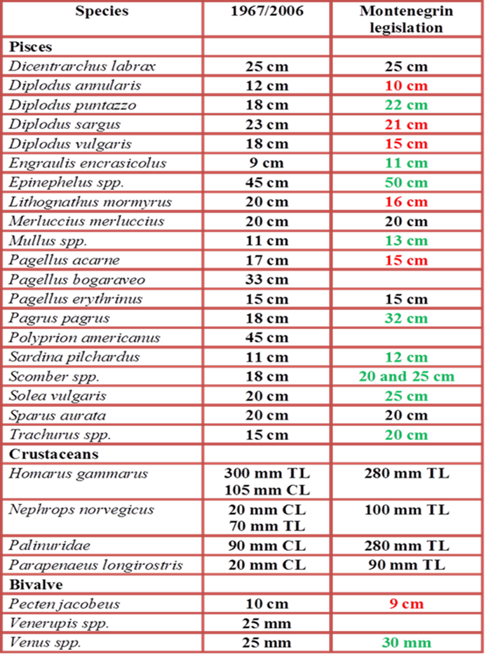
M O N T E N E G R O
Negotiating Team for the Accession of Montenegro to the European Union
Order on prohibition of catch and trade in fish juveniles, undersized fish and other marine organisms (OG of Montenegro No. 8/11) prohibits to catch and trade juveniles, undersized fish and other undersized marine organisms.
21
Chapter 13
Fishery

Slide 22
M O N T E N E G R O
Negotiating Team for the Accession of Montenegro to the European Union
Order on prohibition of catch and trade in fish juveniles, undersized fish and other marine organisms (OG of Montenegro No. 8/11)
Catch of sardines and anchovy of less than 6 cm in length shall be prohibited in the Bay of Boka Kotorska.
Determines the rules how to measure the fish and other marine organisms
Fishing in some are should be stopped if the catch of undersized fish and other marine organisms in fishing operations with bottom and floating trawls, seines or tow nets in one towing is more than 50% of the total catch.
Catch of undersized fish and other undersized marine organisms can be up to % of the total catch.
It shall be prohibited to catch marine mammals (whales, dolphins, seals, etc.) sea birds and sea turtles and in case they are caught accidentally, they must be returned into the sea.
Females of lobster, spiny lobster, Norway lobster with external eggs and spiny spider crab (Maja squinado) with darkened external eggs shall be returned into the sea immediately after catch, regardless of their size.
22
Chapter 13
Fishery

Slide 23
M O N T E N E G R O
Negotiating Team for the Accession of Montenegro to the European Union
Rulebook on construction–technical basis, mesh size, method of use and purpose of certain net types and other means for commercial fishing (OG of Montenegro No. 8/11)
Rulebook lays down the basic construction-technical characteristics, method of use, time, purpose, quantity and type of fishing tools and gear that is permitted for use in large scale and small scale commercial fishing, as well as the marking of fishing tools and gear and the method of establishing the construction-technical characteristics of the fishing tools and gear.
The following fishing tools and gear may be used in commercial fishing:
bottom trawls;
pelagic (floating) trawls;
entangling nets;
beach seines;
beach trawls;
gillnets;
traps for fish and other marine organisms;
harpoons;
long lines and other angling gear.
23
Chapter 13
Fishery

Slide 24
M O N T E N E G R O
Negotiating Team for the Accession of Montenegro to the European Union
Rulebook on construction–technical basis, mesh size, method of use and purpose of certain net types and other means for commercial fishing (OG of Montenegro No. 8/11)
Bottom trawls – Minimal mesh size mm (knot to knot).
Pelagic-floating trawls – Minimal mesh size 10 mm (EU measures 20 mm).
Entangling nets are intended for fishing small and big pelagic fish.
Entangling nets for different species
For sardine minimal mesh size 10 mm (EU measures 20 mm).
For tuna minimal mesh size 40 mm (EU measures 80 mm).
Maximal length of entangling nets is 800 meters, and its highest drop is one-third of the armane of net , except for entangling nets for tuna
24
Chapter 13
Fishery

Slide 25
M O N T E N E G R O
Negotiating Team for the Accession of Montenegro to the European Union
Rulebook on construction–technical basis, mesh size, method of use and purpose of certain net types and other means for commercial fishing (OG of Montenegro No. 8/11)
Beach seines for different species
Mesh size 6 mm for sardine in Boka Kotorska Bay (EU measures 12 mm).
28 mm for greater amberjack (Seriola dumerilli) (EU measures 56 mm)
Beach seines must not be towed by a moving fishing vessel.
Artificial light is allowed for fishing of sardine and anchovy
Using of beach seines is prohibited during some periods of the year depending the spawning period of target species,
For example fishing for greater amberjack (Seriola dumerilli) is permitted from June 1 to March 1, etc...
25
Chapter 13
Fishery

Slide 26

M O N T E N E G R O
Negotiating Team for the Accession of Montenegro to the European Union
Gillnets:
Single layer gillnets
Gillnet Gavunara mesh size 10 mm (EU 20 mm) for Atherina hepsetus permitted from May 1 to January 31.
Gillnet Polandara mesh mesh size 40 mm (EU 80 mm) for bonito, frigate tuna, hake and other big fish
Gillnet for crustaceans mesh size 150 mm (EU 300mm) for Maja squinado permitted from July 1 to April 30.
Maximum height of net is 4 meters regardless of the mesh size, except for net polandara, drop of which may not be above 22 m.
Maximal length of nets is 160 m in the Bay of Boka Kotorska and 500 m in the open sea, except for polandara nets, maximal length 400 m.
26
Chapter 13
Fishery

Slide 27

M O N T E N E G R O
Negotiating Team for the Accession of Montenegro to the European Union
2) Triple layer gillnets – trammel nets
Mesh size from 28 to 40 mm (EU 56 to 80 mm) depending on target species
Forbidden to use in some periods of the year: for example fishing by gillnets poponica, is permitted from August 15 to April 30.
3) Nets for Mugilidae - mesh size 26-28 mm (EU 52-56 mm)
4) Nets for eel - lagoon fyke nets and traps and traps made from netting, minimal mesh size12 mm (EU 24 mm)
27
Chapter 13
Fishery

Slide 28
M O N T E N E G R O
Negotiating Team for the Accession of Montenegro to the European Union
Traps for catching fish and other marine organisms:
Traps for fish
Mesh size 32 mm.
Maximal number of traps 25 pieces
Traps for shrimps
Mesh size 18 mm
Maximal number of traps 100 pieces.
Traps for big crustaceans
Mesh size 55 mm.
Maximal number of traps 50 pieces
28
Chapter 13
Fishery

Slide 29
M O N T E N E G R O
Negotiating Team for the Accession of Montenegro to the European Union
Long lines
Maximum length of fixed (bottom) long lines is 1500 m
  floating lines 24 km
In fishing by fishing lines and fixed long lines, minimal width of hooks 9 mm during daylight and 14 mm during the night.
In fishing by floating long lines intended for fishing tuna (Thunnus thynnus) and other species of big pelagic fish, hooks of width less than 30 mm must not be used.
This Rulebook also determines the rules for marking of fishing tools and gear and the method of establishing the construction-technical characteristics of the fishing tools and gear.
29
Chapter 13
Fishery

Slide 30
M O N T E N E G R O
Negotiating Team for the Accession of Montenegro to the European Union
Rulebook on method of use, maintenance, protection, marking and length of coast, name and place of the fishing sites (OG of Montenegro No. 8/11)
Contains the list of 106 Fishermans posts – fishing sites, in Boka Kotorska Bay, their description, length of the coast, latitude and longitude of the place
Lays down the method of use, maintenance, protection and marking of Fishermans posts
30
Chapter 13
Fishery

Slide 31
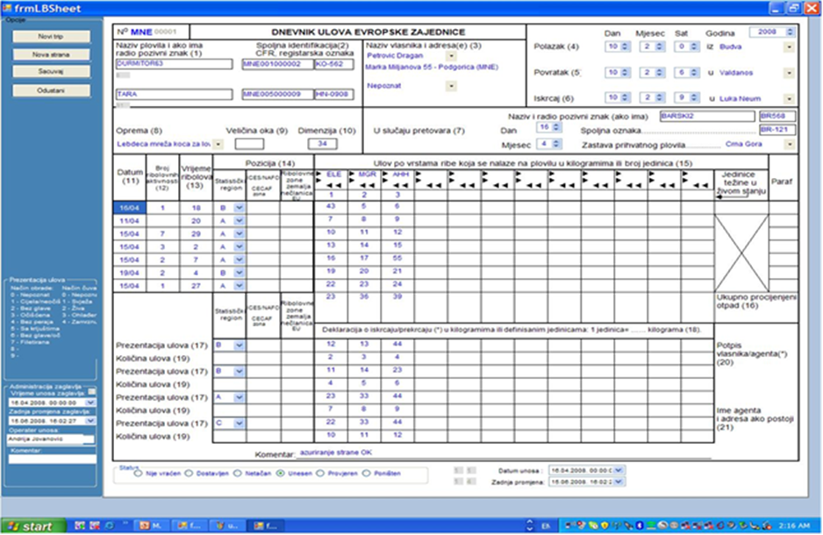
M O N T E N E G R O
Negotiating Team for the Accession of Montenegro to the European Union
Rulebook on the form and contents of fishing log books, declaration on landings, report on catch and deadline for submitting the reports on total catch and landings and method of notification and keeping records on transhipping of fish and other marine organisms (OG of Montenegro” No. 8/11)
Monitoring of catches
Fishing vessel of >10 m LoA shall present a copy of the logbook page together with the declaration to a fisheries inspector within 48 hours from the moment of landings made
31
Chapter 13
Fishery

Slide 32
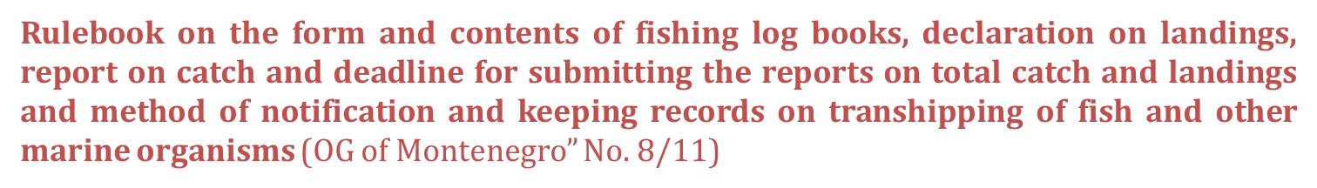
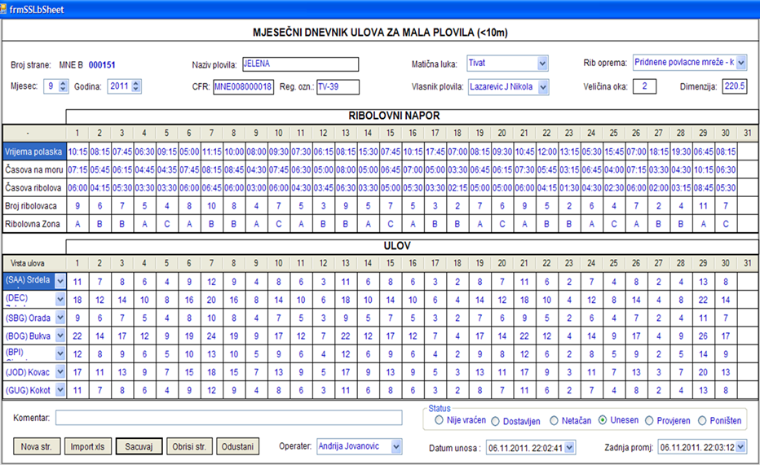
M O N T E N E G R O
Negotiating Team for the Accession of Montenegro to the European Union
Monitoring of catches
Fishing vessel < 10 m LoA report on total catch to a fisheries inspector no later than by 15th day of the month for the previous month
32
Chapter 13
Fishery

Slide 33
M O N T E N E G R O
Negotiating Team for the Accession of Montenegro to the European Union
The data on catch landed shall not deviate more than 10% from the actual catch made.
The permit holders who carry out commercial fishing by bottom trawls, pelagic (floating) trawl, entangling net and floating long line and make a catch of 300 or more kilograms of pelagic fish or 50 kilograms and above of other fish species and/or other marine organisms shall keep the logbook regardless of the fishing vessel’s length.
33
Chapter 13
Fishery

Slide 34
M O N T E N E G R O
Negotiating Team for the Accession of Montenegro to the European Union
Rulebook on requirements, restrictions and order in fishing efforts in certain fishing areas (OG of Montenegro No. 8/11)
Commercial fishing has precedence over the sport-recreational fishing.
Fishing of small pelagic fish by encircling net has precedence over all other fishing categories; in case big pelagic fish appears in fishing grounds of small pelagic fish, fishing of big pelagic fish has the precedence.
Trawl nets > gill-nets > long-lines
Fishing by encircling nets of up to 70 m in height and 400 m in length is permitted in the entrance of Boka Kotorska Bay at the distance of up to 1000 m from the coast.
Fishing with bottom trawl by a fishing vessel of more than 24 m LoA allowed exclusively in the area of 8 to 12 nm, and more, from the coast.
Fishing by a fishing vessel of more than 34 m LoA forbidden in the fishery sea of Montenegro.
34
Chapter 13
Fishery

Slide 35
M O N T E N E G R O
Negotiating Team for the Accession of Montenegro to the European Union
Rulebook on sport and recreational fishery at sea (OG of Montenegro No. 34/10)
Allowed to catch 3 kg of fish or other marine organism (except Chondrichties), or one fish of 5 kg (except on competitions)
Fishing tools allowed:
Fishing lines, maximum 2 pieces with maximum 3 hooks on each line; hook width no less than 7 mm
Fishing lines for Cephalopods, maximum 2 pieces with or without use of light of 400 cd power
Rods, maximum 2 pieces with maximum 3 hooks on each rod
Underwater gun without explosive charge
One harpoon
Harpoon with or without use of light of 400 cd power, with vessel without engine and opaque bottom
One trap
Fixed (bottom) long lines, maximum 50 hooks
The method, the type and the number of fishing tools and gear which is permitted for use in sport-recreational fishing, the form and the content of the permit for sport-recreational fishing shall be laid down by the Ministry (Article 66, Law on marine fisheries and mariculture)
35
Chapter 13
Fishery

Slide 36
Control measures
M O N T E N E G R O
Negotiating Team for the Accession of Montenegro to the European Union
Article 106 of Law on marine fisheries and mariculture
The first landing of fish and other marine organisms shall be performed only in a port, harbour or another place meeting the prescribed technical conditions for inspection of fishing vessels (the fist landing site).
The landing of fish and other marine organisms at the first landing site may be performed only by a holder of a permit for large-scale commercial fishing issued in accordance with this Law or a ratified international agreement.
.
36
Chapter 13
Fishery

Slide 37
M O N T E N E G R O
Negotiating Team for the Accession of Montenegro to the European Union
Control measures
Article 110 of Law on marine fisheries and mariculture defines the rules for transhipment of fish from one vessel to another
Captain of the vessel unloading and the captain of the vessel receiving the fish are oblige to:
1) notify the administration authority or the fishery inspector of the time and the place of transhipment at least 24 hours in advance;
2) about the time when the transhipment was completed;
3) keep records of the transhipment.
37
Chapter 13
Fishery

Slide 38
M O N T E N E G R O
Negotiating Team for the Accession of Montenegro to the European Union
Control measures
Article 111 of Law on marine fisheries and mariculture defines the rules for landing or transhipment of fish and fish products from foreign fishing vessels
Landing and transhipment from a foreign fishing vessel shall be performed only in a port, a harbour or other places meeting the technical requirements prescribed for inspection of foreign fishing vessels. The captain of the fishing vessel registered in a third country that intends to land or tranship fish and other marine organisms and fish products shall:
1) notify the administration authority or fishery inspector of the intention of landing and transhipment at least 72 hours before the scheduled arrival of the vessel;
2) land or tranship fish and other marine organisms and fish products following the approval from the administration authority, which is issued in compliance with the terms of landing and transhipment of fish and other marine organisms and fish products contained in the permit, the treaty, the agreement or other document authorizing the fishing vessel to land or tranship fish and other marine organisms and fish products.
38
Chapter 13
Fishery

Slide 39
M O N T E N E G R O
Negotiating Team for the Accession of Montenegro to the European Union
Register off vessels
According to Law on Maritime and Inland Navigation (Official Gazette of the Socialist Republic of Montenegro 19/78, 8/79, 19/87, 22/90 and 13/91) fishing vessels, as well as other vessels in Montengro’s seas, are entered in the Register of the regional Port Master’s Office.
The entry in the Register is done upon checks of the vessel and establishing of seaworthiness.
Vessels may not be entered in the Register in case they are already entered into the register of another Port Master’s Office or the register of a foreign country.
The Register is a public document and excerpt from the Register has the power of a public document.
39
Chapter 13
Fishery

Slide 40
M O N T E N E G R O
Negotiating Team for the Accession of Montenegro to the European Union
Register off vessels
MARD keeps record of fishing vessels in Register of Fishing Vessels according to Law on marine fisheries and mariculture (OG of Montenegro No. 56/09), Article 57.
The content and the method of keeping the Register of Vessels is prescribed in Rulebook on the register of fishing vessels (OG of Montenegro” No. 8/11)
Data in the Register of Vessels:
Fishing vessel - basic data
Construction of the vessel- place, year, material
Tonnage of the vessel – GT, GRT, NRT, BT, GTs
Dimensions of the vessel – LoA, LbP, width and height
Owner and the person operating the vessel – personal data
Communication equipment on board – radio and radar
Additional equipment on board – sonars and sounders, cold storage etc.
Power generators and auxiliary generators – engine number, model, type, power
Support – type, description and year when support was received
Vessel segmentation on the basis of fishing gear
Permit for commercial fishing – fishing tool, quantity of fishing tools, issuing and expiration date of permit
40
Chapter 13
Fishery

Slide 41
M O N T E N E G R O
Negotiating Team for the Accession of Montenegro to the European Union
Register off vessels
GFCM Segmentation
Small scale coastal fishing with small gear |  |  | Fishing with bottom trawls |  |  | Fishing with encircling nets and pelagic trawls for fishing of pelagic resources (small pelagic fish)
Minor gear without engine < 6 m | Minor gear with engine < 6 | Minor gear with engine 6-12 m | Trawl 6-12 m | Trawl 12-24 m | Trawl > 24 m | Purse seiners 6-12 m | Purse seiners 12-24 m | Polyvalent vessels >12 m
4.46% | 36.61% | 29.46% | 3.57% | 11.61% | 0.89% | 9.82% | 1.79% | 1.79%
70.54% |  |  | 16.07% |  |  | 13.39%
Segmentation based on permits issued in the course of 2011
Large-scale commercial fishing | Small-scale commercial fishing | Small-scale commercial fishing for certain employed persons and pensioners
27.05% | 64.75% | 8.20%
41
Chapter 13
Fishery

Slide 42
M O N T E N E G R O
Negotiating Team for the Accession of Montenegro to the European Union
Management plans
No management plans in terms of EU Requirements –
for fisheries conducted by trawl nets, boat seines, shore seines, surrounding nets and dredges
General Marine fishery management plan (09-13)
42
Chapter 13
Fishery

Slide 43
Stock assessments
M O N T E N E G R O
Negotiating Team for the Accession of Montenegro to the European Union
IPA 09
Merluccius merluccius
Mullus barbatus
Boops boops
Parapenaeus longirostris
Engraulis encrasicolus
Sardina pilchardus
For Montenegrin waters
MEDITS Working group
Merluccius merluccius
Parapenaeus longirostris
Joint stock assessment for GSA 18
43
Chapter 13
Fishery

Slide 44
Conclusions and challenges
M O N T E N E G R O
Negotiating Team for the Accession of Montenegro to the European Union
Montenegrin legislation is partly compliant with EU Requirements.
Until the EU accession Montenegro will adopt rules
in the field of management of resources as set up in the Common Fishery Policy
44
Chapter 13
Fishery

Slide 45
Thank you for your attention!

