Slide 1


M O N T E N E G R O
Negotiating Team for the Accession of Montenegro to the European Union
Working Group for Chapter 13 – Fisheries
Bilateral screening: Chapter 13
AQUACULTURE
Milena KRASIC
milena.krasic@mpr.gov.me
Brussels, 5-6 Jun 2013

Slide 2

M O N T E N E G R O
Negotiating Team for the Accession of Montenegro to the European Union
Relevant Aquis
Celex 32007R0708
Council Regulation (EC) No 708/2007 of 11 June 2007 concerning use of alien and locally absent species in aquaculture
Chapter 13
Fisheries

Slide 3
M O N T E N E G R O
Negotiating Team for the Accession of Montenegro to the European Union
Institucional Capacity
Ministry of Agriculture and Rural Development
  Unit for Fisheries
Environmental Protection Agency
  Department for permit issuing – Permits for EIA (Environmental Impact Assessment)
Scientific and advisory bodies:
  Institute for Marine Biology
  Faculty of Mathematics and Science – Department of Biology
Chapter 13
Fisheries

Slide 4
M O N T E N E G R O
Negotiating Team for the Accession of Montenegro to the European Union
Legal Framework
Law on Marine Fisheries and Mariculture
(Official Gazette of Montenegro 56/09)
Law on Freshwater Fisheries
(Official Gazette of Montenegro 11/07)
Law on Environmental Impact Assessment
(Official Gazette of Montenegro 80/05;40/10;73/10;40/11)
Law on Nature Protection
(Official Gazette of Montenegro 51/08)
Secondary legislation
Chapter 13
Fisheries

Slide 5
M O N T E N E G R O
Negotiating Team for the Accession of Montenegro to the European Union
Law on Marine Fisheries and Mariculture
Definitions:
Mariculture means the rearing or cultivation of fish and other marine organisms in the fishing sea using the techniques designed to increase the production of the said organisms beyond the natural capacity of the environment.
Autochthonous fish species means species whose historically known natural habitat is in the fishing sea.
Allochthonous fish species means fish whose historically known natural habitat is beyond the fishing sea.
Chapter 13
Fisheries

Slide 6
M O N T E N E G R O
Negotiating Team for the Accession of Montenegro to the European Union
Law on Freshwater Fisheries
Definitions:
Aquaculture means a business activity of controlled reproduction and farming of fish and other aquatic fauna in fish farms
Autochthonous fish species is a domestic fish species that has always been present in a specific area
Allochthonous fish species is a fish species introduced from another zoo-geographical area
Chapter 13
Fisheries

Slide 7
M O N T E N E G R O
Negotiating Team for the Accession of Montenegro to the European Union
Introduction and transfer of fish and other organisms
Law on Marine Fisheries and Mariculture
Article 81
„It shall be prohibited to introduce into the fishing sea of Montenegro, without an approval from the administration authority, allochthonous species of fish and other marine organisms or genetically modified fish and other marine organisms, as well as their transfer from one farm into another, or from one place in Montenegro to another“
The approval is issued by the administration authority with prior approval on the environmental impact assessment from the public administration authority in charge of the environmental protection.
Law on Freshwater Fisheries
Article 28
„Without a special approval, it shall be prohibited to introduce new fish species into fishery waters“
Chapter 13
Fisheries

Slide 8
M O N T E N E G R O
Negotiating Team for the Accession of Montenegro to the European Union
Law on Nature Protection
Allochthonous species is an alien species of plants, animals and fungi brought to the eco-system of Montenegro with intentional or accidental introduction
Introduction of alien wild species of plants, animals and fungi
Article 87
It shall be prohibited to introduce alien wild species of plants, animals and fungi (allochthonous species) into the eco-systems in which they do not naturally live.
Exceptionally, allochthonous species of plants, animals and fungi may be introduced where such action has scientific and technical grounds and is acceptable in terms of nature protection, based on an authorisation from the administration body.
The authorisation is issued based on the assessment of the risk to nature
Chapter 13
Fisheries

Slide 9
M O N T E N E G R O
Negotiating Team for the Accession of Montenegro to the European Union
Assessment of the Risk to Nature
Rulebook on method of development and assessment of risk of introduction of alien wild species of plants, animals and fungi
(Official Gazette of Montenegro 46/10)
Study on assessment of the risk to nature has to include:
Purpose and objective of introduction, re-introduction or farming of wild species of plants, animals or fungi;
Description of biological and ecological properties of domestic and alien species;
Description of the intended introduction or farming;
Appraisal of the expected influence on the nature and changes in the nature;
Proposal of measures for prevention of possible adverse effects on habitat and ecosystems and species present therein;
Final risk assessment.
Chapter 13
Fisheries

Slide 10
M O N T E N E G R O
Negotiating Team for the Accession of Montenegro to the European Union
Assessment of Risk to the Nature
Final Risk Assessment has to include:
Opinion on whether introduction, re-introduction or farming of wild species of plants, animals and fungi can jeopardize the natural balance and biodiversity and whether the risk is acceptable for the nature.
The conditions and the scope of the introduction, the method of prevention of risks with protective measures, and the method for remediation of potential damage.
Chapter 13
Fisheries

Slide 11
M O N T E N E G R O
Negotiating Team for the Accession of Montenegro to the European Union
Assessment of Risk to the Nature
Rulebook on method of development and assessment of risk of introduction of alien wild species of plants, animals and fungi (Official Gazette of Montenegro 46/10)
Is not applicable to:
  Genetically Modified Organisms
  Locally absent species
  Non-target species
  Routine and non-routine movement
Chapter 13
Fisheries

Slide 12
M O N T E N E G R O
Negotiating Team for the Accession of Montenegro to the European Union
Aquaculture Permit
Law on Marine Fisheries and Mariculture
Law on Freshwater Fisheries
For an aquaculture permit:
  Project for technical-technological requirements of aquaculture with a study on economic viability of the investment, which includes, among others, the potential impact of the proposed farming on the environment and measures to limit or eliminate the environmental risks;
  Decision on registration for aquaculture activities;
  Water management approval;
  Veterinary-sanitary approval;
  Document on environmental impact assessment.
Chapter 13
Fisheries

Slide 13
M O N T E N E G R O
Negotiating Team for the Accession of Montenegro to the European Union
Environmental Impact Assessment
Intensive farming of fish and bivalve molluscs belongs to projects for which environmental impact assessments may be required
– Decree on projects for which environmental impact assessment is developed (Official Gazette of the Republic of Montenegro 20/07)
  Phase I – Procedure of deciding on the need for impact assessment
    Rulebook on contents of documents to be submitted with the application to decide on the need for an environmental impact assessment (Official Gazette of Montenegro 14/07)
    Phase II – Procedure of setting the scope and content of the study on environmental impact assessment
  Rulebook on the content of documents to be submitted with the application to set the scope and content of the study on environmental impact assessment (Official Gazette of Montenegro 14/07)
  Phase III – Approval procedure for the study on environmental impact assessment
    Rulebook on contents of the study on environmental impact assessment (Official Gazette of Montenegro 14/07)
Chapter 13
Fisheries

Slide 14
M O N T E N E G R O
Negotiating Team for the Accession of Montenegro to the European Union
Environmental Impact Assessment
Informing the public and stakeholders
  Of all applications submitted and decisions made with regard to environmental impact assessment.
  Opinions on all three phases
Notifications of transboundary effects
  If a project/design can have significant effect on the environment of another country, the following notifications are presented:
    On the project/design, together with the data available on its possible impacts;
    On the nature of the decision that may be adopted;
    Deadline within which another country may present its intention to participate in the impact assessment procedure.
Obligation of keeping the records and setting up of a database
records on procedures and decisions on approval or rejection of the application for approval to the study – public book
Chapter 13
Fisheries

Slide 15
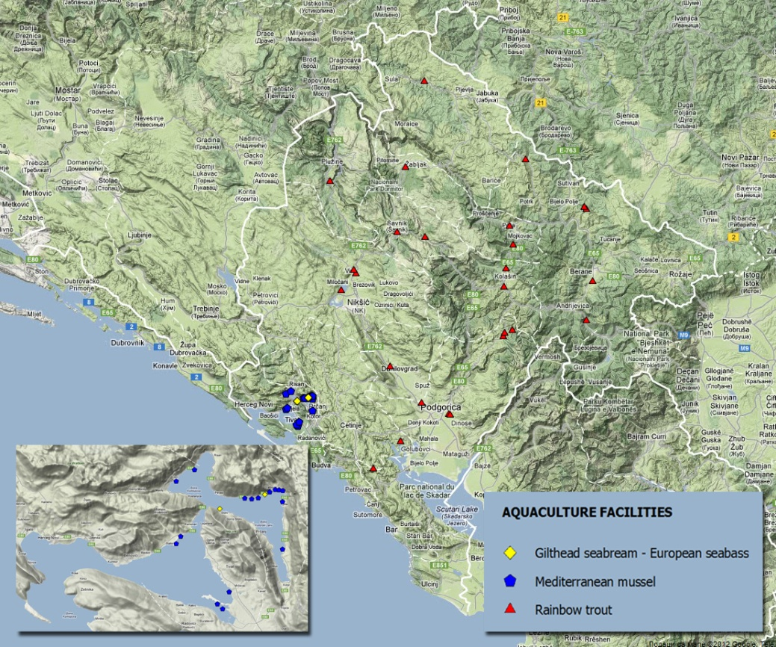
M O N T E N E G R O
Negotiating Team for the Accession of Montenegro to the European Union
Farmed Species
Rainbow trout
Mediterranean mussel
European flat oyster
Gilthead seabream,
European seabass
Chapter 13
Fisheries

Slide 16
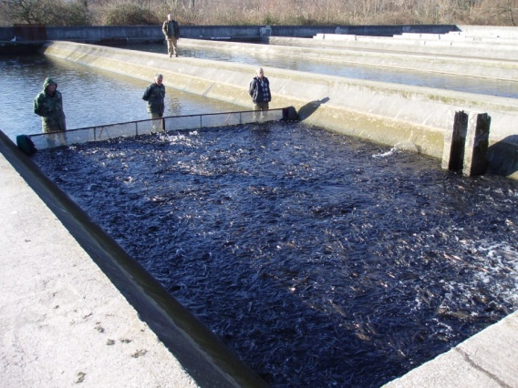
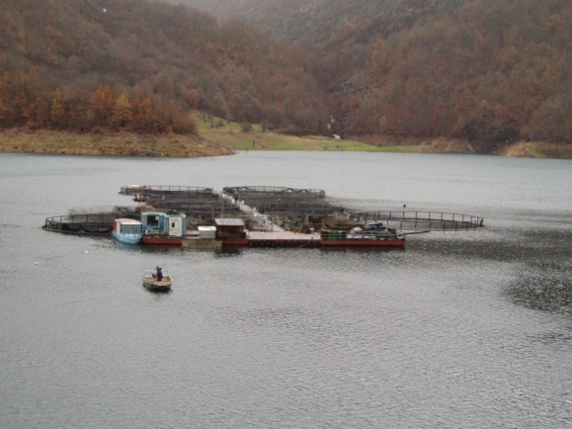
M O N T E N E G R O
Negotiating Team for the Accession of Montenegro to the European Union
Aquaculture Sector
Freshwater Aquaculture
  Present in central and northern parts of Montenegro
  26 rainbow trout farms
  (Oncorhynchus mykiss)
  Farming method:
    23 farms use water from watercourses,
    3 farms on lakes apply cage farming method.
Chapter 13
Fisheries

Slide 17
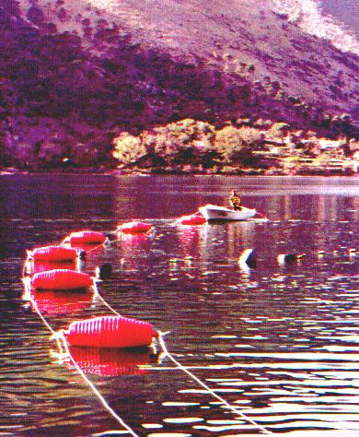
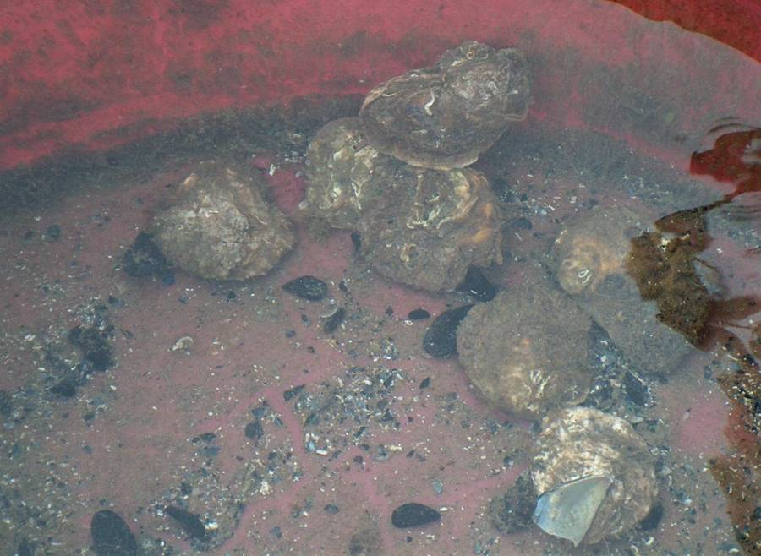
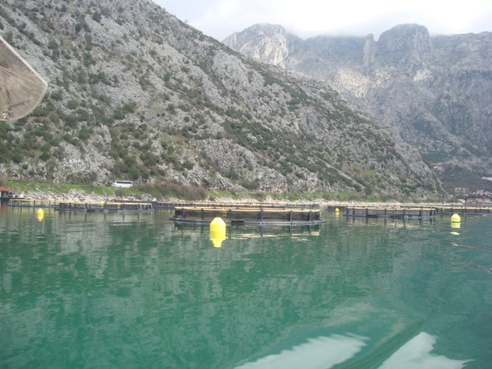
M O N T E N E G R O
Negotiating Team for the Accession of Montenegro to the European Union
Aquaculture Sector
Mariculture
16 farms of Mediterranean mussel
(Mytilus galloprovincialis)
  use the rope farming method.
1 European flat oyster farm (Ostrea edulis)
2 farms of sea-bream (Sparus aurata)
and sea-bass (Dicentrarchus labrax)
  Use cage farming method
Chapter 13
Fisheries

Slide 18
M O N T E N E G R O
Negotiating Team for the Accession of Montenegro to the European Union
Until the EU accession Montenegro will adopt rules
concerning the use of alien and locally absent species in aquaculture as laid down by the Common Fisheries Policy
Chapter 13
Fisheries

Slide 19
Thank you for your attention!

