Slide 1


M O N T E N E G R O
Negotiating Team for the Accession of Montenegro to the European Union
Working Group for Chapter 13 – Fisheries
Vessel characteristics and fleet management
Deniz FRLJUCKIC
deniz.frljuckic@mpr.gov.me
Brussels, 5-6 June 2013

Slide 2

M O N T E N E G R O
Negotiating Team for the Accession of Montenegro to the European Union
Relevant Aquis of EU
2004R0026 - 20061214
Commission Regulation (EC) No 26/2004 of 30 December 2003 on the Community fishing fleet register
32009R1224
laying down detailed rules for the implementation of Council Regulation (EC) No 1224/2009 establishing a Community control system for ensuring compliance with the rules of the Common Fisheries Policy
32011R0404
Commission Implementing Regulation (EU) No 404/2011 of 8 April 2011 laying down detailed rules for the implementation of Council Regulation (EC) No 1224/2009 establishing a Community control system for ensuring compliance with the rules of the Common Fisheries Policy
Chapter 13 Fisheries

Slide 3






M O N T E N E G R O
Negotiating Team for the Accession of Montenegro to the European Union
Montenegrin Institutional Framework
Ministry of Agriculture
and Rural Development
Port Authority
Administration for Inspection Affairs
Institute of Marine Biology
Maritime Border Police
Chapter 13
Fishery

Slide 4
M O N T E N E G R O
Negotiating Team for the Accession of Montenegro to the European Union
Montenegrin Legal Framework
Law on Marine Fisheries and Mari culture
(Official Gazette of Montenegro 56/09)
Set of secondary legislation
(Official Gazette of Montenegro 8/11)
Law on Maritime and Inland Navigation
(Official Gazette of SRJ 12/98, 44/99, 74/99, 73/2000)
Secondary legislation
DECREE ON BOATS
(Official Gazette of Montenegro 51/04 and 44/09)
Chapter 13 Fisheries

Slide 5
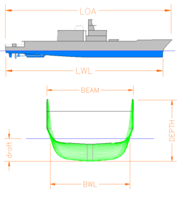
M O N T E N E G R O
Negotiating Team for the Accession of Montenegro to the European Union
Measuring Montenegrin vessels
In accordance with the Law on Maritime and Inland Navigation
Port Authority is in charge of measuring of vessels
Existing legal rules for tonnage measurement of merchant ships and boats do not define specific tonnage measurement method for fishing vessels and boats, or the power of their engines!
The preparation of the draft Law on the Safety of Maritime Navigation
Entering in force of the new Law on Maritime Safety will provide the legal basis for adoption of by-laws. One of these by-laws will be the technical rules for tonnage measurement of fishing vessels, or the existing technical rules for merchant ships and boats will be amended. It will describe in detail the method of determining the gross tonnage (GT) and confirm or verify the engine power of fishing vessels.
Chapter 13 Fisheries

Slide 6
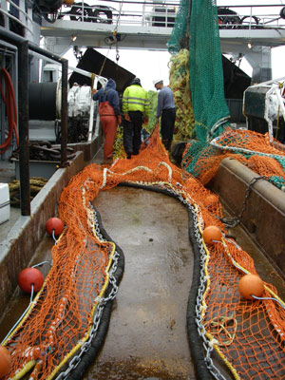
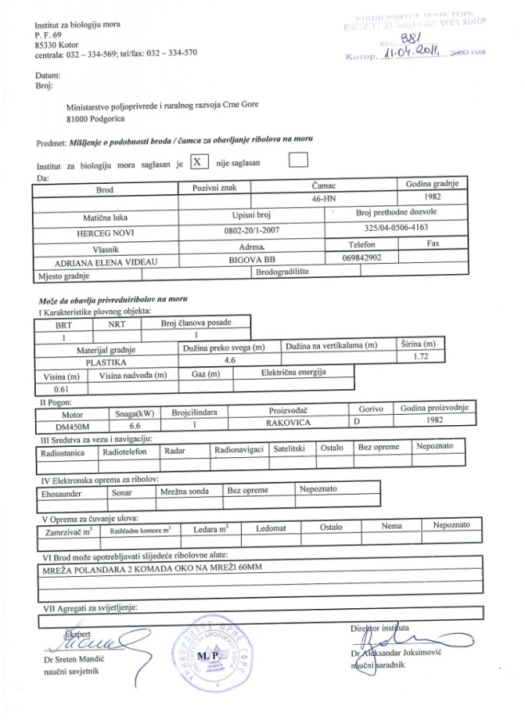
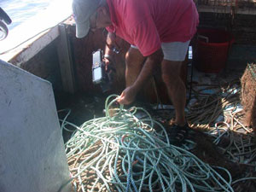
M O N T E N E G R O
Negotiating Team for the Accession of Montenegro to the European Union
Vessels characteristics
Fishing gears technical Certificate
IMBK
Chapter 13 Fisheries

Slide 7

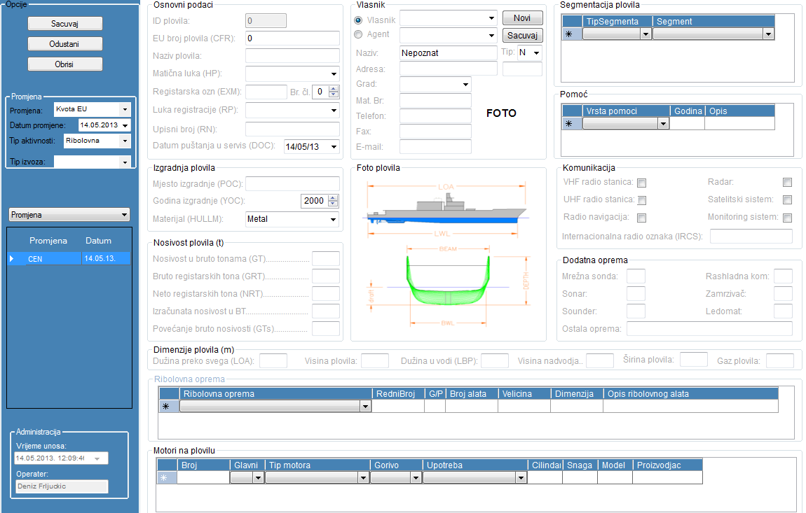



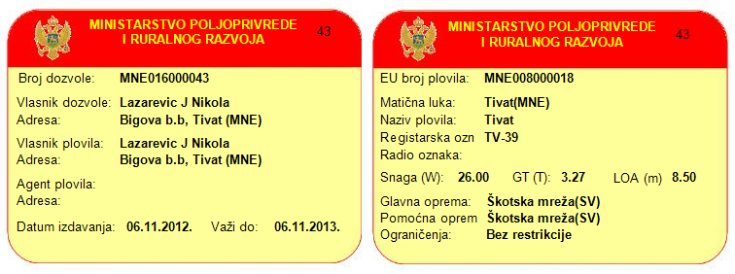
M O N T E N E G R O
Negotiating Team for the Accession of Montenegro to the European Union
Permit for commercial fishing
The permit for commercial fishing shall be issued by the administration authority based on a public advertisement published in at least one printed media distributed throughout Montenegro.
MARD
Chapter 13 Fisheries

Slide 8
M O N T E N E G R O
Negotiating Team for the Accession of Montenegro to the European Union
Vessel Registration Administrative procedures
Existing vessel registration limit:
is in accordance with the sugestion of IMB
Engine modification:
The modification of engine in fishing vessels is allowed for now.
But after completion of the final census we will establish strict control of the engine power increase.
Any change on a fishing vessel must be reported to the Port Authority and MARD
New construction:
The construction of new fishing vessels is allowed for now. After completion of the final census we will establish strict control of the GT increase
Increase GT for safety reasons:
Increase the GT for safety reasons is permitted until the completion of the final census.
All modifications in fishing vessels must be reported to the Port Authority and MARD
Chapter 13 Fisheries

Slide 9
M O N T E N E G R O
Negotiating Team for the Accession of Montenegro to the European Union
Vessel Registration Administrative procedures
Change of the owner and the Agent:
The owner of the fishing vessel, or the holder of a commercial fishing permit shall report to the MARD any change that takes place while the permit for commercial fishing is valid.
Vessel destruction:
The owner of the vessel, or the holder of a commercial fishing permit shall report to the MARD destruction of the fishing vessel in order to perform the deletion from the register of fishing vessels.
Home port change:
In case of change of the home port the vessel must be re-registred. The owner of the vessel, or the holder of a commercial fishing permit has to request the change of the home port in the register of fishing vessels
Change of activity:
Change of activity of a fishing vessel is allowed, and can be done at any time at the request of vessel owner or permit holder.
Vessel Import/ export:
In case of import of the fishing vessel and in order to meet the requirements for registration of that fishing vessel in the Montenegrin register of fishing vessels, the applicant shall submit the deletion from register of the country from which the vessel is imported.
In the case of exports, at the request of the owner of the fishing vessel, MARD will delete the fishing vessel from the register of fishing vessels and issue the proof of deletion.
Chapter 13 Fisheries

Slide 10


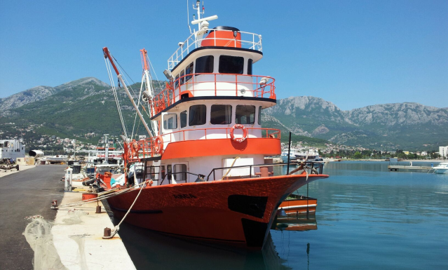
M O N T E N E G R O
Negotiating Team for the Accession of Montenegro to the European Union
Segmentation of Montenegrin fleet by the license in 2011
Large-scale commercial fishing | Small-scale commercial fishing | Small-scale commercial fishing for certain employed persons and pensioners
27.05% | 64.75% | 8.20%
64.75%
8.20%
27.05%
Chapter 13 Fisheries

Slide 11

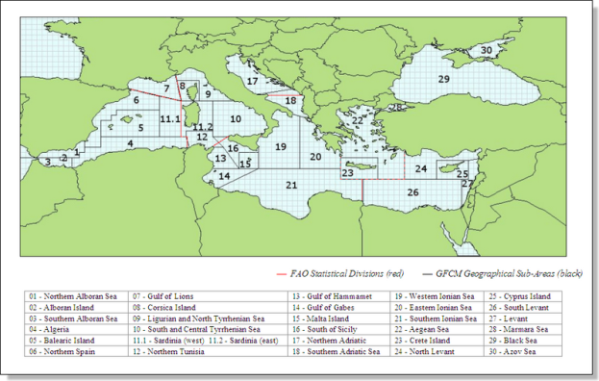
M O N T E N E G R O
Negotiating Team for the Accession of Montenegro to the European Union
GFCM Segmentation of Montenegrin fleet
Small scale coastal fishing with small gear |  |  | Fishing with bottom trawls |  |  | Fishing with encircling nets and pelagic trawls for fishing of pelagic resources (small pelagic fish)
Minor gear without engine < 6 m | Minor gear with engine < 6 | Minor gear with engine 6-12 m | Trawl 6-12 m | Trawl 12-24 m | Trawl > 24 m | Purse seiners 6-12 m | Purse seiners 12-24 m | Polyvalent vessels >12 m
4.46% | 36.61% | 29.46% | 3.57% | 11.61% | 0.89% | 9.82% | 1.79% | 1.79%
70.54% |  |  | 16.07% |  |  | 13.39%
1.1 | Fleet and area variables
1.2 | Main resource and activity components variables per Operational Units
1.3 | Economic component variables
1.4 | Catch and effort variables (catch, effort, discard, bycacth)
1.5 | Provisional biological parameters
GFCM Task 1
Chapter 13 Fisheries

Slide 12
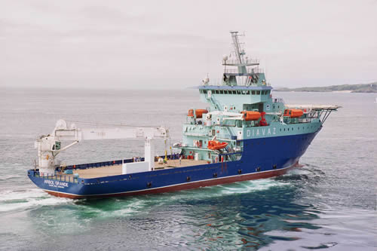
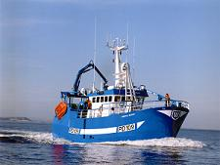
M O N T E N E G R O
Negotiating Team for the Accession of Montenegro to the European Union
Fleet management
Commission Regulation (EC) No 26/2004 of 30 December 2003 on the Community fishing fleet register
According to this Regulation, an information system has been set up with the following characteristics:
  Minimum information required by EU.
  Event based system with historical data.
Vessels to be registered
Main Information
Marine Fishing vessels.
Vessels used in Mariculture production
Vessel identification
Technical Data.
Owners identification.
Administrative data.
Vessel permit
Chapter 13 Fisheries

Slide 13
M O N T E N E G R O
Negotiating Team for the Accession of Montenegro to the European Union
Fleet management
Events to be registered
New fleet entrants
Within fleet
Exit from the fleet
Census of Pre-existing fishing vessels.
New construction.
Change of activity.
Intra-Community import or transfer.
Modification
Break-up, shipwreck.
Change of activity.
Intra-Community Export, transfer.
Change of activity (just for fishing vessels and mariculture auxiliaries)
Chapter 13 Fisheries

Slide 14
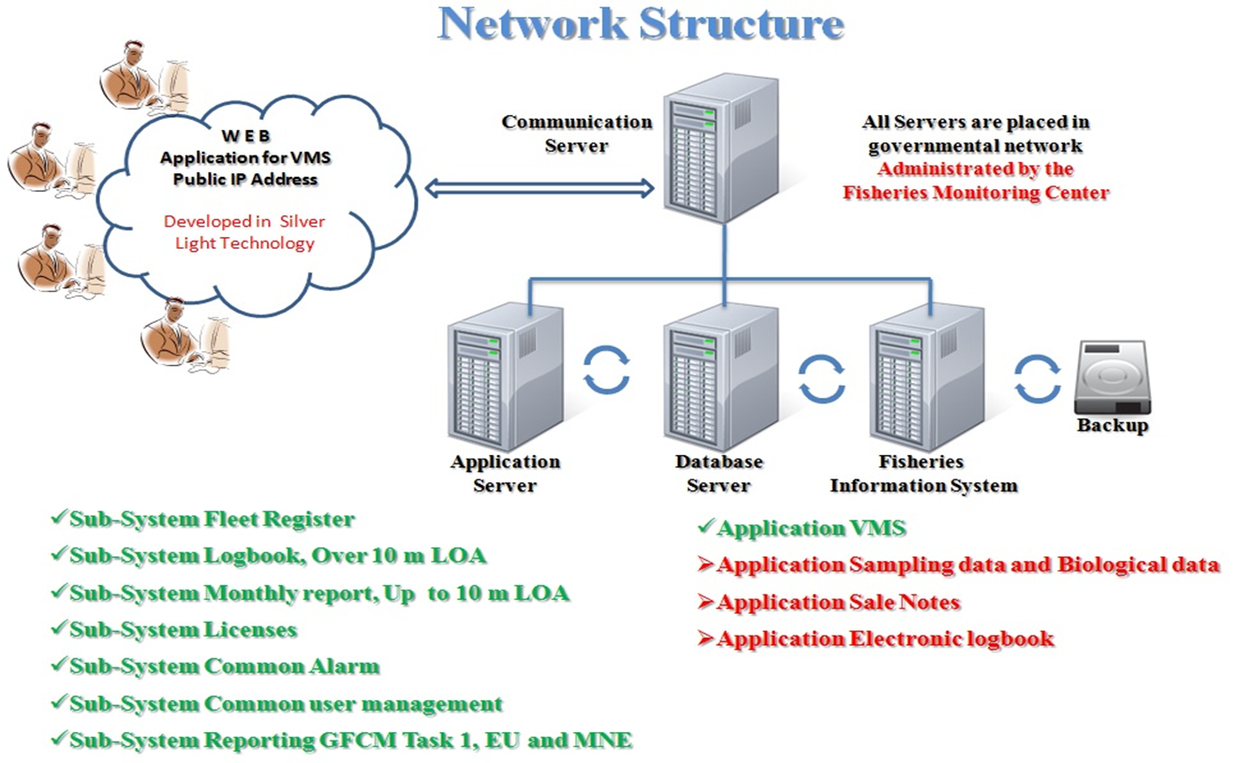
M O N T E N E G R O
Negotiating Team for the Accession of Montenegro to the European Union
Fisheries Information System
Chapter 13 Fisheries

Slide 15
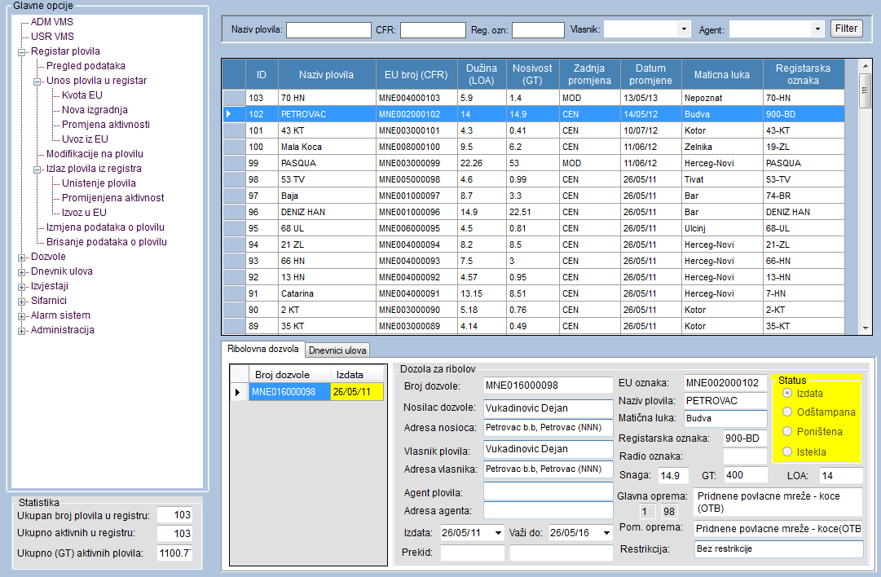
M O N T E N E G R O
Negotiating Team for the Accession of Montenegro to the European Union
Fisheries Information System
Chapter 13 Fisheries

Slide 16
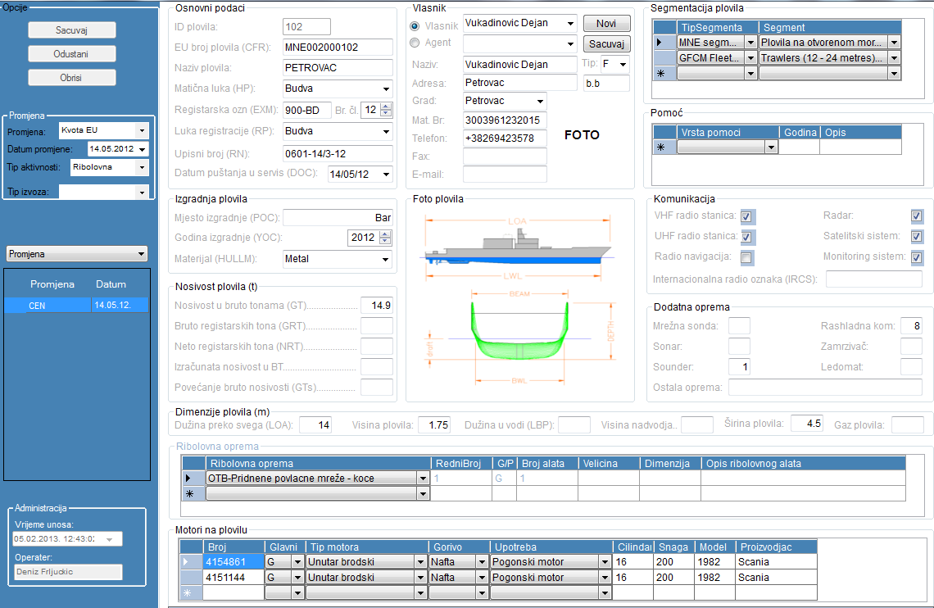
M O N T E N E G R O
Negotiating Team for the Accession of Montenegro to the European Union
Fleet Register
Chapter 13 Fisheries

Slide 17
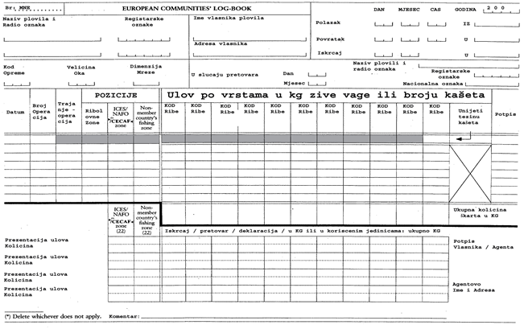
M O N T E N E G R O
Negotiating Team for the Accession of Montenegro to the European Union
Logbook for vessels over 10m LOA
Chapter 13 Fisheries

Slide 18
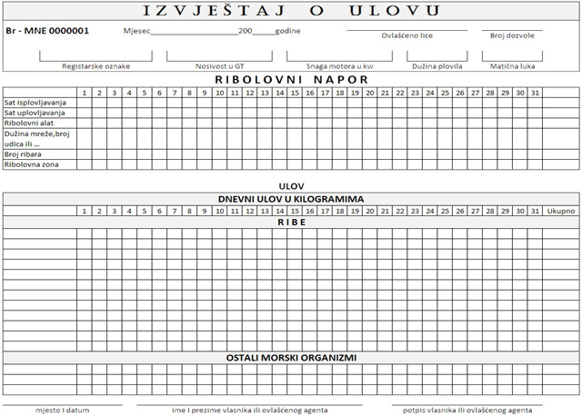
M O N T E N E G R O
Negotiating Team for the Accession of Montenegro to the European Union
Monthly report for vesseles up to 10m LOA
Chapter 13 Fisheries

Slide 19
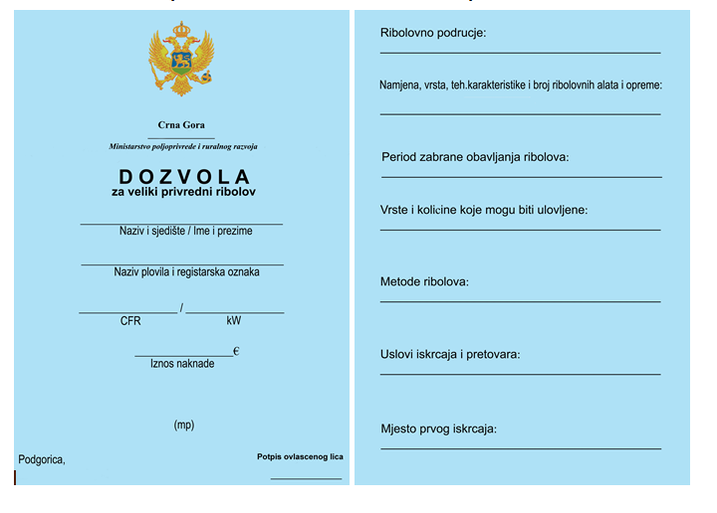

M O N T E N E G R O
Negotiating Team for the Accession of Montenegro to the European Union
Permits
Chapter 13 Fisheries

Slide 20
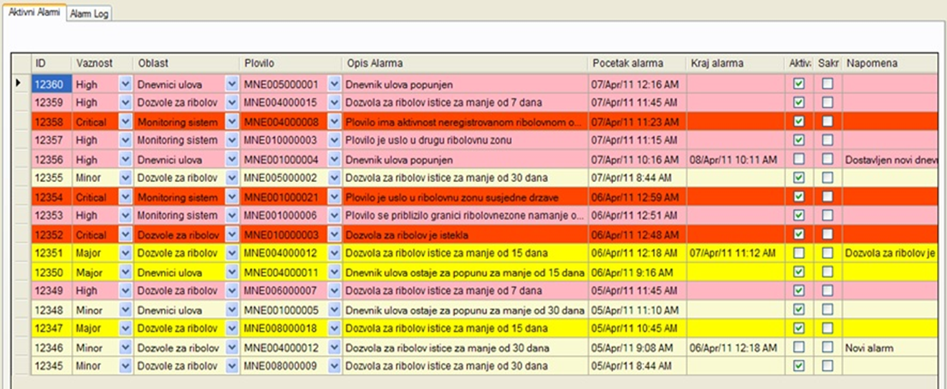
M O N T E N E G R O
Negotiating Team for the Accession of Montenegro to the European Union
Common Alarm
Chapter 13 Fisheries

Slide 21
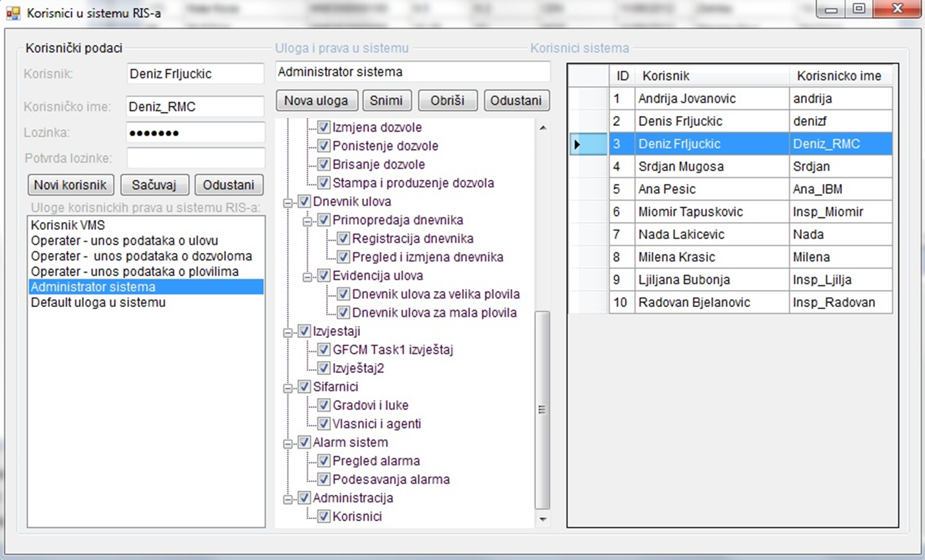
M O N T E N E G R O
Negotiating Team for the Accession of Montenegro to the European Union
Common User Management
Chapter 13 Fisheries

Slide 22
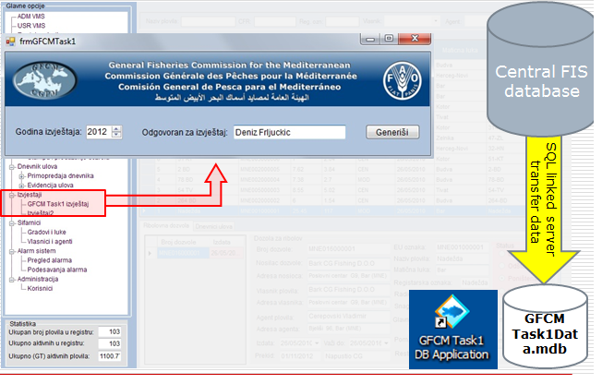
M O N T E N E G R O
Negotiating Team for the Accession of Montenegro to the European Union
Reporting - GFCM Task 1
Chapter 13 Fisheries

Slide 23
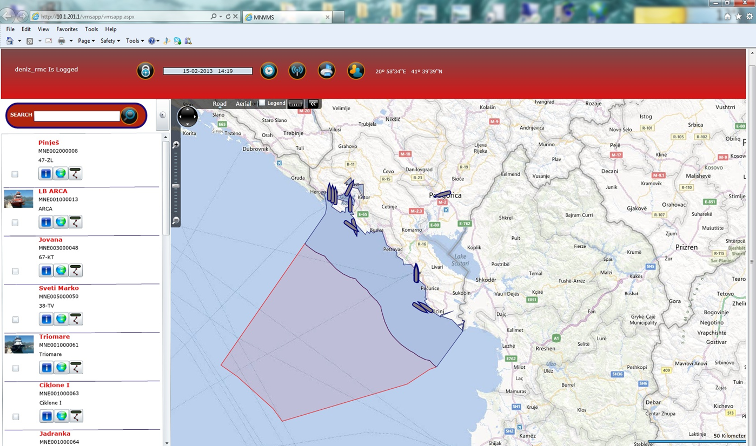
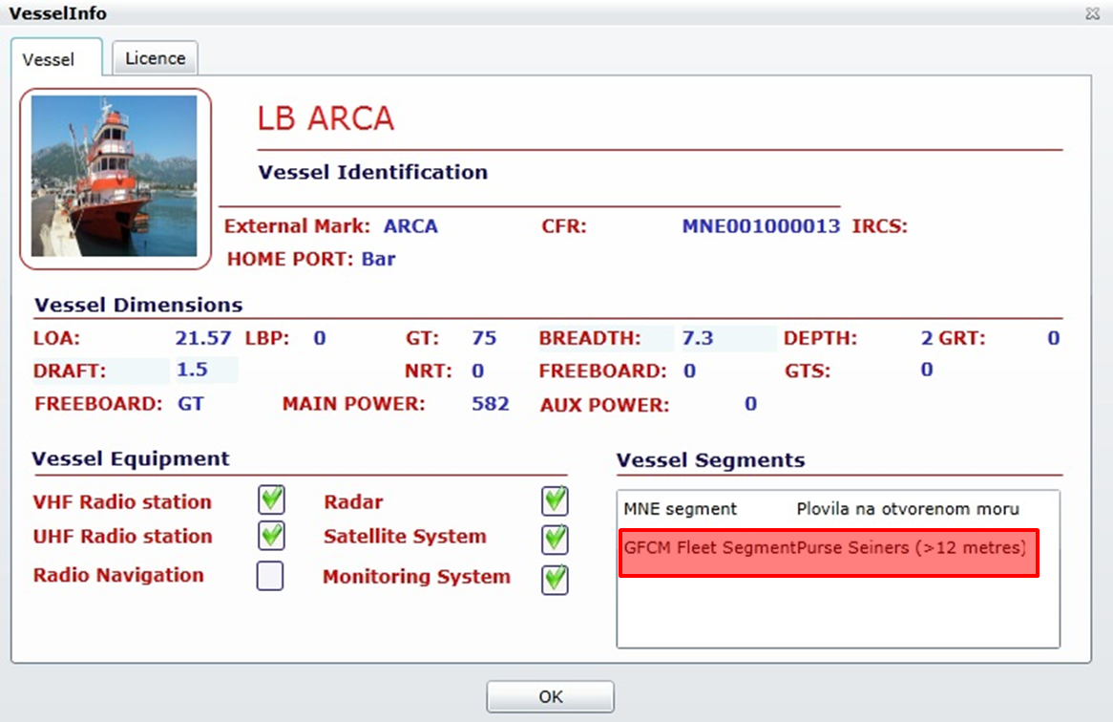
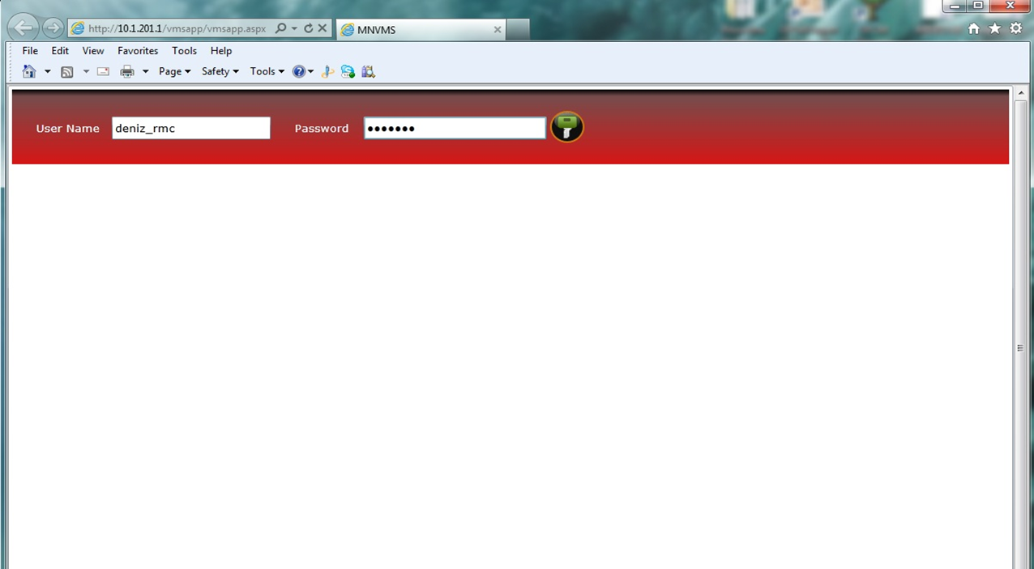
M O N T E N E G R O
Negotiating Team for the Accession of Montenegro to the European Union
Vessel Monitoring System
Chapter 13 Fisheries

Slide 24
M O N T E N E G R O
Negotiating Team for the Accession of Montenegro to the European Union
Challenges
After completion of the census, increases in overall fishing capacity will not be permitted.
For instance. If a vessel with 200 GT’s wants to be registered in the fleet, the same quantity of GT’s has to exit.
Vessel withdrawn
50 GT
200 gt
Fleet Register
25 GT
Total Tonnage established
2000 GTs
130 GT
Since Montenegro has not yet completed the census, the fishing capacity has not been limited yet in terms of GT and Power.
Chapter 13 Fisheries

Slide 25



M O N T E N E G R O
Negotiating Team for the Accession of Montenegro to the European Union
challenges
Developing sub-system for Electronic logbook
Developing sub-system for Sales Notes
Developing sub-system for Register of fishermen
Developing sub-system for Sampling data and Biological data
Fleet Register
Further development and harmonization of fisheries information systems, for the purpose of more efficient control and management of fisheries
Chapter 13 Fisheries

Slide 26





M O N T E N E G R O
Negotiating Team for the Accession of Montenegro to the European Union
Conclusions
Further cooperation with EU and continous harmonisation of legislation
Strengthening cooperation with countries of the region - Albania, Croatia, Slovenia, Italy etc. and transfer of knowledge, experiences and other forms of assistance.
Administrative capacity building in institutions in charge of fishery, inspection and data collection.
Further support by EU & GFCM funded projects in developing new FIS functionalities and fishery
Chapter 13 Fisheries

Slide 27
Thank you for your attention!

