Slide 1


M O N T E N E G R O
Negotiating Team for the Accession of Montenegro to the European Union
Working Group for Chapter 30 –External Relations
Bilateral screening: Chapter 30
PRESENTATION OF MONTENEGRO
Brussels, 12 June 2013

Slide 2


Chapter 30: External Relations
WTO
Multilateral Policy and Relations
Ministry of Economy
Aida Salagić Ceković
aida.salagic@mek.gov.me
M O N T E N E G R O
Negotiating Team for the Accession of Montenegro to the European Union
Chapter 30:
External Relations

Slide 3
Chapter 30: External Relations
Content
1. Montenegrin accession to WTO Main facts
2. Montenegro as a member of the WTO
3. Post- accession period
4. WTO
Montenegro and EU
M O N T E N E G R O
Negotiating Team for the Accession of Montenegro to the European Union
Chapter 30:
External Relations

Slide 4
Montenegrin accession to WTO - Main facts
Chapter 30: External Relations
Letter of application submitted on 23 December 2004
Working Party established on 15 February 2005
Memorandum on Foreign Trade Regime submitted on 8 March 2005
Initial Services Offer submitted on 1 July 2005
Initial Goods Offer submitted on 12 June 2006
Bilateral agreements concluded with 11 members
During accession process WP held 8 meetings
WP completed its mandate on 5 December 2011. The 8th MC formally approved MNE accession package on 17 December 2011
On 29 April 2012, Montenegro became a full-fledged member of the WTO
M O N T E N E G R O
Negotiating Team for the Accession of Montenegro to the European Union
Chapter 30:
External Relations

Slide 5
Montenegro as a member of the WTO (1)
Chapter 30: External Relations
Montenegro’s most important commitments
Obligations by Montenegro undertaken during the negotiations are contained in:
The Report of the Working Party (par. 281)
The Schedule of Concessions and Commitments on Goods
The Schedule of Specific Commitments on Services
Montenegro is committed to implement the Marrakesh Agreement Establishing the WTO (with Annexes) without transitional period
Montenegro is committed to respect the WTO principles
Plurilateral Trade Agreements (Government Procurement and Civil aircraft)
Information Technology Agreement (ITA)
Law on Ratification of the Protocol on the Accession of Montenegro to the Marrakesh Agreement Establishing the World Trade Organization (Official Gazette of Montenegro – International Treaties 3/2012)
M O N T E N E G R O
Negotiating Team for the Accession of Montenegro to the European Union
Chapter 30:
External Relations

Slide 6
Montenegro as a member of the WTO (2)
Chapter 30: External Relations
Market access for goods
The Schedule of Concessions and Commitments on Goods (in document WT/ACC/SPEC/CGR/38/Add.1)
All Montenegro’s tariffs are bound (ad valorem)
It is done in HS 2007 CN 2008
Tariff reductions will be phased out during a period up to 2022 for some products
“other duties and charges” are bound at zero
Final Bound Rate (FBR) - Montenegro will apply an average FBR of 6,60% (14,79% for agricultural products and 4,44% for industrial products)
MFN Applied
Before 29 April 2012 (from 1.1.2012 to 28.4.2012) average rate in Customs Tariff was 6,68 (14,67% for agricultural products and 4,34% for industrial products)
After a full-fledged member of the WTO: in 2012 average rate was 5,95 (14,51% for agricultural products and 3,43% for industrial products) and 2013 is 5,79 (14,09% for agricultural products and 3,35% for industrial products)
M O N T E N E G R O
Negotiating Team for the Accession of Montenegro to the European Union
Chapter 30:
External Relations

Slide 7
Montenegro as a member of the WTO (3)
Chapter 30: External Relations
Agriculture
Final Bound Rate - FBR:
Most dutiable lines have 5-10%
No tariffs above 50% (FBR 50% - 47 tariff lines )
No export subsidies granted (bound at zero)
Administered by the Ministry for Agriculture and Rural Development, Ministry of Finance and Customs office
M O N T E N E G R O
Negotiating Team for the Accession of Montenegro to the European Union
Chapter 30:
External Relations

Slide 8
Montenegro as a member of the WTO (4)
Chapter 30: External Relations
Industrial products
Final Bound Rate-FBR:
Most dutiable lines have 5-10%
No tariffs above 20% (FBR 20% - 21 tariff lines )
Fish and marine products – no tariff lines above 20% (from duty free to 20%)
Administered by the Ministry of Economy, the Ministry of Finance and Customs office
M O N T E N E G R O
Negotiating Team for the Accession of Montenegro to the European Union
Chapter 30:
External Relations

Slide 9
Montenegro as a member of the WTO (4)
Chapter 30: External Relations
Market access for services
The Schedule of Specific Commitments on Services (in document WT/ACC/SPEC/CGR/38/Add.2 )
Montenegro has undertaken commitments in 136 subsectors of services in its Schedule of Specific Commitments on Services
Horizontal commitments (Public Utilities, Legal Entities- Limitations on branches, agencies and representative offices, Subsidies, Real Estate, Temporary Entry and Stay of Natural Persons)
Sector specific commitments (commitments in 11 out of 12 services sectors)
List of Article II MFN Exemptions (Legal services, Audiovisual services, Road transport services, Passenger and freight transportation, Selling marketing and computer reservations systems of air transport services, All sectors)
M O N T E N E G R O
Negotiating Team for the Accession of Montenegro to the European Union
Chapter 30:
External Relations

Slide 10
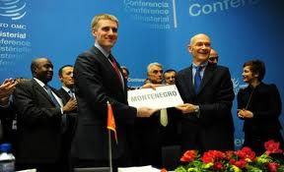
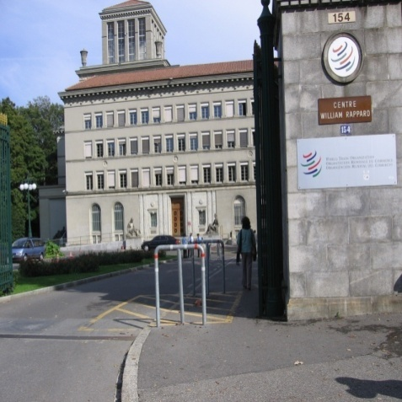
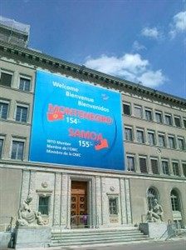
Chapter 30: External Relations
Post-accession period
Montenegro has been a member of WTO since 29 April 2012
M O N T E N E G R O
Negotiating Team for the Accession of Montenegro to the European Union
Chapter 30:
External Relations

Slide 11
Post-accession period (1)
Chapter 30: External Relations
During the WTO membership Montenegro has done the following:
Acceded to the Agreement on Trade in Civil Aircraft
Acceded to the Ministerial Declaration on Trade in Information Technology Products (Montenegro joined the initiative of the EU aimed at further liberalization of the market)
Appointed Permanent Representative - Ambassador Extraordinary and Plenipotentiary of Montenegro to the WTO
Got observer status in the Agreement on Government Procurement (GSP) - Administered by the Ministry of Finance
Doha Devepoment Agenda (DDA) - Montenegro will monitor the positions of the EU in the WTO
M O N T E N E G R O
Negotiating Team for the Accession of Montenegro to the European Union
Chapter 30:
External Relations

Slide 12
Post-accession period (2)
Cooperation with other institutions involved
Chapter 30: External Relations
Round tables and meetings (business associations and media representatives in order to inform the public)
Cooperation with University – through round tables and lectures
Ministry of Economy published WTO legal texts translated in Montenegrin language (Delegation of EU in Montenegro financed the project)
M O N T E N E G R O
Negotiating Team for the Accession of Montenegro to the European Union
Chapter 30:
External Relations

Slide 13
WTO - Montenegro and EU (1)
Chapter 30: External Relations
EU - Founding member of the WTO (1995)
Montenegro has been a member of WTO since 2012
In reference to the requests of the other WTO negotiating partners, direct communication with DG Trade has been established. That resulted with the fact that none of the requests that was not previously harmonized with the DG Trade has not been accepted
Law on Ratification of the Protocol on the Accession of Montenegro to the Marrakesh Agreement Establishing the World Trade Organization
M O N T E N E G R O
Negotiating Team for the Accession of Montenegro to the European Union
Chapter 30:
External Relations

Slide 14
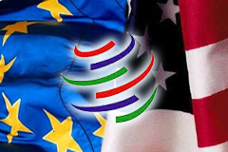
WTO - Montenegro and EU (2)
Chapter 30: External Relations
  GATT 1994 - Art. XXIV:5 & Art. XXIV:6
  Consolidation of the services schedule to the EU schedule (Art. XXI of GATS)
  Government Procurement (GSP)
M O N T E N E G R O
Negotiating Team for the Accession of Montenegro to the European Union
Chapter 30:
External Relations

Slide 15
Thank you for your attention!
QUESTIONS

