Slide 1


M O N T E N E G R O
Negotiating Team for the Accession of Montenegro to the European Union
Working Group for Chapter 30 –External Relations
Bilateral screening: Chapter 30
PRESENTATION OF MONTENEGRO
Brussels, 12 June 2013

Slide 2


Chapter 30: External Relations
Brief Overview
Commercial policy of Montenegro
Ministry of Economy
Goran Šćepanović, Deputy Minister
goran.scepanovic@mek.gov.me
M O N T E N E G R O
Negotiating Team for the Accession of Montenegro to the European Union
Chapter 30:
External Relations

Slide 3
Structure of the Presentation
Chapter 30: External Relations
Basic informations
Legal Acts
Multilateral dimensions
Bilateral dimensions
Unilateral dimensions
Montenegro and EU
Administrative Capacity - Organisation chart
M O N T E N E G R O
Negotiating Team for the Accession of Montenegro to the European Union
Chapter 30:
External Relations

Slide 4
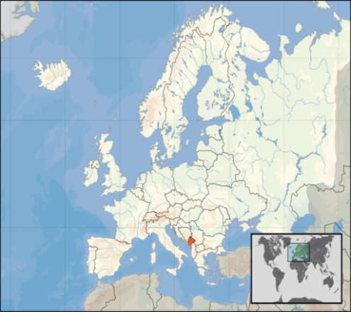
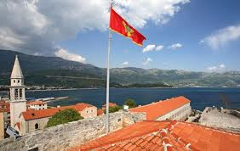
Chapter 30: External Relations
Basic informations
Area:13,812 square kilometers
Population: 625 266 citizens
Official currency: Euro
Agricurtural land: 5.165 km2
Open liberalized economy
GDP per capita
Montenegro
2006 | 2007 | 2008 | 2009 | 2010 | 2011
3.443 | 4.282 | 4.908 | 4.720 | 5.006 | 5.279
M O N T E N E G R O
Negotiating Team for the Accession of Montenegro to the European Union
Chapter 30:
External Relations

Slide 5
Chapter 30: External Relations
Basic informations
EU integration set as priority – on 17 December 2010 Montenegro became EU candidate
On the 2nd February 2012 the Government decided on the establishment of structures for negotiations between Montenegro and the EU
The first Intergovernmental Conference between Montenegro and the EU was also held on 29 June 2012, thus officially opening the negotiation process
The WG 30 is formed by the Government’s decision adopted on 18th April 2013 and it has 24 members
EU Integration
M O N T E N E G R O
Negotiating Team for the Accession of Montenegro to the European Union
Chapter 30:
External Relations

Slide 6
Commercial policy
Chapter 30: External Relations
Close integration with the EU through the SAA establishes
the framework within which Montenegro conducts trade policy
Legal Acts
WTO
FTA , BITs....
SAA
MNE and EU
M O N T E N E G R O
Negotiating Team for the Accession of Montenegro to the European Union
Chapter 30:
External Relations

Slide 7
Trade Policy - Basic Legal Acts (1)
Chapter 30: External Relations
Foreign Trade Law
The Decree on Implementation of Foreign Trade Law
The Customs Law
Decree on Implementation of the Customs Law
Customs Tariff Law
Decree on Harmonization of Customs Tariff
M O N T E N E G R O
Negotiating Team for the Accession of Montenegro to the European Union
Chapter 30:
External Relations

Slide 8
Trade Policy - Basic Legal Acts (2)
Chapter 30: External Relations
Legislation in the area of dual-use goods
The Law on Foreign Trade in Arms, Military Equipment and Dual Use Goods
The Law on Export Control of Dual Use Goods
The Decision on Establishment of National Control List of Arms and Military Equipment
The Decision on Establishment of National Control List of Dual Use Goods
The Decision on Establishing List of Non-Military Ordnance
The Decree on Foreign Trade with Special Purpose
M O N T E N E G R O
Negotiating Team for the Accession of Montenegro to the European Union
Chapter 30:
External Relations

Slide 9
Multilateral dimension (1)
Chapter 30: External Relations
World Trade Organization (WTO)
Efforts have been made to achieve balance between requirements of WTO member states on the one hand, and Montenegrin law and practice of the EU on the other
Law on Ratification of the Protocol on the Accession of Montenegro to the Marrakesh Agreement Establishing the World Trade Organization
Montenegro has been a member of WTO since 2012
M O N T E N E G R O
Negotiating Team for the Accession of Montenegro to the European Union
Chapter 30:
External Relations

Slide 10
Bilateral / regional dimension (1)
Chapter 30: External Relations
Free trade agreements with third countries
Free Trade Agreement between the Federal Government of FYR and the Government of Russian Federation (Entered into force: 19 May 2001)
Agreement on amendment of and accession to the central European Free Trade Agreement -CEFTA 2006 (Entered into force: 22 November 2007)
Free Trade Agreement between Montenegro and the Republic of Turkey (Entered into force: 1 March 2010)
Free Trade Agreement between Montenegro and the EFTA states (Entered into force with: Swiss and Lichtenstein - 1 September 2012, Island – 1 October 2012, Norway – 1 November 2012)
Free Trade Agreement between the Government of Montenegro and the Government of Ukraine (Entered into force: 1 January 2013)
M O N T E N E G R O
Negotiating Team for the Accession of Montenegro to the European Union
Chapter 30:
External Relations

Slide 11
Bilateral / regional dimension (2)
Chapter 30: External Relations
Bilateral Investment Treaties
Economic Cooperation Agreements
Montenegro has 20 BIT’s
13 with the EU countries
7 with non EU countries
Montenegro has 17 Economic Cooperation Agreements
10 with the EU countries
7 with the non EU countries
M O N T E N E G R O
Negotiating Team for the Accession of Montenegro to the European Union
Chapter 30:
External Relations

Slide 12
Unilateral dimension
Chapter 30: External Relations
Generalised System of Preferences (GSP)
Montenegro does not apply a GSP
Montenegro is a beneficiary of the GSP benefits in the following countries: Japan, USA, Norway, Russian Federation, Ukraine, Belarus and Kazakhstan
EU - Trade Preferences for Countries of the Western Balkans (Regulation (EU) No 1336/2011 of the European Parliament and of the Council)
M O N T E N E G R O
Negotiating Team for the Accession of Montenegro to the European Union
Chapter 30:
External Relations

Slide 13
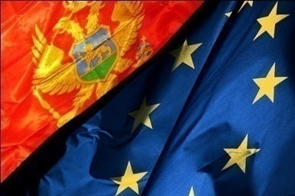
Chapter 30: External Relations
Montenegro and EU (1)
Stabilisation and Association Agreement between the European Communities and their Member States and the Republic of Montenegro (SAA)
  The SAA was signed on 15 October 2007
  Interim Agreement entered into force on 1 january 2008
  The SAA entered into force on 1 May 2010, after being ratified by all member states
Total realised merchandise trade with the European Union had a value of EUR 805 million, which is 36.8% of the total realised merchandise trade of Montenegro in 2012.
The export to the EU-27 countries amounted to EUR 105.46 million, whereas the import amounted to EUR 699.29 million.
The most important export partners are Slovenia, Hungary, Germany, and Italy with the participation of more than 70% in the total export to the EU
The most important import partners are Greece, Germany, Italy, and Slovenia, with the participation of 65 % in the total import from the EU
M O N T E N E G R O
Negotiating Team for the Accession of Montenegro to the European Union
Chapter 30:
External Relations

Slide 14
Chapter 30: External Relations
Montenegro and EU (2)
Accession of the Republic of Croatia to the European Union
Protocol to the SAA
Protocol and the Annexes thereto shall form an integral part of the SAA (agriculture, rules of origine....)
Article 12 - Protocol shall enter into force on the first day of the first month following the date of the deposit of the last instrument of approval. If not all the instruments of approval of this Protocol have been deposited before 1 July 2013, Protocol shall apply provisionally with effect from 1 July 2013
M O N T E N E G R O
Negotiating Team for the Accession of Montenegro to the European Union
Chapter 30:
External Relations

Slide 15
Montenegro and EU (3)
Chapter 30: External Relations
All trade acquits will be directly applicable upon accession of Montenegro to the EU, except the following trade issues which require national transposition (EU Export Control regime for dual-use items and technologies, Export Credits and GSP)
During the pre-accession period Montenegro will harmonize with the EU legislation and adopt appropriate regulations to ensure the conditions for the direct application of EU legislation where is necessary
During the pre-accession period Montenegro will closely work with the EC regarding changes in its trade policy
M O N T E N E G R O
Negotiating Team for the Accession of Montenegro to the European Union
Chapter 30:
External Relations

Slide 16
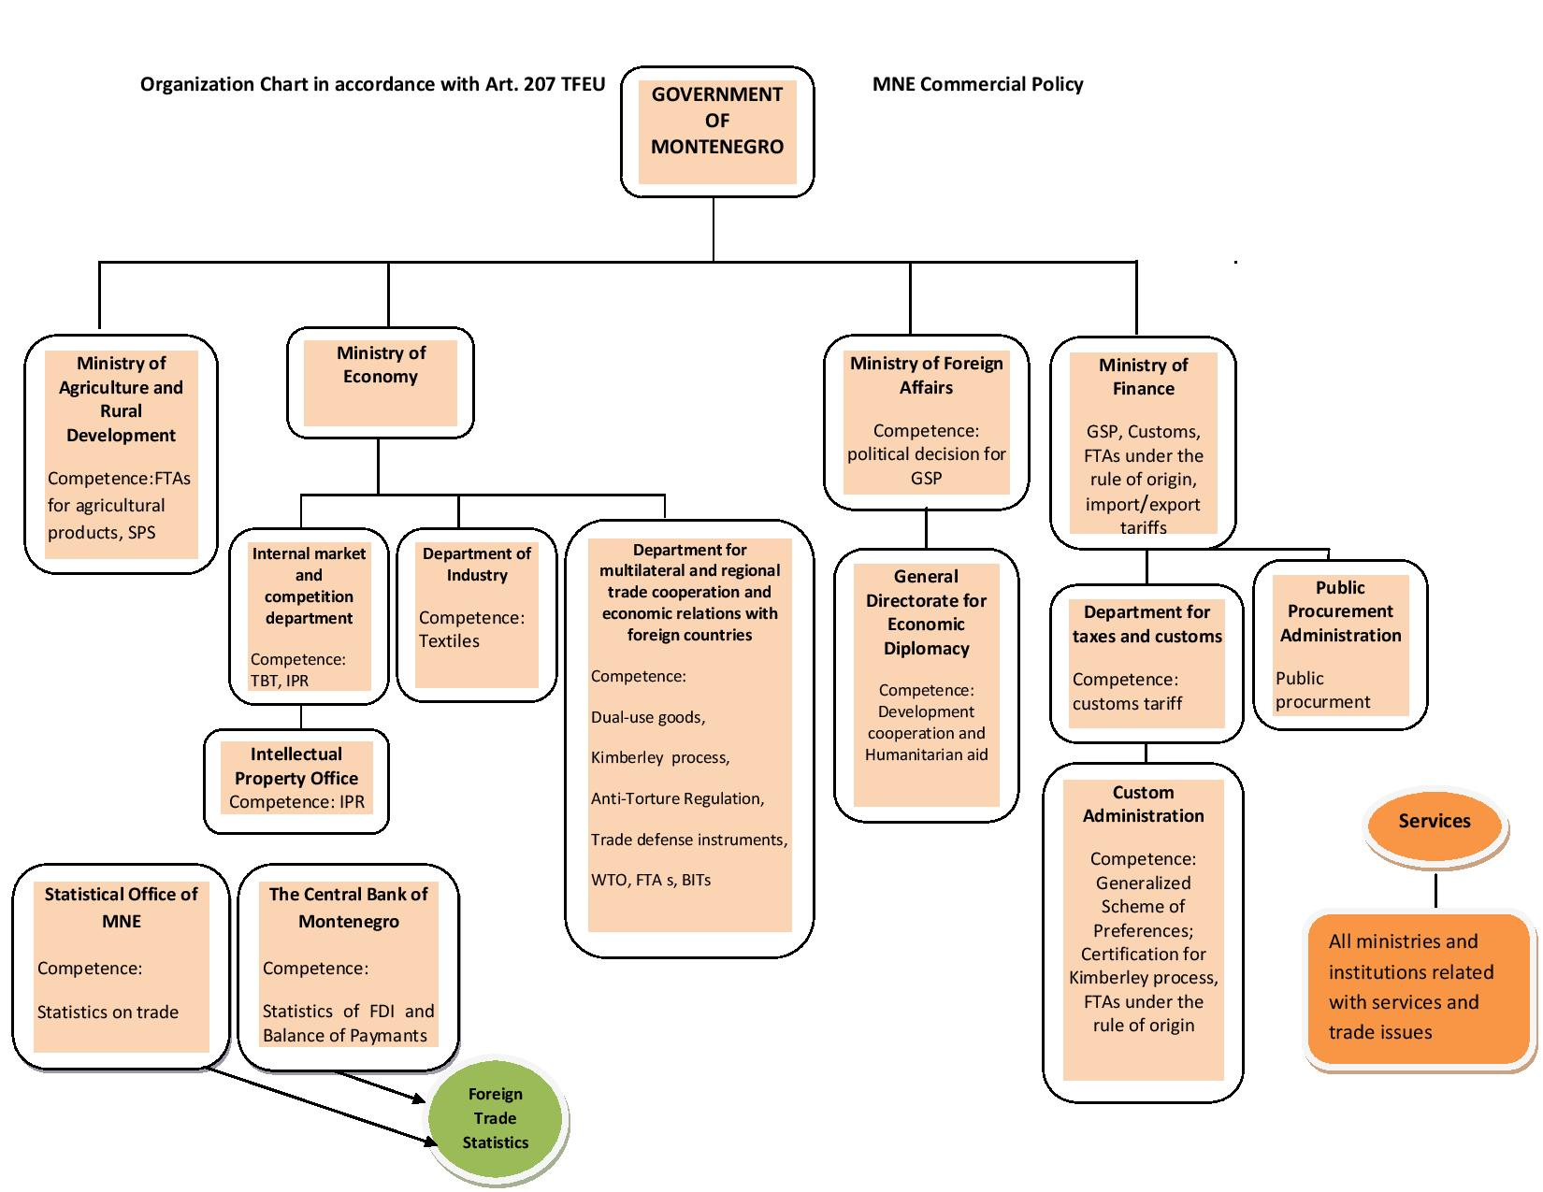
Chapter 30: External Relations
M O N T E N E G R O
Negotiating Team for the Accession of Montenegro to the European Union
Chapter 30:
External Relations

Slide 17
Thank you for your attention!
QUESTIONS

